Slide 1


My Brain – Your Brain
Understanding Perspective-Taking
Notes:
Read slide with students. Explain that today’s lesson is about understanding Perspective-Taking. Ask students for their definitions of perspective-taking.

Slide 2
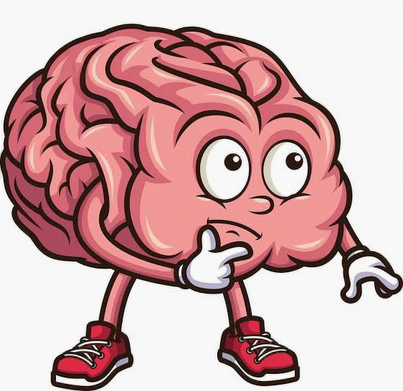
What is “perspective-taking”?
Perspective-taking means thinking about what another person may see, know, think, or feel.
Notes:
Read slide with students. Define perspective-taking.

Slide 3
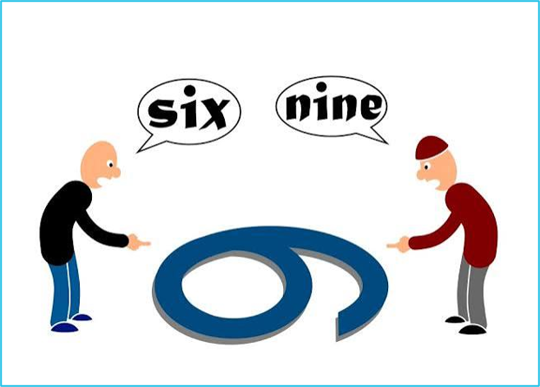
People can have different thoughts – even in the same situation
Notes:
Read slide with students. Talk about the fact that some people may see things differently. Have the students look at the picture and talk about what’s happening and why.

Slide 4
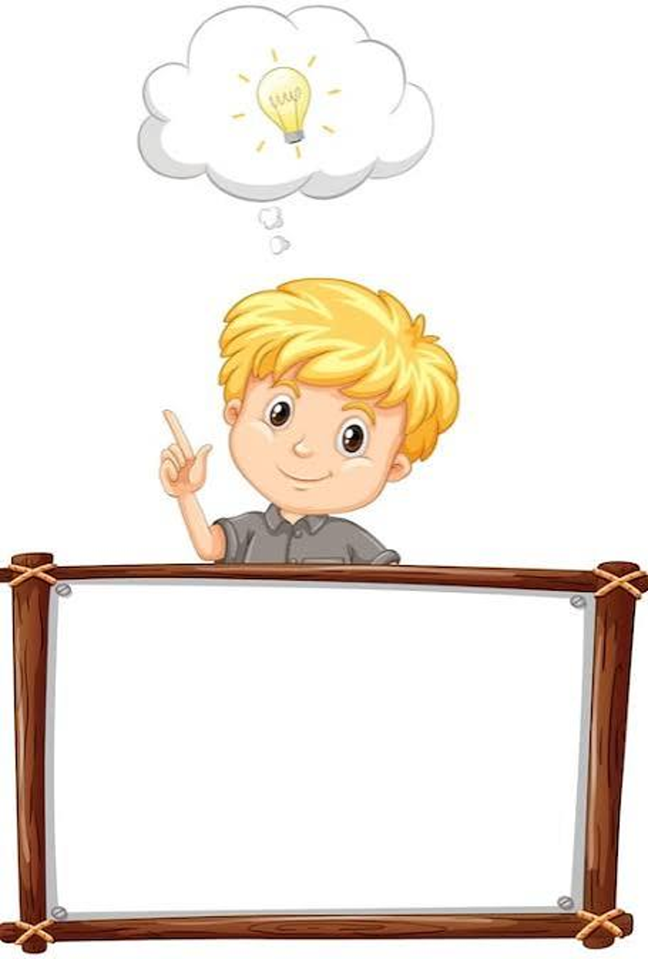
Just because it’s in my brain doesn’t mean it’s in yours!
Notes:
Read slide with students. Explain that what you’re thinking and feeling can be very different from the other person.

Slide 5

People can have thoughts and feelings that may be different from ours.
Understanding that other people think and feel differently can help us make and keep friends!
Notes:
Read slide with students. Explain that working to understand that another person can have thoughts and feelings different from our own can help us make and keep friends. Why? Because you can’t change how other people think or feel. Trying to do so can end up making the other person mad or upset.

Slide 6
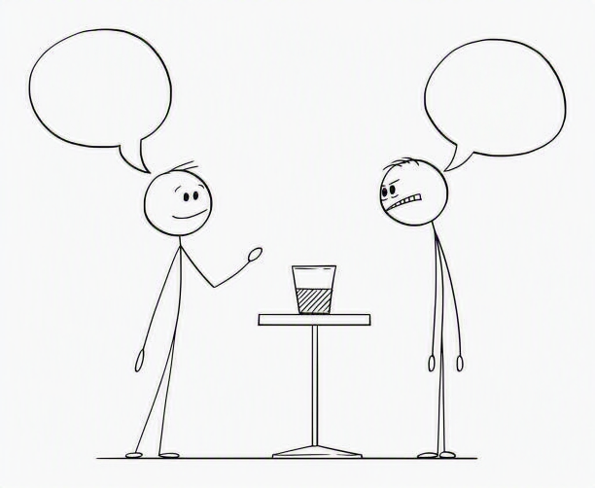
It’s not about right or wrong – it’s just a different way of looking at things
Notes:
Read slide with students. Talk about the picture and ask the students what they see happening.

Slide 7



Clues We Can Use
face
words
body
situation
Notes:
Read slide with students. Explain that we can look for clues that can help us understand what the other person is thinking or feeling.

Slide 8
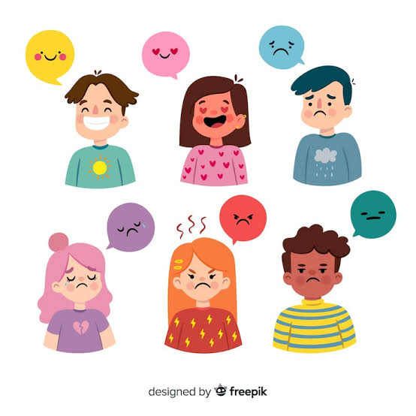
Look at their face.
How might they be feeling?
Feelings are clues, not facts. We can make a careful guess.
Notes:
Read slide with students. Talk about the different facial expressions and how each person might be feeling. Remind students that these facial expressions we’re seeing are just clues that can help us make a careful guess about how they’re feeling.

Slide 9
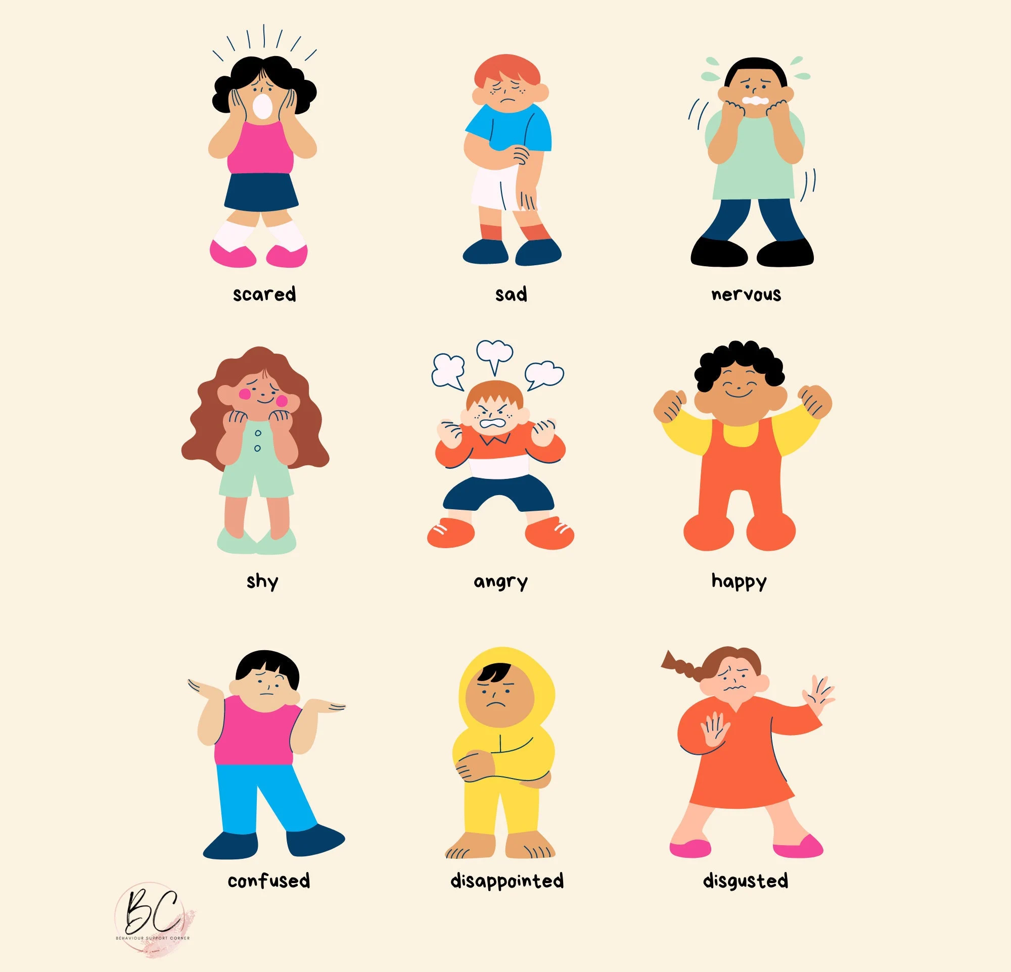
Look at their body language.
What does it tell you?
Notes:
Read slide with students. Talk about each picture and explain that looking at the other person’s body language can also help us understand how they might be feeling or what they might be thinking.

Slide 10
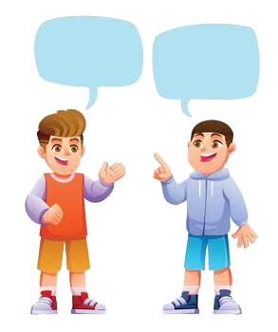


Listen to their words.
What are they saying?
Notes:
Read slide with students. Explain that it’s also important to really listen to what the other person is saying in order to understand what they’re thinking or feeling.

Slide 11
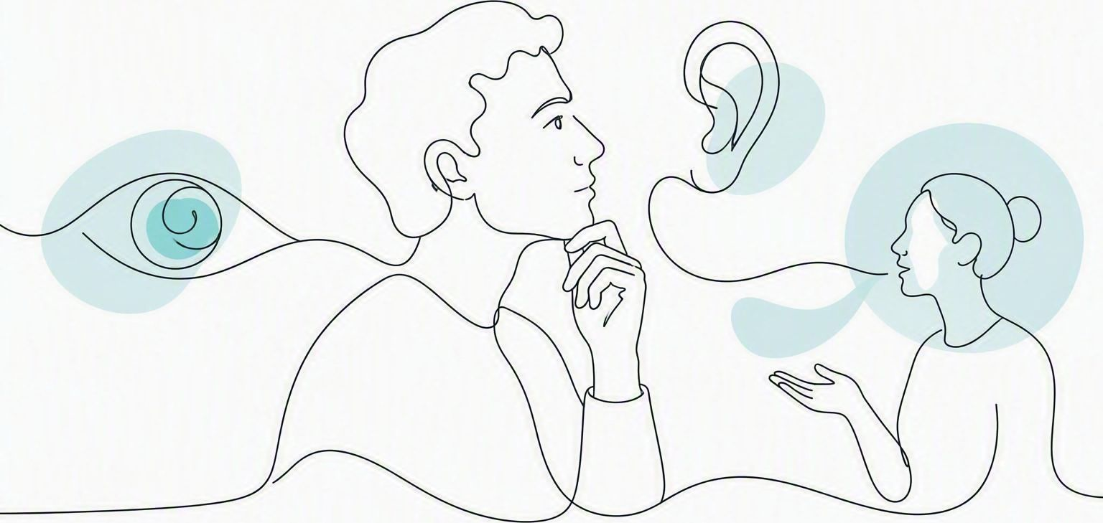
What does the person know?
We only know what we have seen, heard,
or been told
Notes:
Read slide with students. Explain that we act on what we have seen, heard, or been told. Again, it’s important to remember that other people may have seen different things, heard different things, and been told different things than we have.

Slide 12
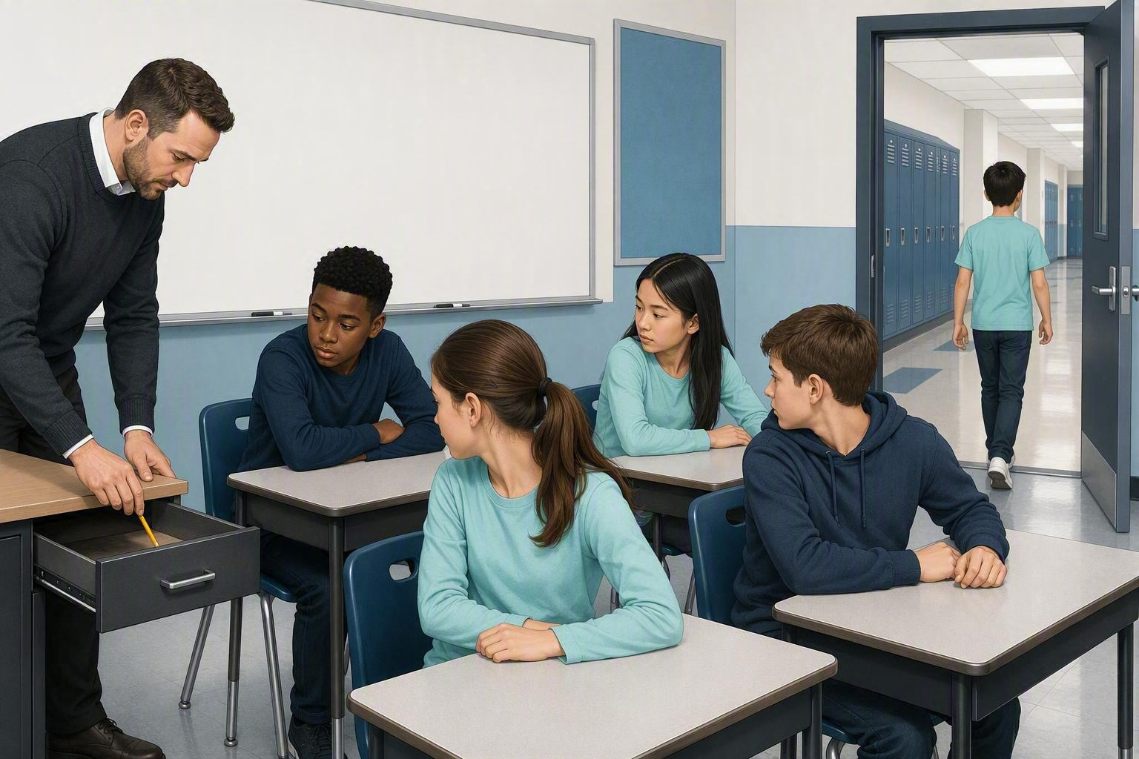
Let’s practice…
Mr. Smith places a pencil on top of his teacher’s desk while the whole class is watching.
He then sends Riley out of the room while he hides the pencil in his desk drawer.
Before Mr. Smith calls Riley back into the classroom, he asks the students where Riley thinks the pencil is. Remember, the last time Riley saw it, the pencil was on top of the teacher’s desk.
You’re using perspective-taking if you said that Riley will think the pencil is on top of the teacher’s desk, even though YOU know it’s not. Riley doesn’t know that.
Notes:
Read slide with students. Consider acting out the scenario with the students in your classroom using a different object and hiding place.

Slide 13
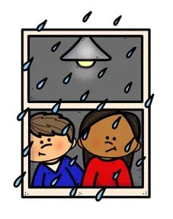
What is the situation?
Same situation – different feelings
It’s raining so we have indoor recess. I get to play a board game with my friends. Yay!
It’s raining so we have indoor recess. I can’t play tag with my friends. Boo…
Notes:
Read slide with students. Talk about the fact that even though it’s the same situation (raining outside means indoor recess) the two students feel very differently about it. Ask the students how they feel when it rains and they have to have indoor recess instead of playing outside.

Slide 14
Think It or Say It?
Some thoughts are private
Some words are helpful to say out loud
If you’re not sure, ask yourself:
Is it true?
Is it kind?
Is it helpful right now?
Notes:
Read slide with students. Talk about how it’s important to really think before you speak so that your words aren’t hurting someone. Sometimes it’s just better to keep your thoughts to yourself.

Slide 15
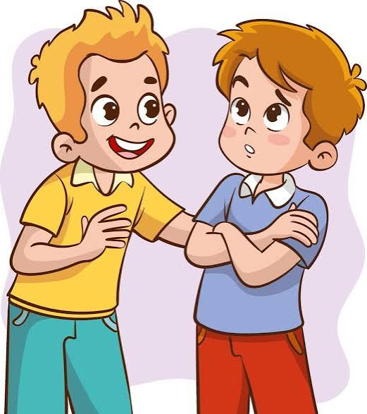
What might he be thinking?
I thought Noah was your best friend. He’s been hanging out with Tony a lot!
Notes:
Read slide with students. Ask for their ideas about what the other boy might be thinking. What could the boy do differently instead?

Slide 16
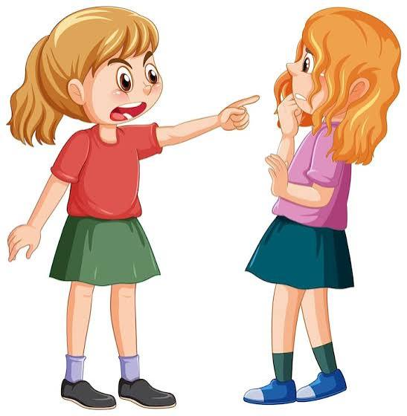

What might she be thinking?
There’s no way you’re going to pass the test if you didn’t study!
Notes:
Read slide with students. Ask for their ideas about what the girl might be thinking. What could the girl do differently instead?

Slide 17




Perspective-Taking Steps
Stop
Look for clues
Ask yourself: What do they see, know, think, or feel?
4. Choose a helpful response
Notes:
Read slide with students. Talk about each step and explain their importance.

Slide 18
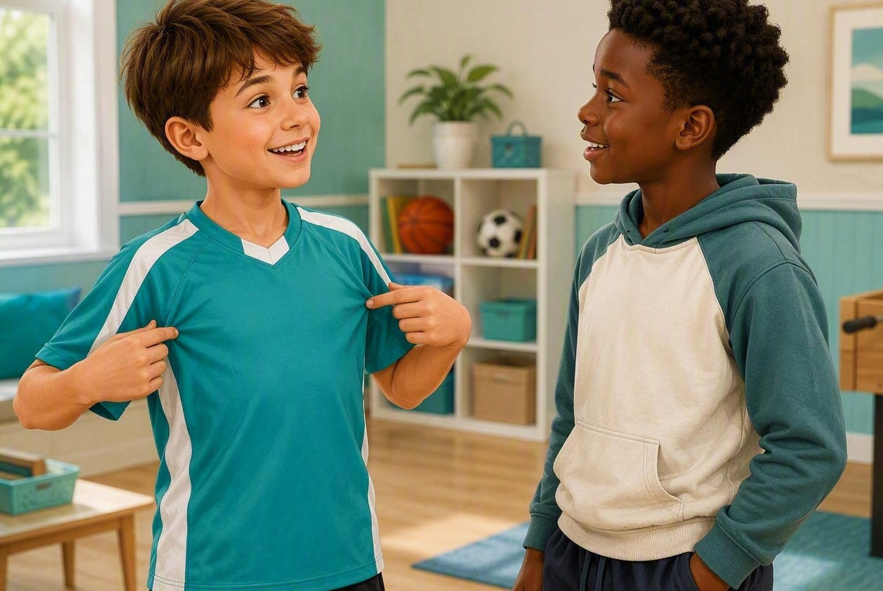

So…what do YOU think?
Your friend comes to school wearing a new t-shirt and asks you if you like it. You’re not really into basketball.
What can you say?
Notes:
Read slide with students. Ask for their ideas about what to do or say in that situation. Remind them of the 4 perspective-taking steps so that they can apply them to the situation.

