Slide 1








I Can Show I’m Listening!
Notes:
Read slide with students. Explain that today’s lesson is about different ways we can show someone we’re listening. We can find ways to be more comfortable while we’re listening.

Slide 2
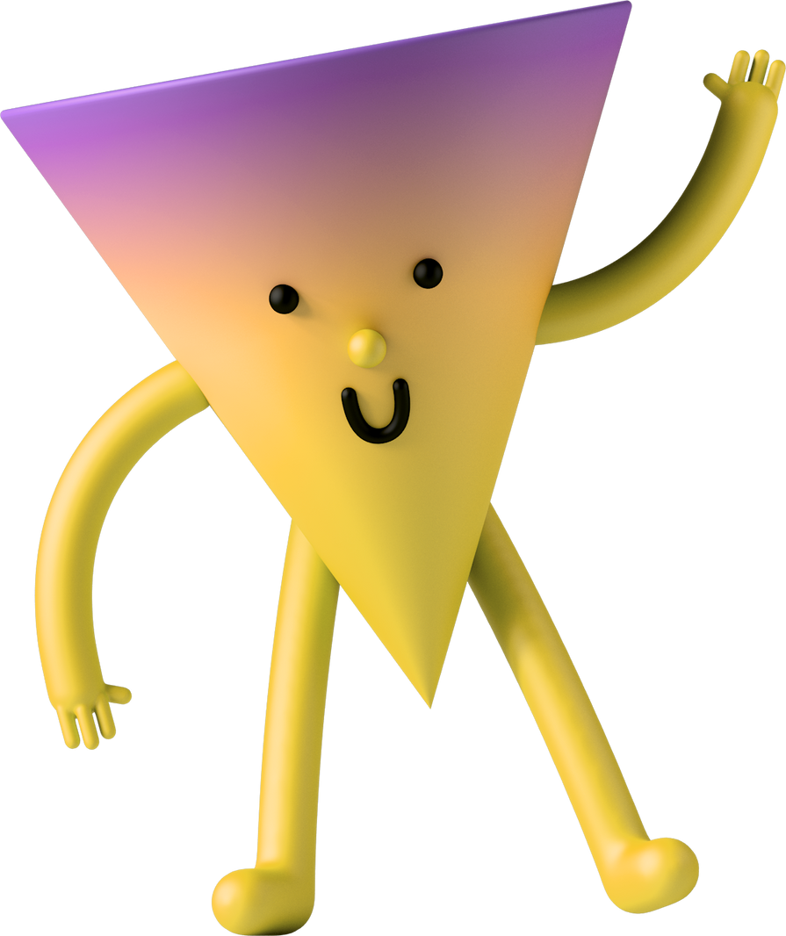
What does listening look like?
Notes:
Read slide with students. Ask for their ideas about what listening looks like.

Slide 3

Listening can look different for different people
We can show that we’re listening with our eyes, body, words, or actions
Notes:
Read slide with students. Explain that there are different ways to show we’re listening to the speaker.

Slide 4
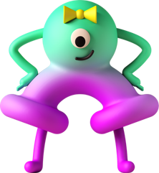
Eye contact is one way to show listening.
It’s not the only way.
Some people like looking at eyes.
Some people only like quick glances.
Some people feel better
looking near the person.
Notes:
Read slide with students. Talk about how some people aren’t comfortable looking at someone’s eyes while they’re talking. Explain that there are options that might make them feel more comfortable. Consider practicing each option with the students and discuss how they feel with that choice.

Slide 5






Looking toward someone speaking can help us:
show we’re listening
notice face and body cues
know when it’s our turn to respond
Notes:
Read slide with students. Talk about the ways looking towards the person speaking can be helpful.

Slide 6



Remember: faces and bodies can give us clues, like when someone is asking a question or waiting for us to speak.
Looking toward someone does not mean staring.
Notes:
Read slide with students. Explain that the speaker’s body language can help us figure out what we should do and say in that situation. Emphasize that this doesn’t mean staring. Staring makes people feel very uncomfortable.

Slide 7




“Listening Looks”
We can choose how to look while we’re listening
We can look:
at their eyes for a quick moment
at their face, forehead, temple, nose, or mouth
near the person
at a shared object
Notes:
Read slide with students. Demonstrate the different options for “listening looks” and consider having the students practice each.

Slide 8
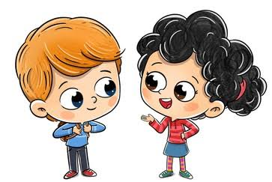
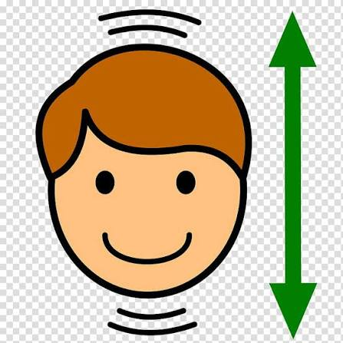
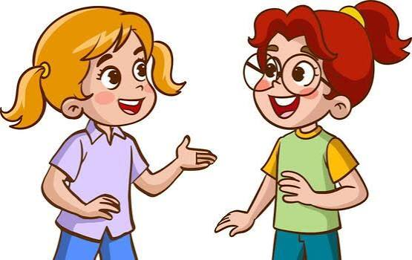
I can turn my body toward the speaker
“Listening Actions”
Our actions can help a speaker know we’re listening – even if we’re not looking at their eyes
I can nod my head
I can say “okay” or ask a question
?
Notes:
Read slide with students. Talk about the different “listening actions” and consider having the students practice each.

Slide 9


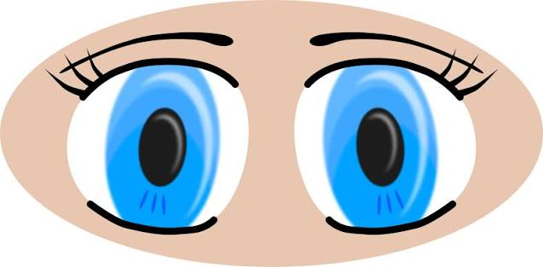
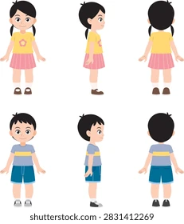
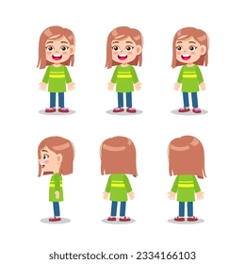
I can show I’m listening in different ways
I can choose a way that helps me feel comfortable!
I can look at their eyes, somewhere on their face, or at a shared object
I can turn my body toward the speaker, nod my head, say “okay”, or ask a question about something they said
I can try to remember not to stare
Notes:
Read slide with students. Review the strategies from today’s lesson and ask the students to share what option(s) they feel most comfortable doing.

Slide 10

So…what do YOU think?
You’re sitting at lunch with some friends and someone you don’t know stops by your table to chat. He talks mostly to your friends but then he turns to you and compliments you on your shirt. You want to be polite but you’re not really comfortable talking to people you don’t know.
What can you do?
Notes:
Read slide with students. Remind them of the strategies they just learned and ask for their solutions to the scenario.

