Slide 1

I Can Respect Other People’s Things
Notes:
Read slide with students. Explain that today’s lesson is about respecting other’s belongings.

Slide 2
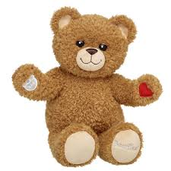

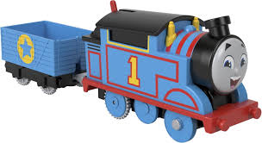
Everyone has special things that belong to them
This is where you section ends. Duplicate this set of slides as many times you need to go over all your sections.
Notes:
Read slide with students. Talk about the pictures.

Slide 3
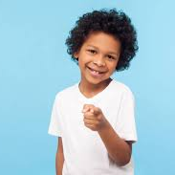
What things are special to you?
Notes:
Read slide with students. Ask students to share the things that are special to them.

Slide 4
It’s important to treat other people’s things with care and respect – just like you want others to respect
your things.
Notes:
Read slide with students. Ask them if they’ve ever had something of theirs lost or broken because someone wasn’t respectful of their property. How did they feel?

Slide 5
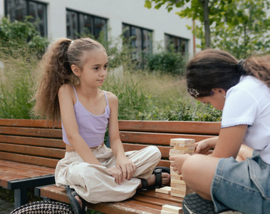
What does “respect” mean?
Respect means showing kindness and care for people and their belongings.
Notes:
Read slide with students. Talk about the definition of respect. Ask how the girl in the picture is showing respect for her friend while she’s building with the blocks.

Slide 6
Why is this important?
When you respect other people’s things, you help them feel happy and safe
Respecting other people’s things helps you make and keep friends!
Notes:
Read slide with students. Discuss the importance of being respectful with other people’s things and how that affects your relationships with them.

Slide 7
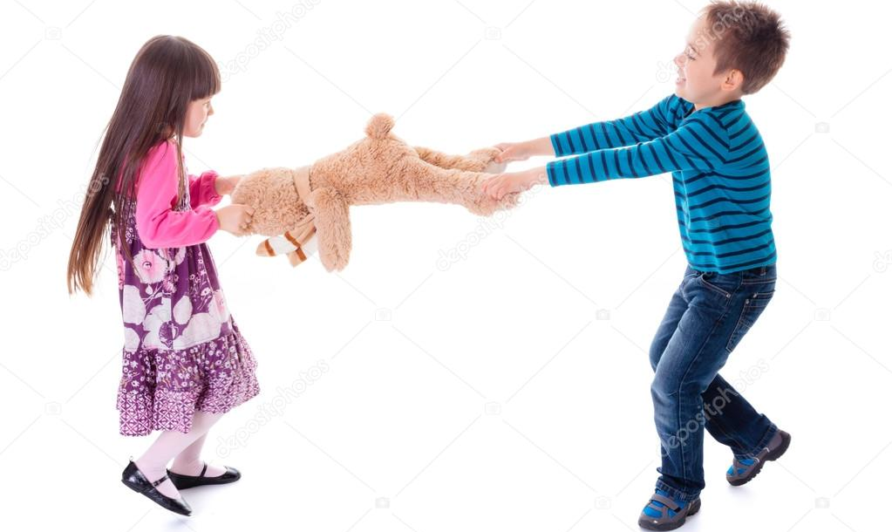
Is this boy showing respect?
Notes:
Read slide with students. Ask them what is happening in the picture – is the boy being respectful of her toy? How do they think the girl feels?

Slide 8
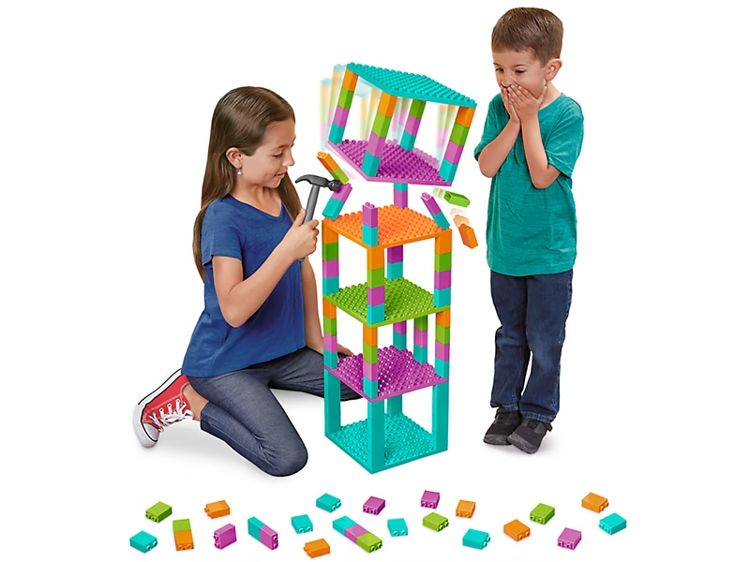
Is this girl showing respect?
Notes:
Read slide with students. Ask them what is happening in the picture. Is the girl being respectful of the boy’s building? How do they think the boy feels?
‘

Slide 9
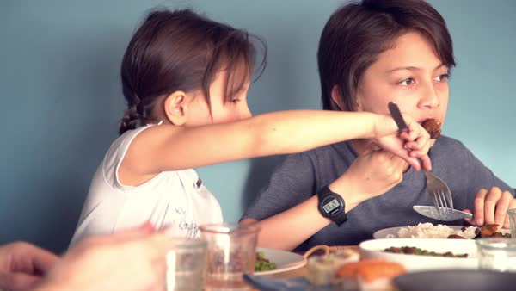
Is this girl showing respect?
Notes:
Read slide with students. Ask what is happening in the picture. Is the girl being respectful of the boy’s lunch? Is there something else she could do besides taking food off his plate? (Ask parent for more; ask him to share; etc.)

Slide 10
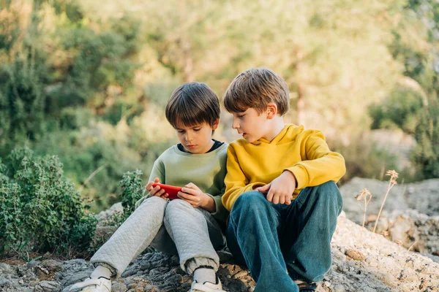
Is this boy showing respect?
Notes:
Read slide with students. Have them look carefully at the photo. What do they see? Point out how the boy in the yellow shirt is sitting. (Hands folded – not grabbing; watching his friend play the video game.) Emphasize how asking for and waiting your turn is being respectful of other people’s property.

Slide 11
6 Ways to Respect Other People’s Things!
Notes:
Read slide with students. Explain that there are 6 ways to respect other people’s things. Ask for their ideas before showing the next slide.

Slide 12
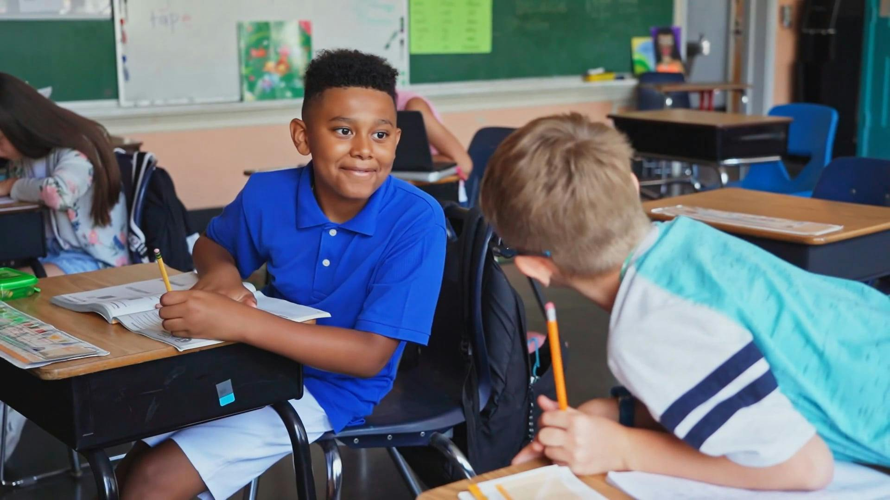
1. Ask permission
Can I use your eraser?
Ask before using someone else’s belongings
Notes:
Read slide with students. Talk about the photo and the question the boy is asking his classmate. What might happen if he just grabbed the eraser instead of asking?

Slide 13
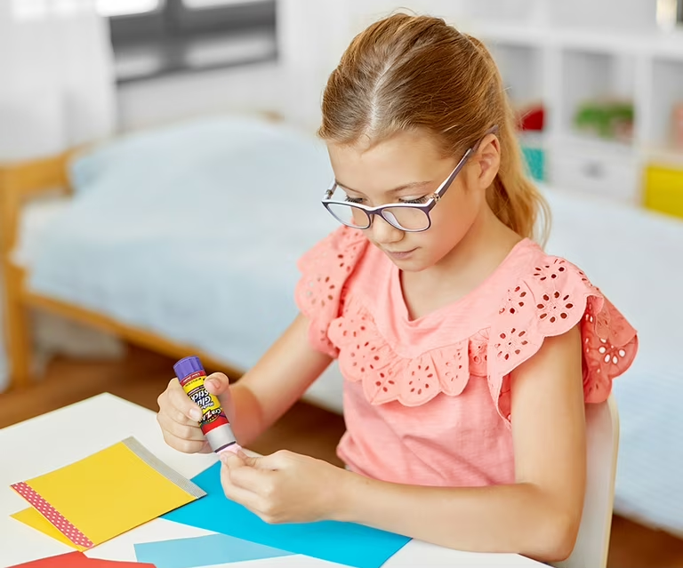
2. Be careful
I’ll put the lid back on so his glue stick doesn’t dry out
Take care of other people’s things to avoid damaging them
Notes:
Read slide with students. Talk about the importance of taking care of other’s belongings and how the girl is making sure to put the lid back on her friend’s glue stick. Ask students for other examples.

Slide 14
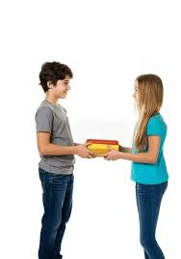
3. Give items back
Here are your books – I took good care of them!
Return items in the same condition you found them
Notes:
Read slide with students. Talk about the importance of returning borrowed items back to their owner. Ask students if they’ve ever had someone borrow something from them and not return it. How did they feel?

Slide 15
4. Say thank you
Thank you for letting me read them!
Say thank you to the person who let you use their things.
Notes:
Read slide with students. Talk about the importance of thanking someone who lets you borrow their belongings. Ask how they feel when someone thanks them.

Slide 16
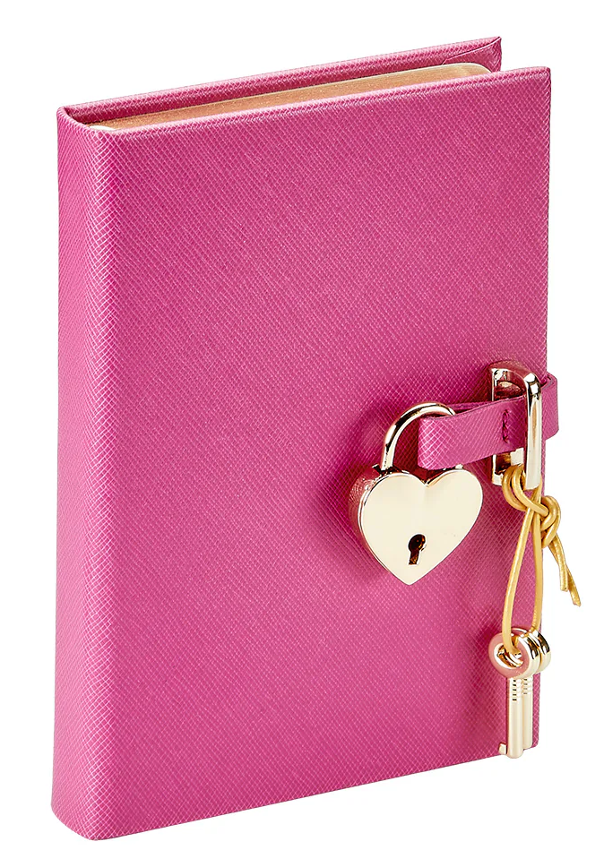
5. Respect privacy
Don’t look through someone else’s personal items without permission
Notes:
Read slide with students. Talk about privacy and explain the importance of asking permission before looking through someone else’s things. How would they feel if this happened to them?

Slide 17
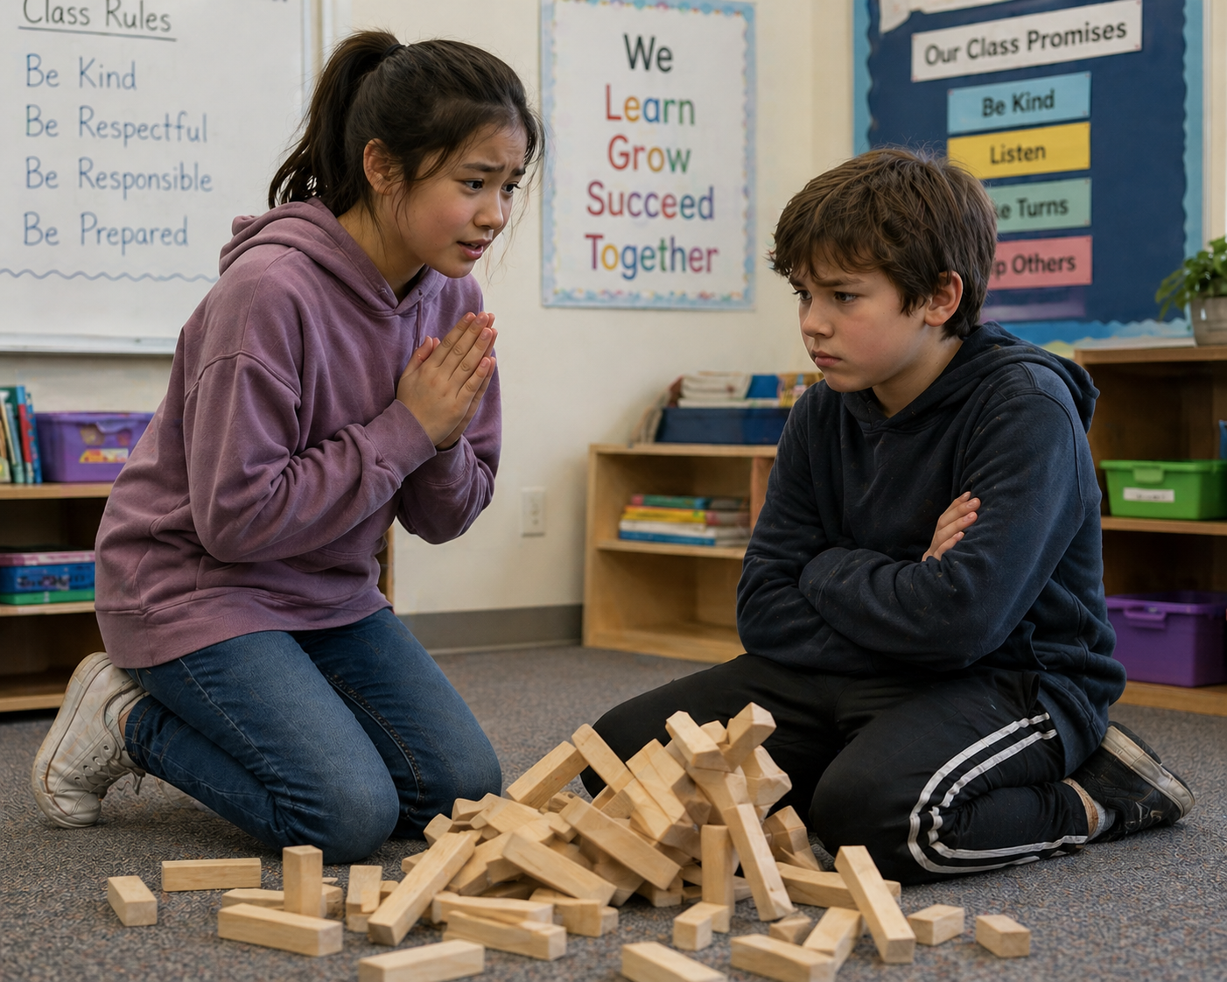
6. Apologize
I’m so sorry! Can I help you build it back up again?
Say you’re sorry if something gets lost or broken.
Offer to help fix it or replace it.
Notes:
Read slide with students. What’s happening in the picture? Talk about the importance of apologizing if something gets lost or broken. What can you do next?

Slide 18
6 Ways to Respect Other People’s Things!
Ask permission
Be careful
Give items back
Say thank you
Respect privacy
Apologize
Notes:
Read slide with students. Review the 6 ways to respect other people’s things.

Slide 19
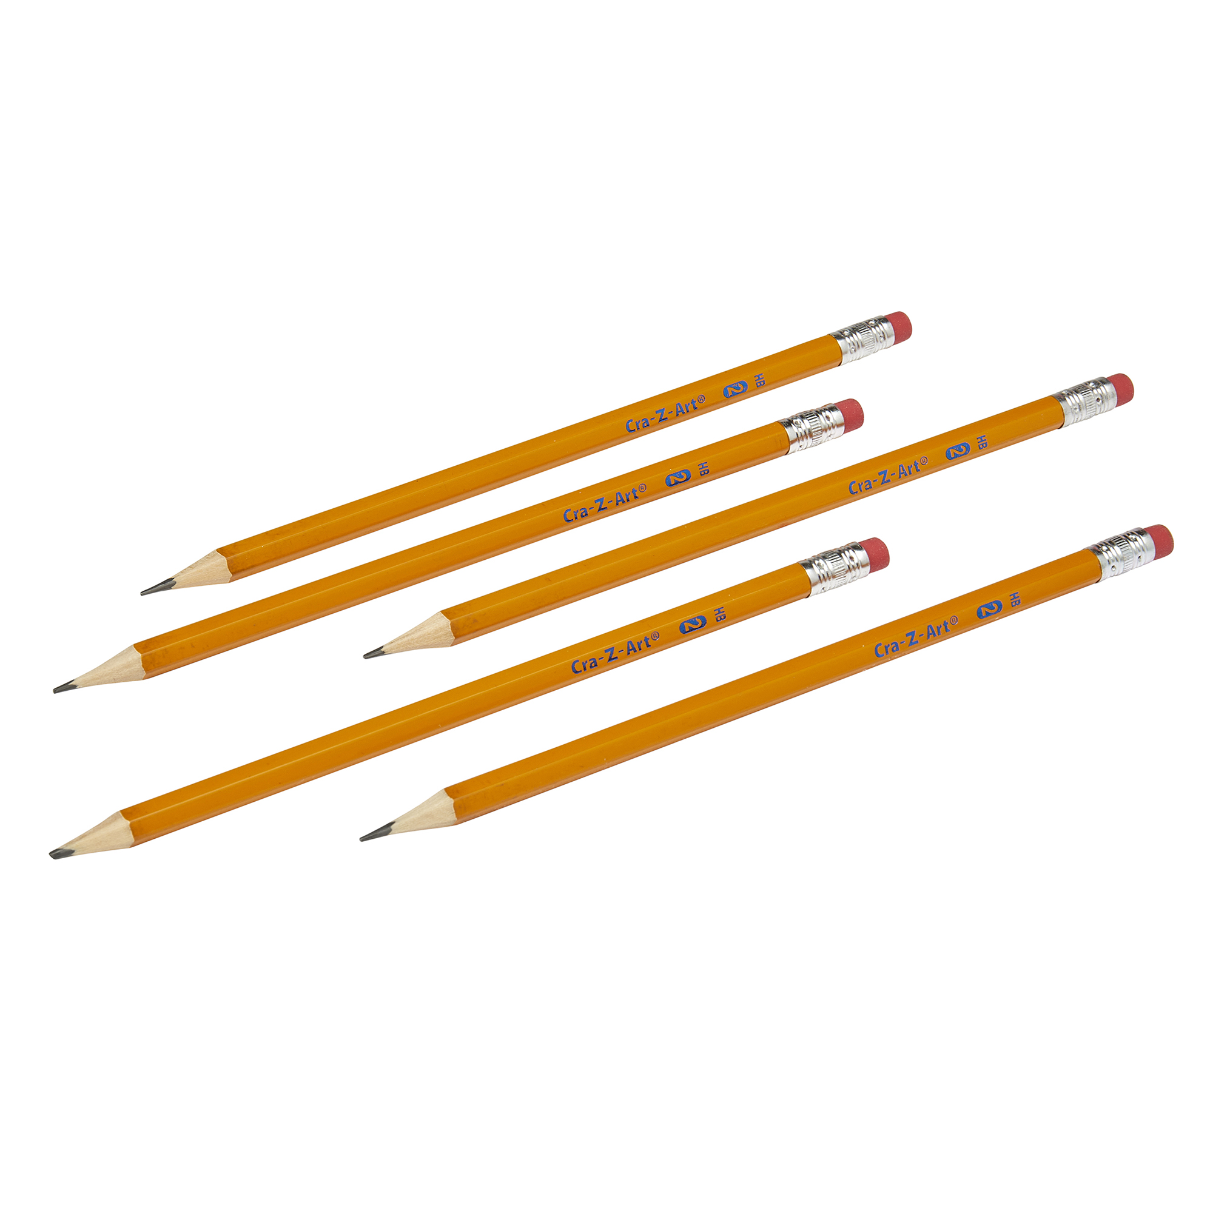
So…what do YOU think?
You lost your pencil and need to borrow one. You know your friend has extra pencils in his desk but he’s not in school today.
What can you do?
Notes:
Read slide with students. Ask for their ideas of what to do in the situation. (Ask teacher or other classmate for a pencil; borrow a pencil, leave a note, and return it back to the friend’s desk when you’re finished; etc.)

