Slide 1
Conversation Skills: Voice and Body Language
Notes:
The following resources were used in developing this lesson:
Social Skills Training by Jed Baker
Navigating the Social World A Curriculum for Individuals with Asperger’s Syndrome, High Functioning Autism and Related Disorders by Jeanette McAfee, M.D.
The following websites were used to provide visual support to this lesson:
www.kezako.be/blog/index.php/2006/09

Slide 2

SWEET!
Notes:
When this slide comes up a teen’s voice will say “SWEET”. This lesson uses the current teen “slang” of SWEET and LAME as acronyms for the suggestions for appropriate conversation skills.

Slide 3
SWEET Conversations!!
Space – maintain the right physical distance from the other person
Ways to give feedback and show you’re listening - “hmm”, “uh-huh” or “really?”
Eye contact – eyes and body facing toward partner
Expression – facial expressions and body language
Tone of voice – appropriate volume, tone and inflection
Notes:
Go over the information on this slide as an overview, then break it down with the following slides.

Slide 4

Space
Stand or sit at arm’s length from the other person
“Don’t be a space invader”
Getting too close makes other people uncomfortable
“What are some ways to
tell if you are too close?”
http://www.kezako.be/blog/index.php/2006/09
Notes:
Discuss the information on the slide and lead a discussion based on the question, “What are some ways to tell if you are too close?” There is a place on Activity Sheet 1 to fill in this information if desired. Point out examples when someone is too close in the pictures on the following slides.

Slide 5
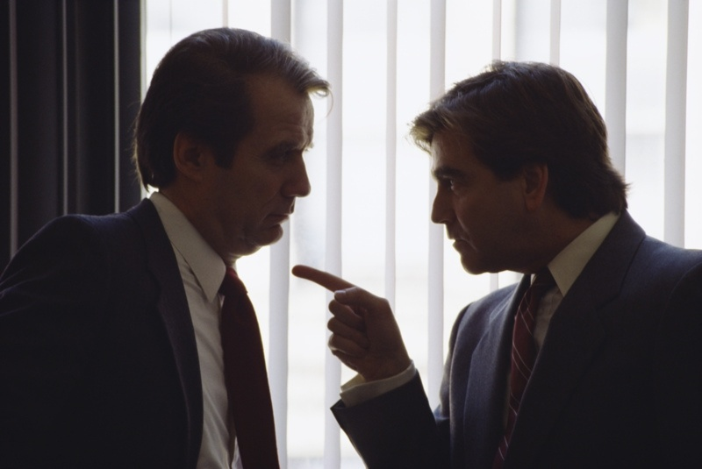
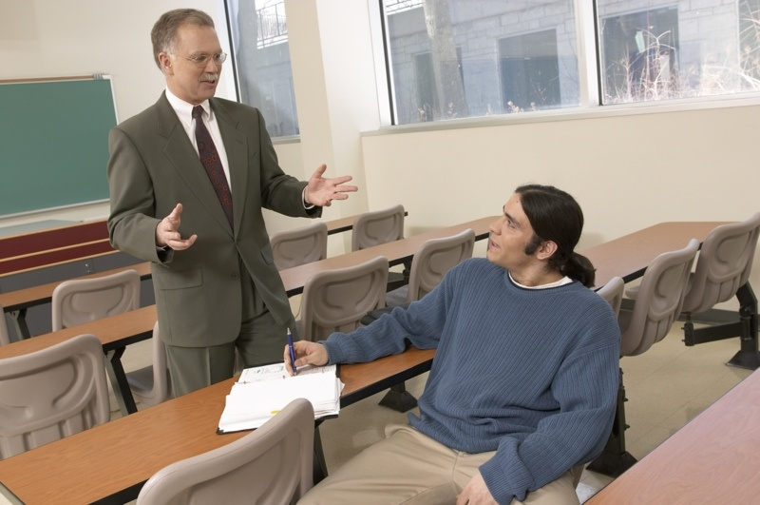
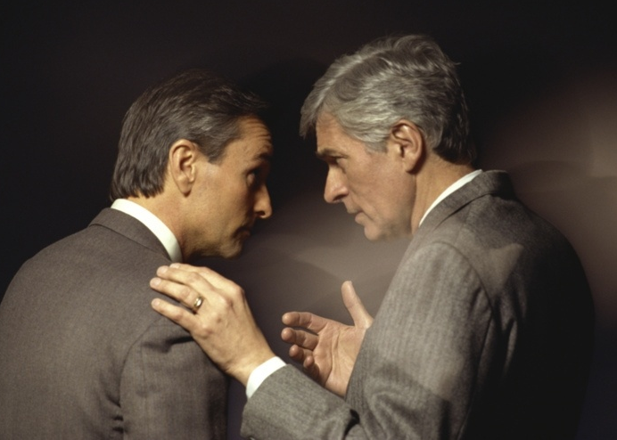
Notes:
Use these pictures to discuss appropriate distance when having a conversation.
Compare the different distances.

Slide 6


Notes:
Use these pictures to discuss appropriate distance when having a conversation.
Compare the different distances.

Slide 7

To Give Feedback
Ways
“hmm”
“uh-huh”
“really!”
Nod your head
Genuine listening
Notes:
Ask students for additional ways to respond to show that you are listening and to encourage your conversation partner to continue.
Other examples:
“Oh”
“you’re kidding”
“I can’t believe it”
“Bummer”
“too bad”
Use conversation starter cards from Activity Sheet 2 to role play showing you are interested and giving feedback:
Partner 1 chooses card and begins the conversation – Partner 2 simply gives feedback to encourage Partner 1 to continue and to show he/she is interested.

Slide 8
IM Feedback
OMG
np
LOL
ROTFL
jk
Notes:
Discuss how kids use this type of language when they are talking to someone on the computer. The purpose is to let the other person know you are listening and encouraging them to continue to talk. When you are talking face to face, you use short comments, head nods and changes in facial expression.
See if students can identify the meanings – they can fill in these meanings on Activity Sheet 1.
NP – No problem
OMG – oh my gosh
ROTFL – rolling on the floor laughing
LOL – laugh out loud
JK – just kidding

Slide 9

Eye Contact
Make eye contact intermittently
  When one of you is starting to speak
  To emphasize a point
  To show you are interested
  To check how interested your partner is
Notes:
Discuss how it may sometimes be difficult for some people to make direct eye contact when listening to a conversation. Discuss alternatives such as:
Look at their forehead instead of their eyes,
Look briefly at their eyes, but always orient your body toward the person you are talking to
Look at their eyes at the beginning of your conversational turn and at the beginning of their turn.
Ask students for other examples.

Slide 10
Expression
Facial expression
  Interest
  Emotion
  Smile
Body language
  Face your partner
  Open vs. Closed
Notes:
Introduce and define the expressions and body language on this slide. Use the pictures on the next slides to discuss them.

Slide 11

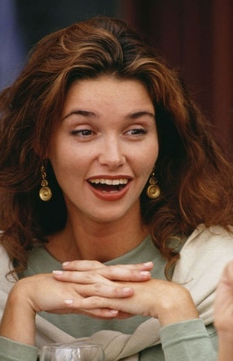
Notes:
(Pictures of interested vs. bored)
Have students identify the person that is interested.
Point out the differences in eye contact, posture, and facial expressions.

Slide 12

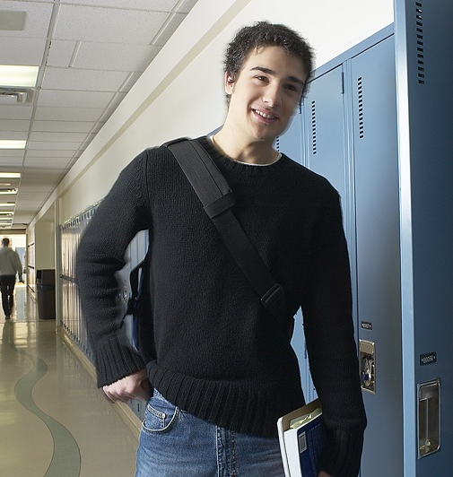
Closed Posture
Open Posture
Notes:
(pictures of open vs. closed posture)
Show pictures of and demonstrate an open posture and a closed posture. Discuss how body posture can show interest in conversation.

Slide 13
Tone of Voice
Volume
Pitch
Inflection
Notes:
Introduce information and elaborate with the next 3 slides.

Slide 14
Volume
Notes:
On Activity Sheet 1, ask students to identify 3 situations when they would need to use a loud voice and 3 situations when they would need to use a quiet voice.

Slide 15
Pitch
High
Low
Notes:
When you press the sound buttons you will hear a statement in a high pitched excited voice then a low pitched bored voice. Discuss how different pitch changes the meaning of what is said.

Slide 16
Inflection
“I never said you were silly”
1
2
3
“I would love to be in that class”
1
2
Notes:
Each time you click on a sound, you will hear the statement with a different inflection. Have students discuss how the inflection changes the meaning. The first statement will change the emphasis on different words in the statement:
I never said you were silly (but someone else did)
I never said you were silly (but I thought it)
I never said you were silly (but I said you were crazy).
The second statement will be said with different emotional inflections.
First – enthusiastic
Second –sarcastic
Third – angry, spiteful

Slide 17

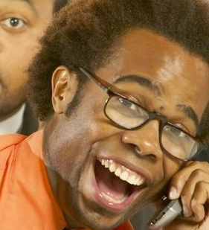
Boy that kid is crazy!
Boy that kid is crazy!
Notes:
Note: click on the sound icon first – discuss the emotion that you hear in the voice, then click outside of the “callout” to bring the picture up.
(pictures of emotional expressions)
Look at each picture
First picture (angry).
Second picture (teasing – smiling)
Think about this person saying the phrase, “boy, that kid is crazy”.
Have students identify the emotion and discuss how you would change the way you respond depending on the emotional expression.

Slide 18
SWEET!

Slide 19
LAME
Notes:
A voice will say “that is soooo lame” when this slide comes up. The LAME acronym will be used to identify what not to do in a conversation.

Slide 20
LAME Conversations
Looking away or turning away
Always talking about yourself or your interests
Misinterpretations
Expressionless
Notes:
Use the letters in LAME to describe some qualities of a conversation that may discourage others from talking to you.

Slide 21
LAME

Slide 22
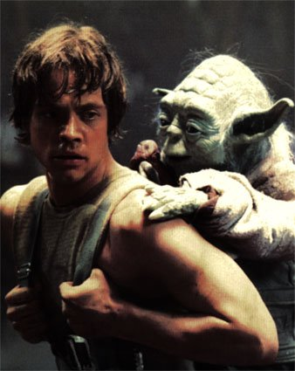
So, what do you think?
What are some ways to tell if someone is interested in what you are saying?
Notes:
Use this slide to lead a discussion on today’s lesson.

Slide 23
SWEET Conversations!!
“Social Power” Point Card
Space – maintain the right physical distance from the other person
Ways to give feedback and show you’re listening - “hmm”, “uh-huh” or “really?”
Eye contact – eyes and body facing toward partner
Expression – facial expressions and body language
Tone of voice – appropriate volume, tone and inflection
Notes:
This visual is a good summary of the information in this lesson. This slide has been made into a format that can be printed on card stock to give to each student (“Social Power Point” Card). You may also want to laminate the cards and place a magnet on the back as a visual that could be hung in the student’s home as a reminder of the lesson.

