Slide 1

Instigator or Encourager?
Notes:
Read slide with students. Talk about the topic of today’s lesson: Learning the difference between being an instigator or an encourager. Ask students for their definitions of each word.

Slide 2
What is an “Instigator”?
an Instigator is someone who tries to get others to do things that might be unkind, unsafe, or against the rules
an Instigator might prompt others to make bad choices or to start trouble
an Instigator might tell a friend to break a rule or tease someone
Photo by Jake Nackos on Unsplash
Notes:
Read slide with students. Discuss the different ways someone might be an instigator. Ask students if they’ve ever had someone instigate trouble for them.

Slide 3
What is an “Encourager”?
an Encourager is someone who helps others do their best, make good choices, and feel good about themselves
an Encourager uses kind words and actions to support their friends
an Encourager might cheer a friend on during a game or help someone when they’re feeling upset
Photo by Jake Nackos on Unsplash
Notes:
Read slide with students. Review the different ways you can be an encourager. Ask students for their experiences and examples.

Slide 4
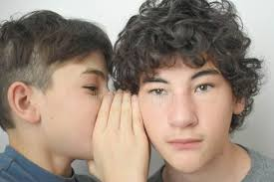

Instigator or Encourager?
If you get frustrated, just rip up your worksheet!
If you get frustrated, raise your hand to ask for help!
Notes:
Read slide with students. Ask them to identify each picture.

Slide 5
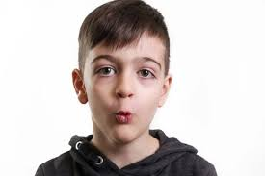


Instigator or Encourager?
Go ahead – whistle!
C’mon dude, don’t do that. You know it bothers his ears.
Notes:
Read slide with students. Talk about the seriousness of prompting someone to do something so unsafe. Talk about what might happen to the student pulling the fire alarm.

Slide 6

How do they make others feel?
Instigator | Encourager
Makes others feel upset, nervous, or pressured | Makes others feel happy, confident, and safe
Notes:
Read slide with students. Emphasize the impact each type of person can make on others. Ask students for their examples when they were the recipients.

Slide 7
How can you be an encourager?
Notes:
Read slide with students. Ask students for their ideas on how to be an encourager.

Slide 8
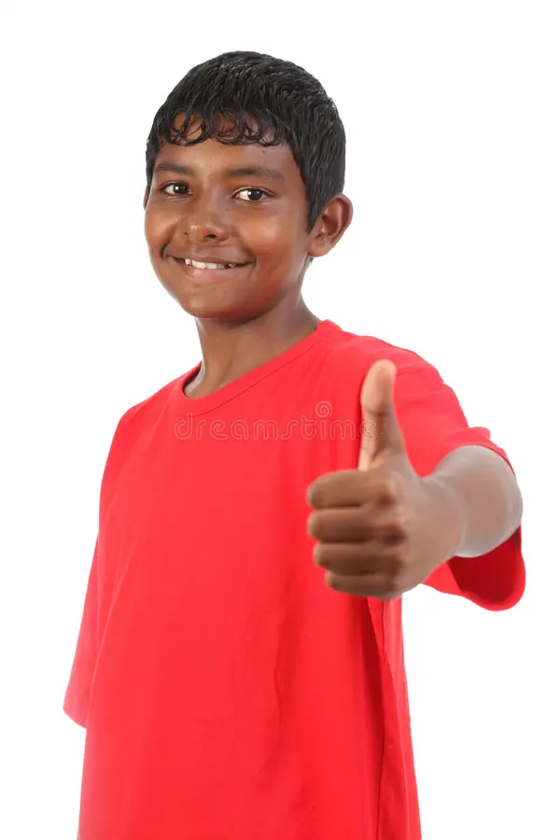
4 Ways to be an Encourager
Say kind things to others
Help people when they need it
Invite others to join in activities
Celebrate others’ successes
Notes:
Read slide with students. Explain that there are 4 things we can do to encourage others.

Slide 9

1. Say kind things to others
You’ve got this!
That was awesome!
Do you want some help?
Do you want to sit with us?
Notes:
Read slide with students. Ask for their examples of kind things to say to others. How does it make them feel when they say kind things OR when someone says kind things to them?

Slide 10
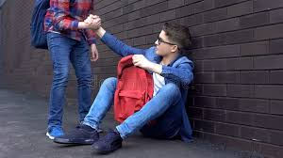
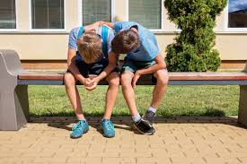


2. Help people when they need it
Notes:
Read slide with students. Talk about each picture. How are the students helping the other person? Practice what helpful words or actions each person might be saying or doing for the other. Now ask for examples of instigating in each situation instead. Which is the right thing to do?

Slide 11
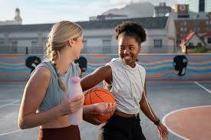

3. Invite others to join in activities
Wanna play on my team?
Want to be my partner?
Notes:
Read slide with students. Talk about the pictures. Ask students if they’ve every been left out of a game or a group project. How did they feel?

Slide 12

4. Celebrate others’ successes
You made the track team. Way to go!!
Notes:
Read slide with students. Talk about the picture and how important it is to praise others for their “wins” – even if you didn’t have the same success. It may be hard to do but it says a lot about you when you can celebrate others’ achievements.

Slide 13
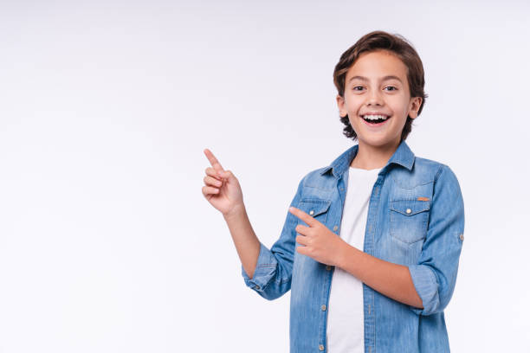
Remember: Using kind words and actions helps others make good choices.
Being an ENCOURAGER makes you and everyone around you feel good!
Notes:
Read slide with students. Summarize the lesson and ask students to list the 4 ways they can be encouragers instead of instigators.

Slide 14

So…what do YOU think?
You know that your friend really likes a classmate and wants to talk to her but he doesn’t know what to say. The other guys in your group tell him to start teasing her about her glasses so that she doesn’t think he likes her.
What can you do?
Notes:
Read slide with students. Ask for their ideas on how to handle the situation.

