Slide 1
Objectives
I will identify wise mind, reasonable mind, and emotion mind.
I will practice wise mind during a game.

Slide 2
CASEL SEL Competencies
Self Awareness:
-Identifying one’s emotions
Self Management:
-Exhibiting self-discipline and self-motivation
-Setting personal and collective goals
-Managing one’s emotions
-Demonstrating personal and collective agency (taking initiative to achieve goals)
Social Awareness:
-Taking others’ perspectives
Relationship Skills:
-Communicating effectively
-Practicing teamwork and collaborative problem-solving
-Resolving conflicts constructively

Slide 3
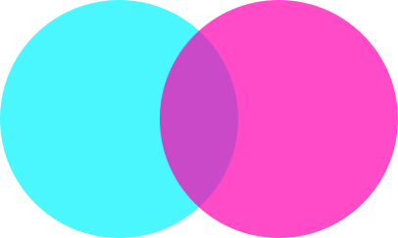

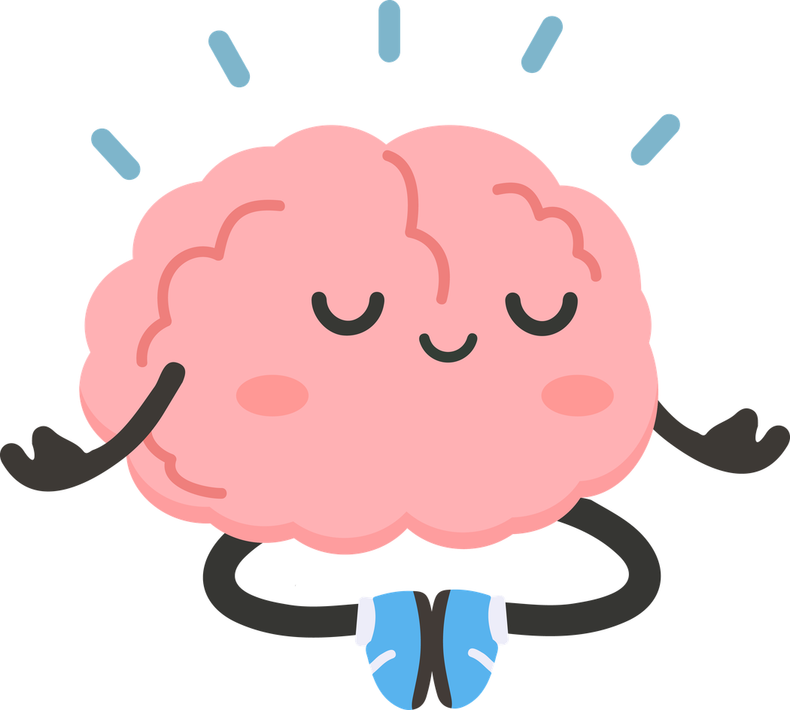

Wise Mind
Reasonable
Mind
Emotion
Mind
Notes:
Introduce these concepts to the students. Direct instruction
Think about your mind as having three different states:
1. Reasonable Mind
2. Emotion Mind
3. Wise Mind
Let's look at each one.

Slide 4
Reasonable Mind
Reasonable mind is like a robot.
It uses logic and facts to make decisions.
It ignores feelings.
Left Brain
Notes:
Read this slide to the students.
When might we be in Reasonable Mind? Let's look...

Slide 5

Example of Reasonable Mind: Math Test Problem Solving
Notes:
Here is an example of a student in "Reasonable Mind".
Math Test problem Solving:
A student carefully reads each question, shows his work, and double-checks answers instead of rushing. He isn't thinking about how nervous he feels, because he's so focused on the process.

Slide 6

Example of Reasonable Mind:
Following School Rules
Notes:
Here is another example of "Reasonable Mind".
A student follows the classroom rules even if she doesn't feel like it. She raises her hand because she knows it’s expected.

Slide 7



Example of Reasonable Mind: Ignoring feelings
You can’t come
to my party.
You’re too little
to play with us.
Notes:
Here is another example of "Reasonable Mind".
Jenna tells her little sister, Emily, that she's too little to come to her birthday party. Her party is going to be at the arcade, and she things Emily is too young to play the games. Jenna ignores Emily's feelings and is focused on the facts.

Slide 8

What is Logic?
Rules of smart thinking
Help us figure out if something is true, reasonable, or makes sense.
Using clues, facts, and patterns to solve puzzles, make good choices, and understand how ideas connect.
Notes:
Read this slide to the students. Clarify any questions students may have regarding this concept.

Slide 9
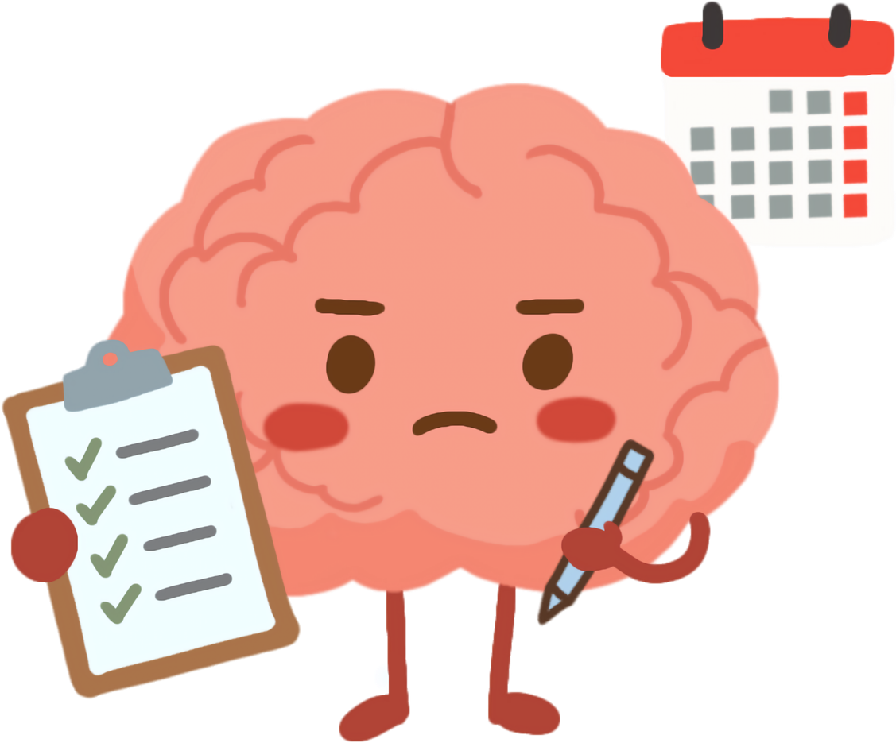
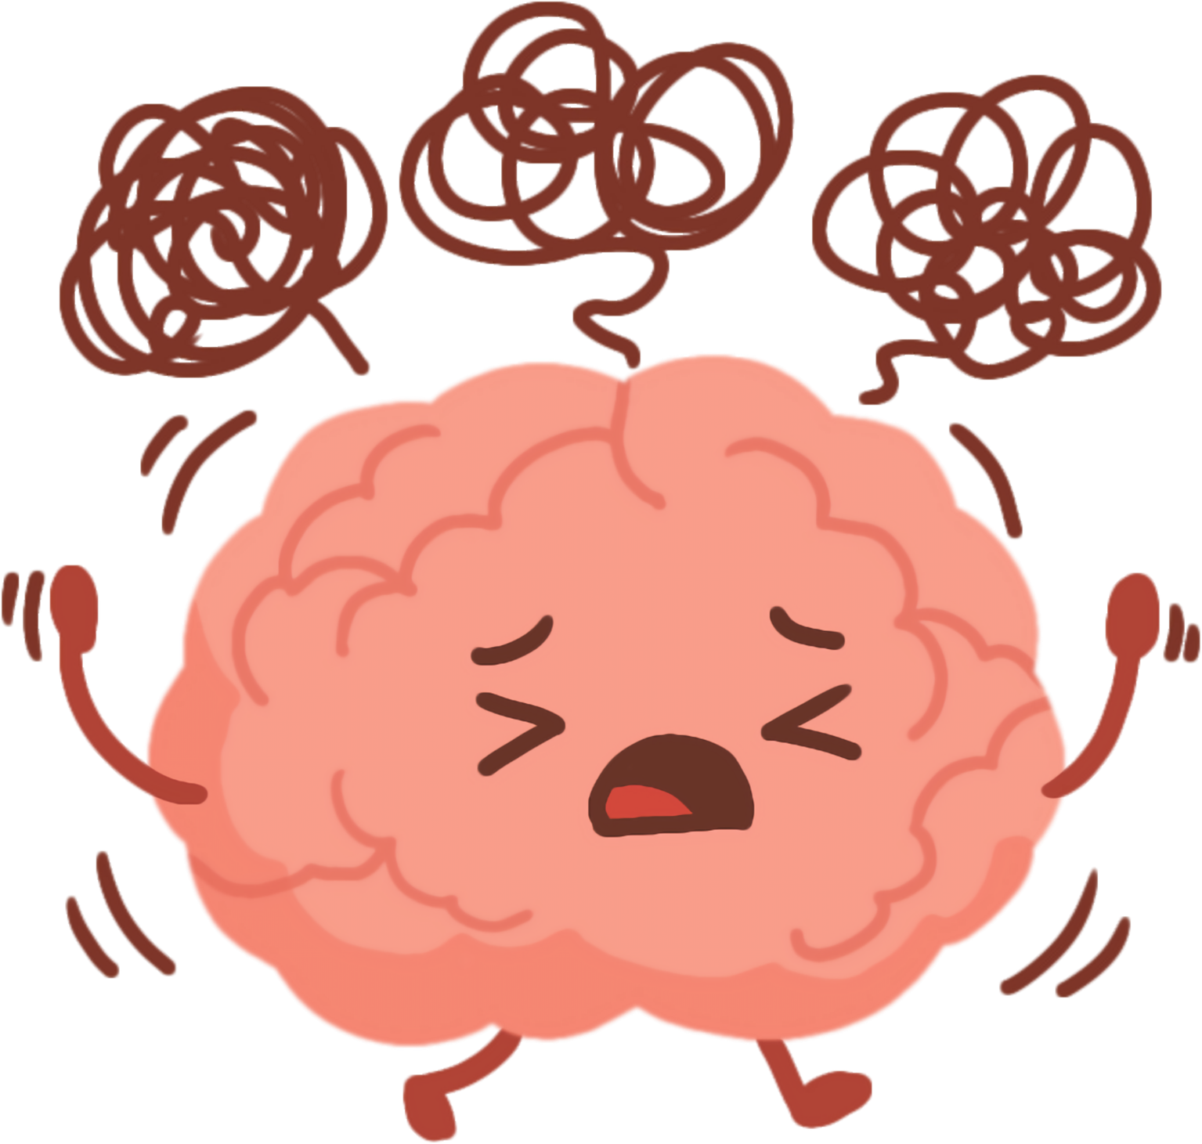
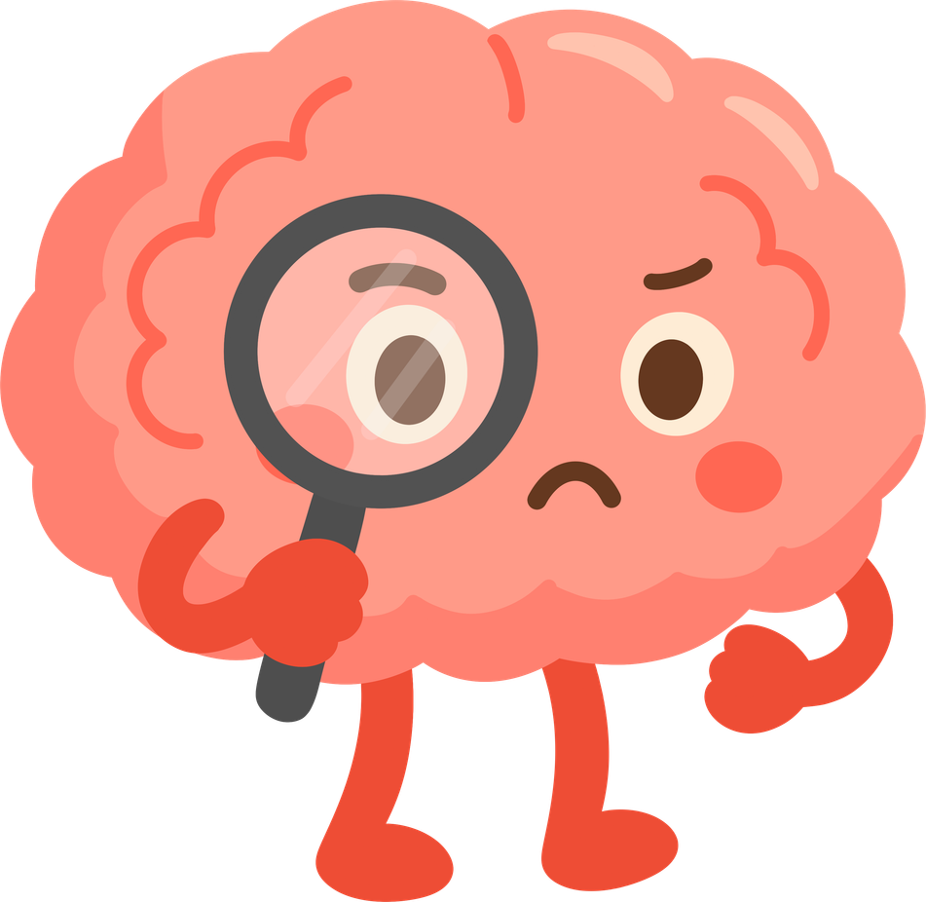
Reasonable Mind
When I am in a reasonable mind...
I might ignore my feelings.
I might hurt other peoples’ feelings.
I might make choices that are right for me, but not kind to others.

Slide 10

Reasonable Mind
Feelings are not important.
Only facts matter.
What might go wrong if this robot is in charge all the time?
Notes:
Ask students to brain storm what could happen if someone ignores their feelings or someone else's feelings.

Slide 11
Wise Mind
Reasonable
Mind
Emotion
Mind
Notes:
Now let's look at Emotion Mind.

Slide 12
Emotion Mind
In emotion mind,
big feelings take over.
Emotions control actions and words.
Being “stuck” in an emotion.
Right Brain
Notes:
Read this slide to the students.
When might we be in emotion mind? Let's look at some examples.

Slide 13


Example of Emotion Mind: Sadness
I didn’t get invited. Nobody likes me.
I have no friends.
Check the facts.
Do you her thinking is true?
Or is it false because of how sad she feels?

Slide 14

Example of Emotion Mind: Anger
This is so unfair!
*slams tablet on ground*
Is it ok to throw things that could break when you are angry?

Slide 15
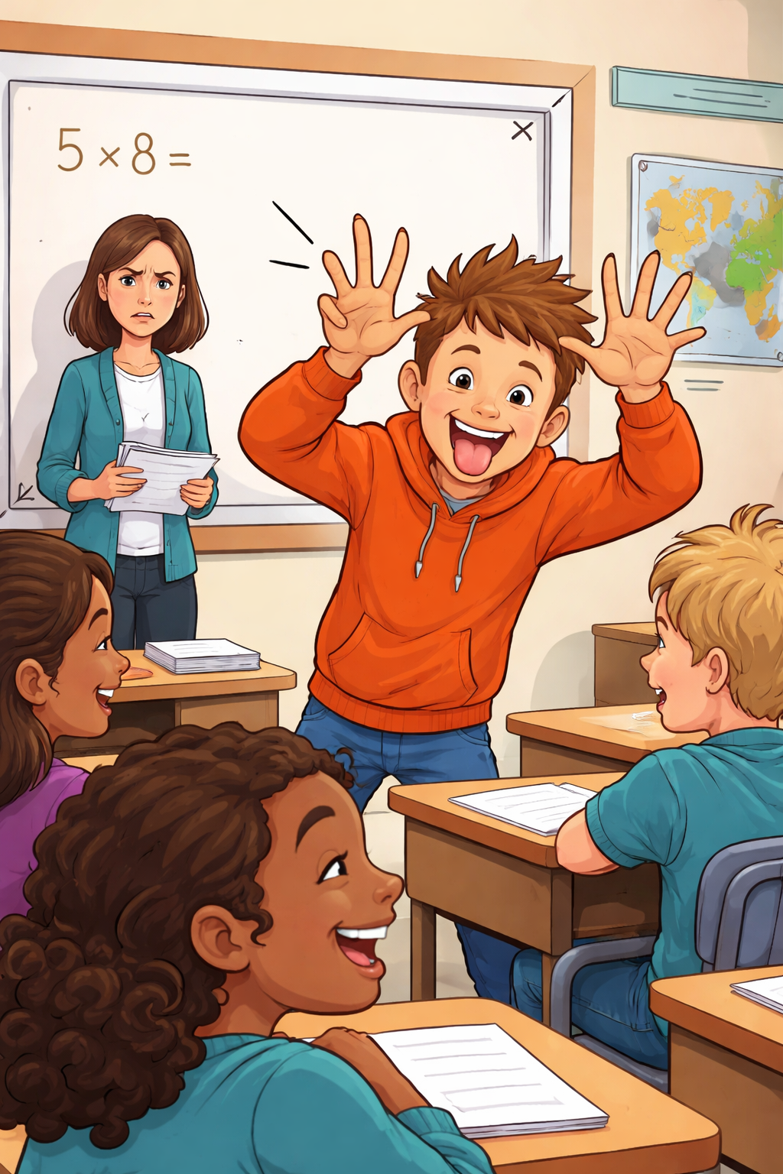
Example of Emotion Mind: Silly
I don’t care if I disrupt the class. This is too funny!
Is it ok to disrupt the learning of others?
Notes:
Note. Graphic created using ChatGPT (OpenAI, 2026).

Slide 16
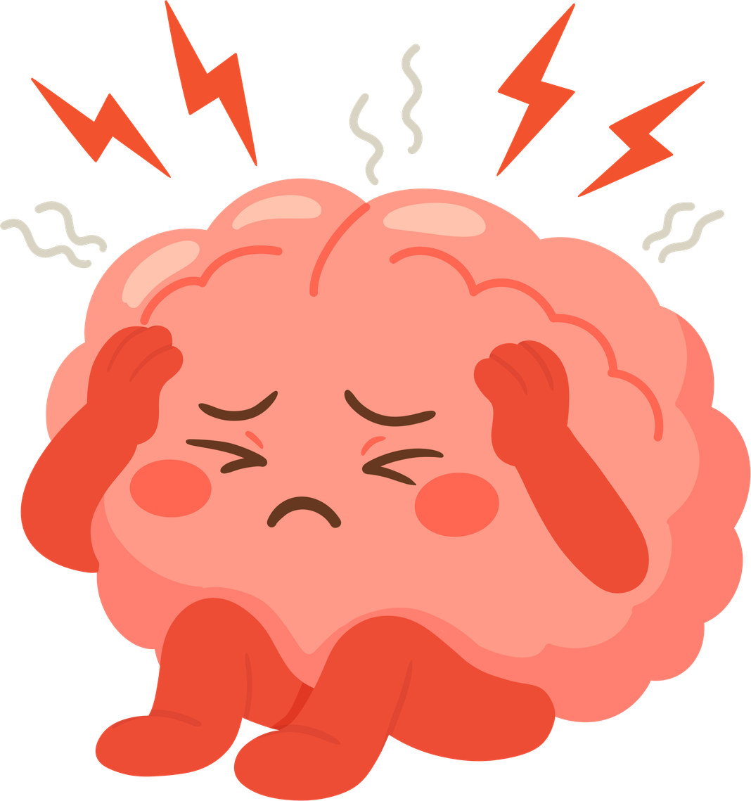
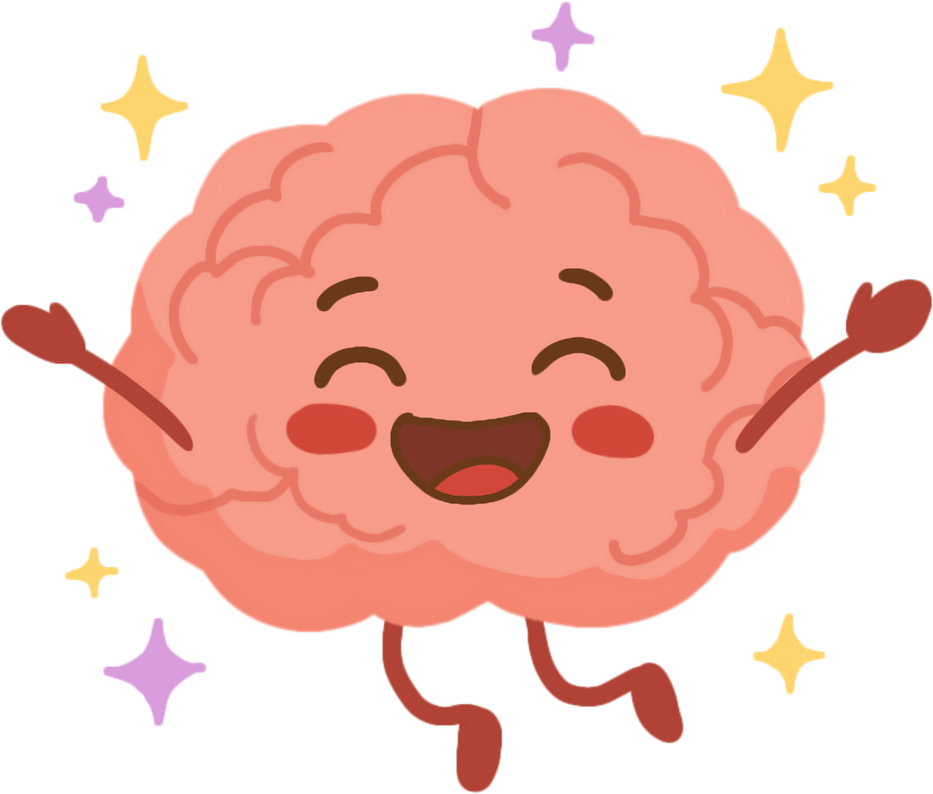
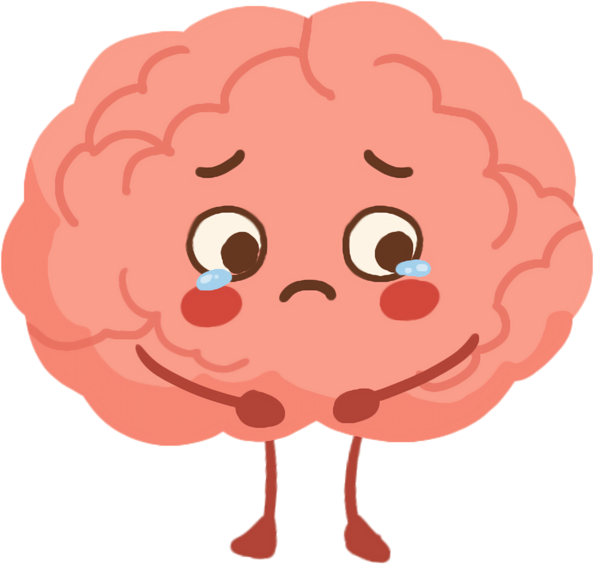
Emotion Mind
I might be impulsive because I am too excited.
I might be mean and hurtful because I am too mad.
I might cry and run away because I am too sad.
Notes:
Read this slide to the students as a recap of emotion mind.

Slide 17
Emotion Mind
I’m just going with
how I feel right now!
What might go wrong if we ignore the facts?
Notes:
Read this slide to the students. Start a discussion of what can go wrong if we ignore the facts. Allow students to share.

Slide 18
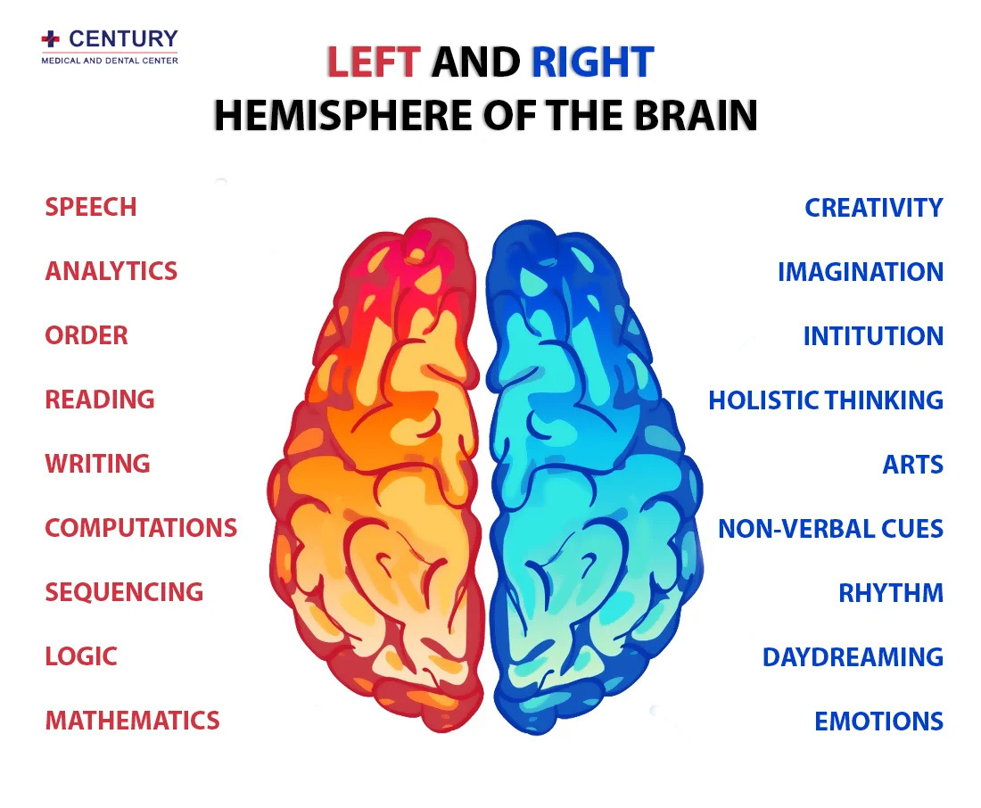
Left and Right Brain
Notes:
Left Brain - logical, literal, linguistic, linear
Right Brain - processes nonverbal communication (facial expressions, eye contact, tone, posture), big picture thinking, creativity

Slide 19
Wise Mind
Reasonable
Mind
Emotion
Mind
Notes:
Now let's look at Wise Mind.

Slide 20
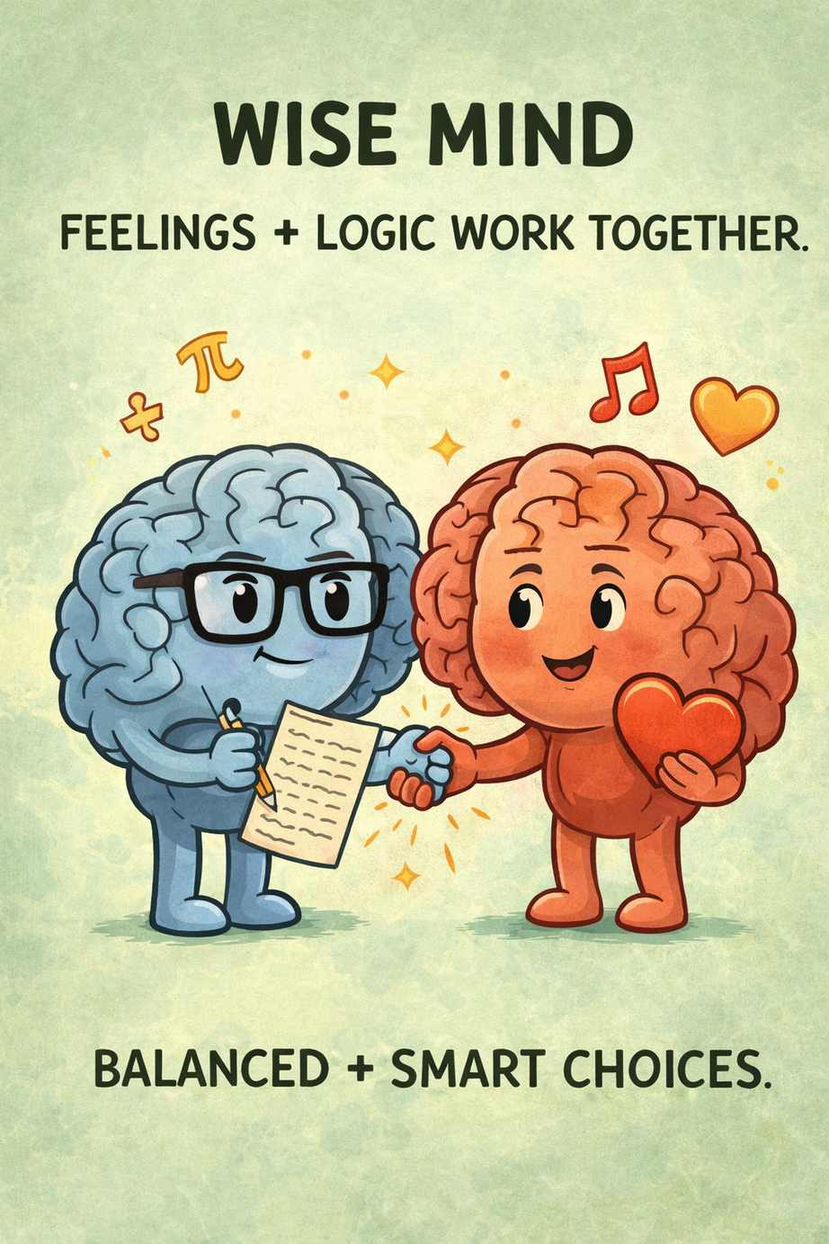
Wise Mind
-Logic and feelings work together to help make the best choice.
-Bring the left and right brain together.
Notes:
Read the slide to the students.
Let's look at some examples of Wise Mind. In each example, Emotion Mind and Reasonable Mind work together.
Note. Graphic created using ChatGPT (OpenAI, 2026).

Slide 21
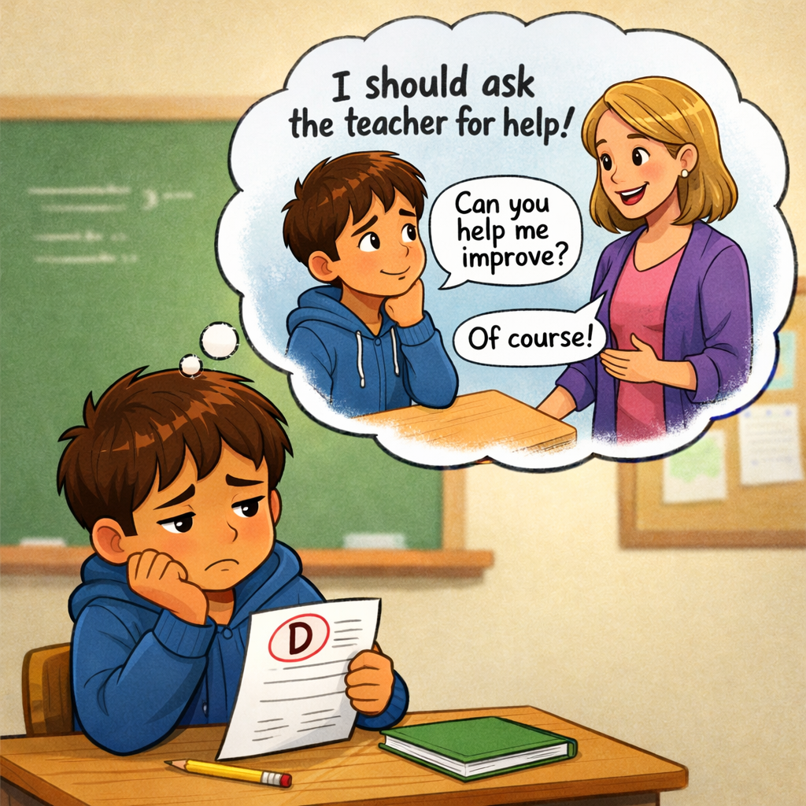
Emotion Brain: Feeling sad
Reasonable Brain: Make a plan to do better
Notes:
Emphasize how acknowledging the emotion can be motivation to problem solve. Strong emotions are important to inspire actions that will bring about positive change.
Note. Graphic created using ChatGPT (OpenAI, 2026).

Slide 22
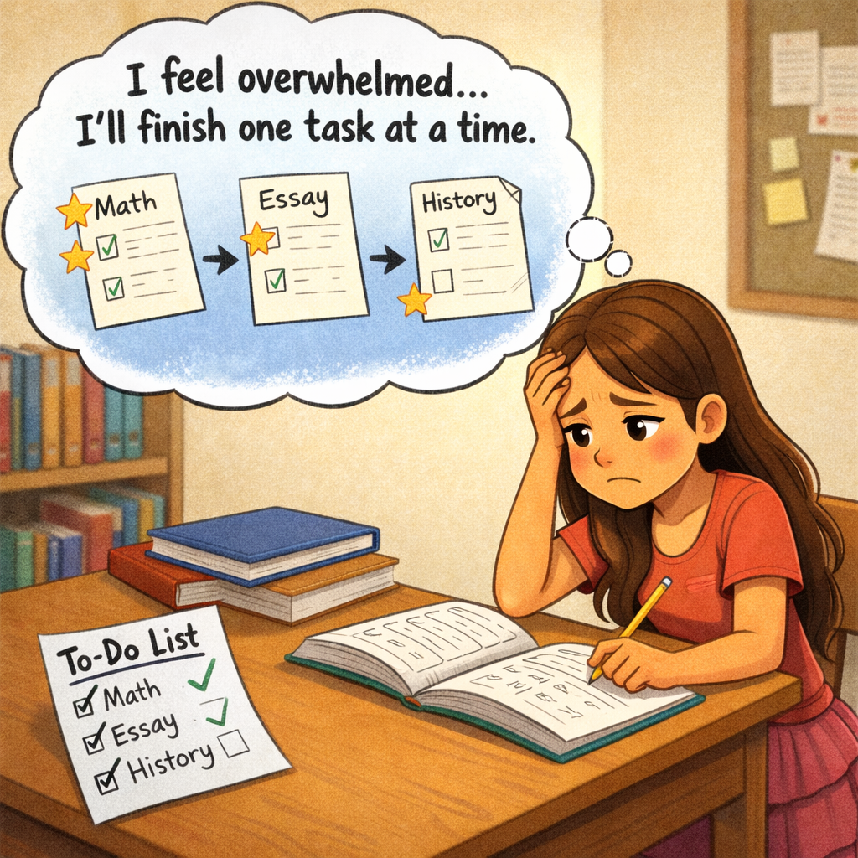
Emotion Brain: Feeling overwhelmed
Reasonable Brain: Break large task into pieces
Notes:
Note. Graphic created using ChatGPT (OpenAI, 2026).

Slide 23
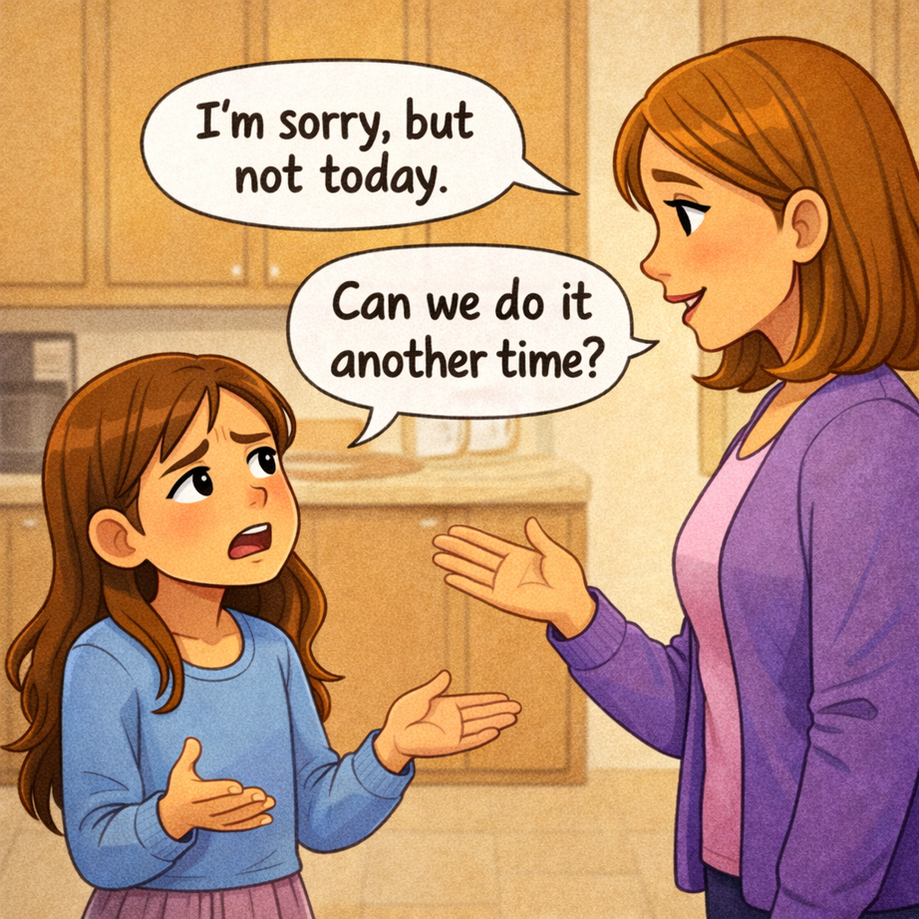
Emotion Brain: Feeling mad
Reasonable Brain: Ask to do it another time
Notes:
Note. Graphic created using ChatGPT (OpenAI, 2026).

Slide 24
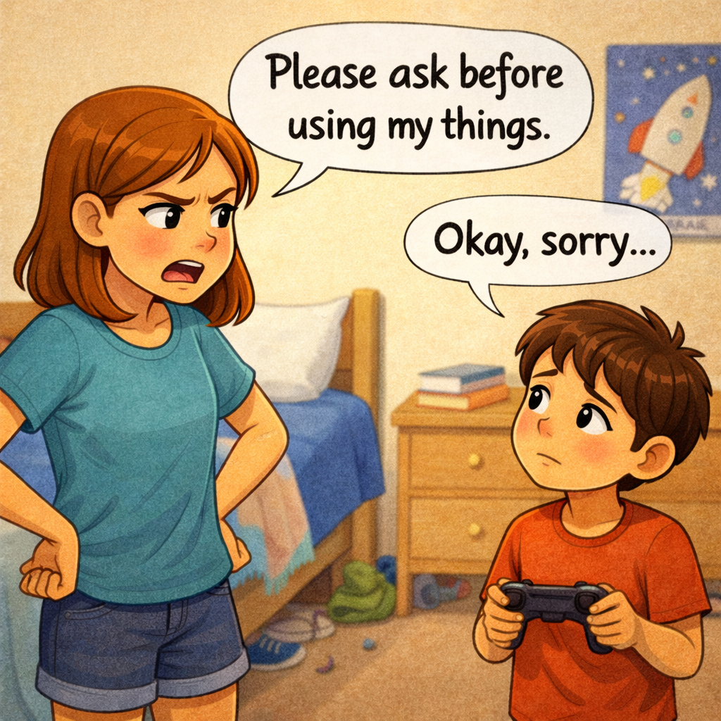
Emotion Brain: Feeling mad
Reasonable Brain: Set a boundary
Notes:
Note. Graphic created using ChatGPT (OpenAI, 2026).

Slide 25
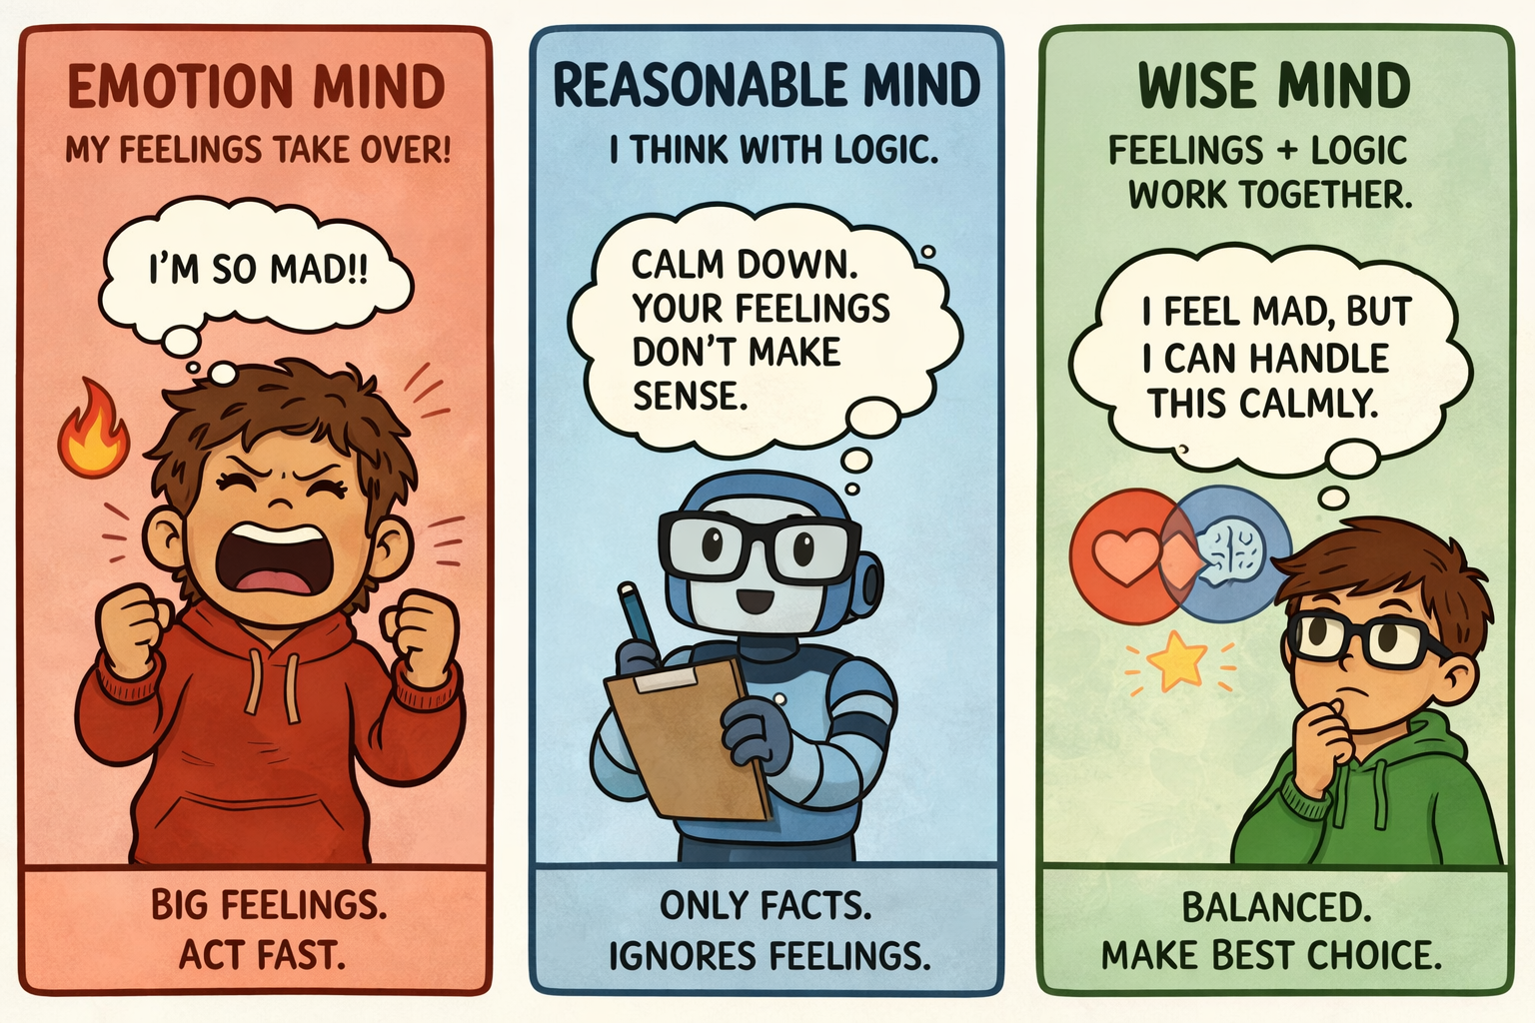
Notes:
Note. Graphic created using ChatGPT (OpenAI, 2026).

Slide 26
Worksheet Discussion
Wise Mind,
Reasonable Mind,
or Emotion Mind?
Notes:
Guided practice- Model the first few problems for the students- think out loud to explain the answers.
Do the next few problems together - students call out the answers.
Save the last few problems for students to try on their own, and ask for volunteers to share their answers. Discuss the answers that students share.

Slide 27
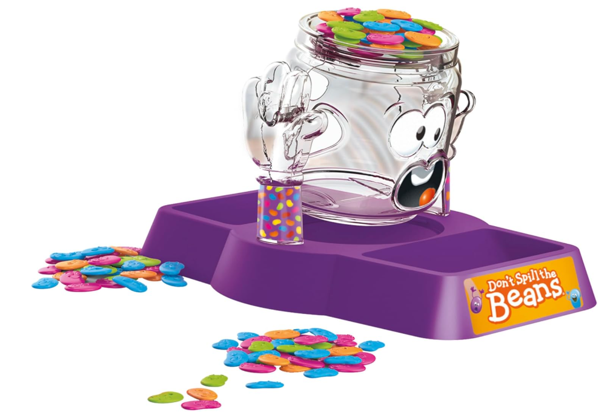
Activity Break
Don’t Spill the Beans
While we play...
Are we going to use
emotion mind (fast, grab, drop!)
or wise mind (slow, careful, thinking)?”
Notes:
See the Facilitator's Guide for complete game directions. Break students into groups of 4 with two teams of two in each group. Have one set of "Don't Spill the Beans" materials for each group.
Explain the rules:
Teams will take turns putting beans on the pot in the middle. The goal is to keep the pot of beans balanced. Whichever team spills the beans looses.
Discuss how student will need to make their reasonable mind and emotion mind work together in order to play the game well. Emotions may come up if a team mate makes a mistake, or if feeling too excited/silly.

Slide 28
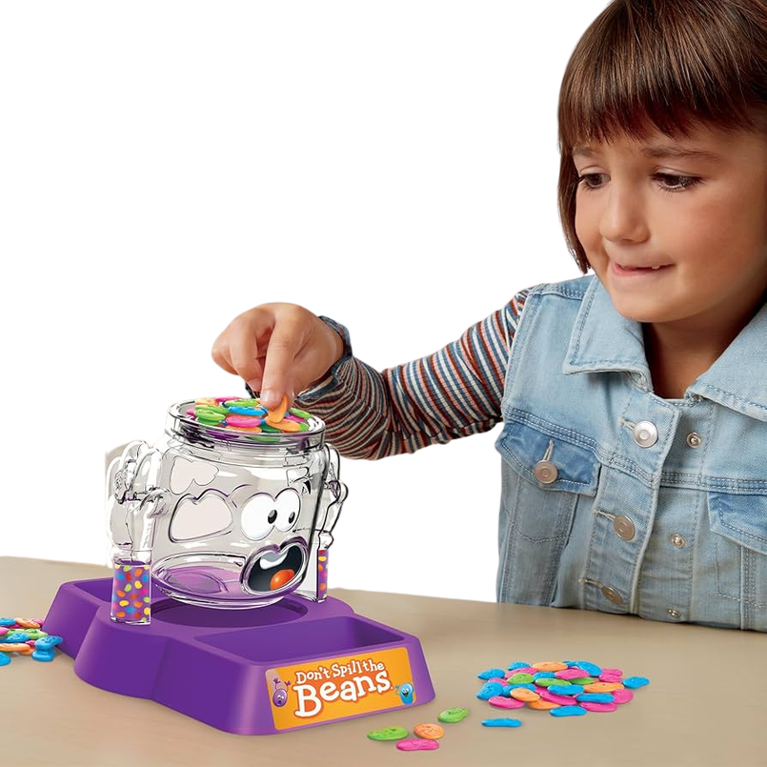
During the game...
Pause before you place each bean
What is your wise mind telling you to do?
Notes:
Explain that students should use wise mind to stop and think when it is their turn. Use wise mind to collaborate with partners.

Slide 29
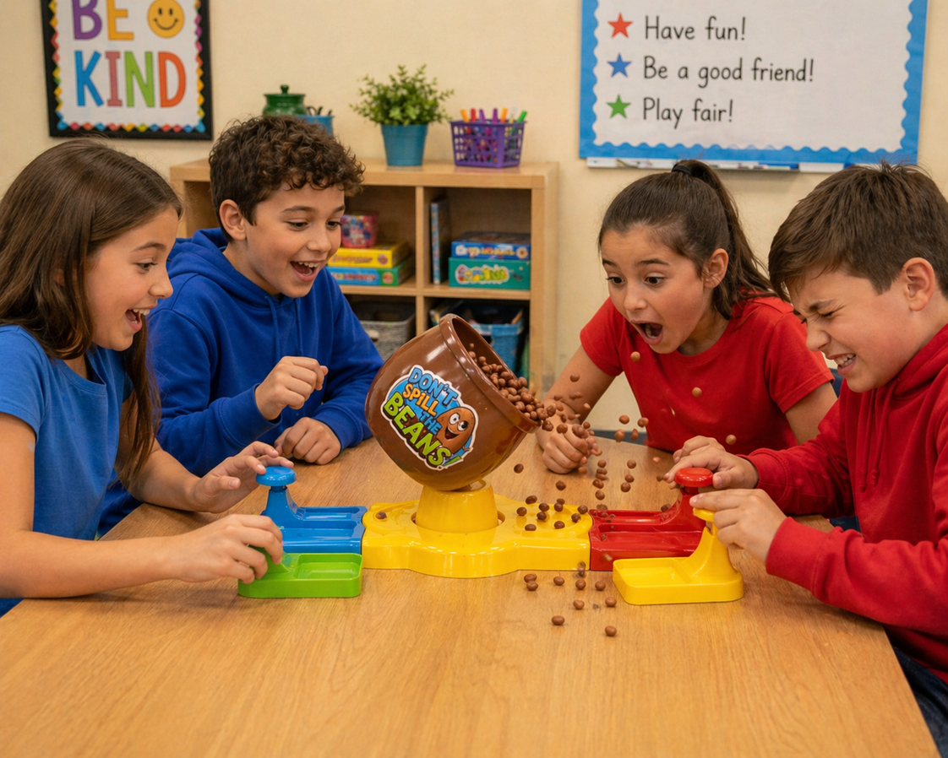
After the game...
What helped your team to stay in wise mind?
What happened when someone rushed or got frustrated?
How is this like real life situations?
Notes:
Ask students to reflect on how they played the game. Read these questions to the students and discuss them.
Note. Graphic created using ChatGPT (OpenAI, 2026).

Slide 30

Exit Ticket
Luke studied hard but still got a bad grade and wants to give up.
Circle what type of mind Luke is in:
Emotion Mind
Reasonable Mind
What would wise mind tell Luke to do?
Notes:
Display the exit ticket on the board and pass out papers to students.
Have the students complete the exit ticket questions before they leave group.

