Slide 1



I Can Handle Scary Weather!
Notes:
Read slide with students. Introduce the topic of today’s lesson about scary weather. Talk about the picture – what do they see? Does the boy look scared? Why or why not?

Slide 2

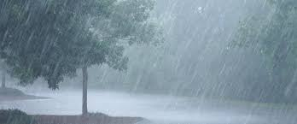

What kinds of weather can feel scary?
strong winds
heavy rain
thunder and lightning
Notes:
Read slide with students. Ask what kinds of weather they find scary. Talk about the pictures and ask students for their experiences.

Slide 3
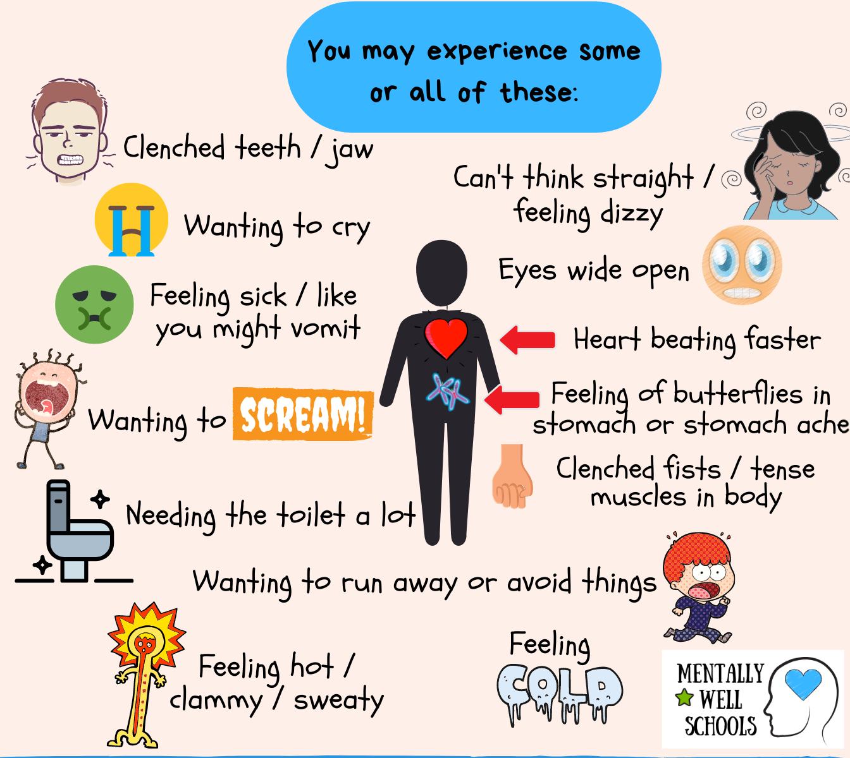
It’s okay to feel scared or nervous
How does your body feel when you’re scared?
Notes:
Read slide with students. Explain that it’s okay to feel scared about the weather. Talk about how your body feels when you’re scared. Share different examples.

Slide 4
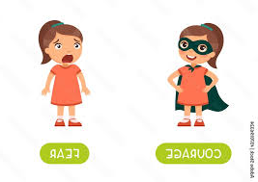
There are things we can do when the weather scares us
The thunder is so loud!
That’s okay. I know what to do!
Notes:
Read slide with students. Explain that they’ll learn about things to do when the weather is scary.

Slide 5
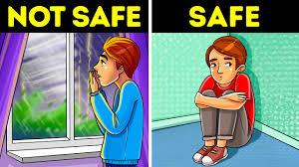
1. We need to stay safe
Stay indoors and away from windows during storms
Notes:
Read slide with students. Emphasize that the most important thing to do during scary weather is to stay safe. Explain that staying indoors and away from windows can help keep everyone safe.

Slide 6
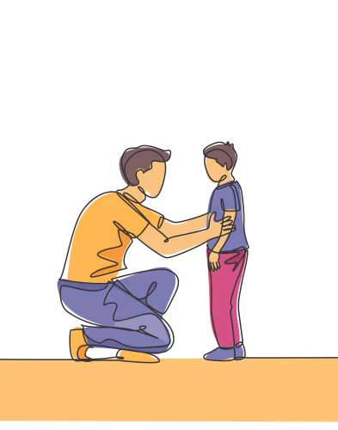
2. Listen to grown-ups
Grown-ups can let you know what to do and where to go during scary weather
Let’s go sit in the basement until the storm is over
Notes:
Read slide with students. Encourage students to ask a grown-up if they’re not sure what to do during scary weather.

Slide 7
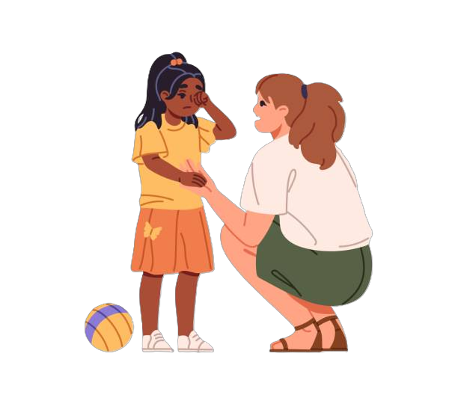
3. Ask for help if you need it
Sure!
I’m scared of the lightning. Can I sit with you?
Notes:
Read slide with students. Let them know that it’s okay to ask for help if they’re feeling scared.

Slide 8

4. Do something to feel more comfortable
hug a toy
sit under a blanket
read a book
listen to music
Notes:
Read slide with students. Explain that there are things they can do to help them feel more comfortable when afraid. Read through the examples and ask students for their ideas.

Slide 9
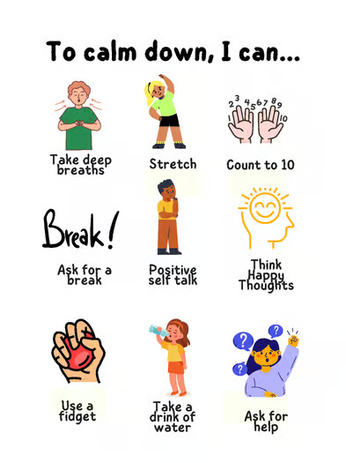
5. Practice calming strategies
Notes:
Read slide with students. Lead them in practicing the calming strategies listed. Ask for other examples.

Slide 10

I Can Handle Scary Weather
Stay safe
Listen to grown-ups
Ask for help if you need it
Do something to feel more comfortable
Practice calming strategies
I can handle it!
Notes:
Read slide with students. Review the strategies they learned in today’s lesson.

Slide 11
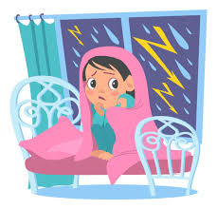
So…what do YOU think?
You’re sleeping over at a friend’s house when a storm hits. There’s lots of thunder, lightning, and heavy rain. Your friend is scared (and so are you.)
What can you do?
Notes:
Read slide with students. Ask for their ideas on how to help the friend. Encourage them to think about what they just learned in the lesson and apply it to this situation.

