Slide 1
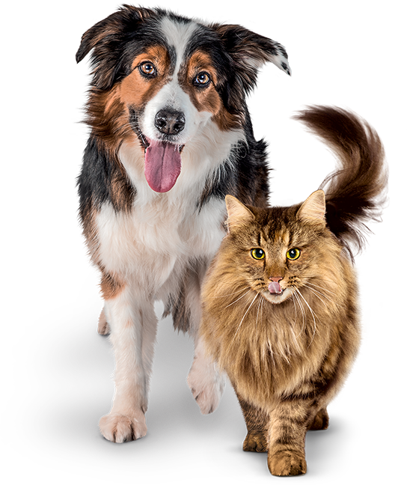

I Can Be Kind to Animals
slidesppt.net
Notes:
Read slide with students. Explain that today’s lesson is about learning how to be kind to animals. Ask students about their pets at home. Ask for their examples of being kind to their pets.

Slide 2
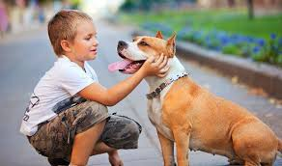
What does “being kind” mean?
“Being kind” means treating animals with care and respect.
Being kind is being gentle and friendly with our animals.
Notes:
Read slide with students. Ask for their definitions of “being kind”.

Slide 3

How do you feel when someone is kind to you?
Notes:
Read slide with students. Ask them to share how it feels when someone shows them kindness. Give your own examples to start things off if necessary.

Slide 4
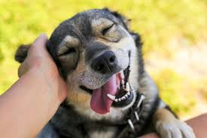
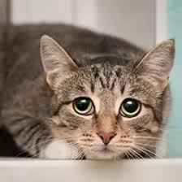
Animals are living creatures that feel emotions. Just like people!
Notes:
Read slide with students. Talk about the photos. Ask students about the emotions shown. Ask them how they can tell.

Slide 5
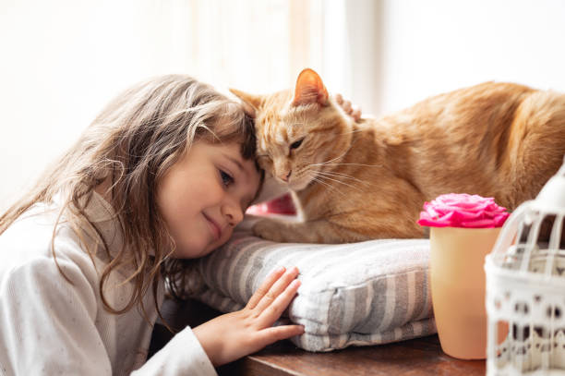
Why is kindness important?
Being kind to animals helps us build trust and friendship with them
Notes:
Read slide with students. Explain the importance of being kind so that animals will trust us and build relationships with us.

Slide 6
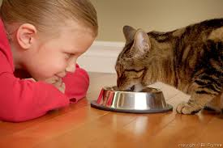
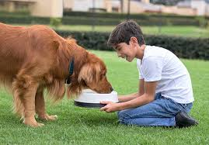
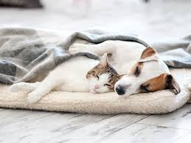
Being kind to animals means taking care of their needs.
Animals need food
Animals need water
Animals need a
safe place to live
Notes:
Read slide with students. Talk about how to meet the needs of our animals. Read the examples and ask students to share how they care for their pets’ needs.

Slide 7
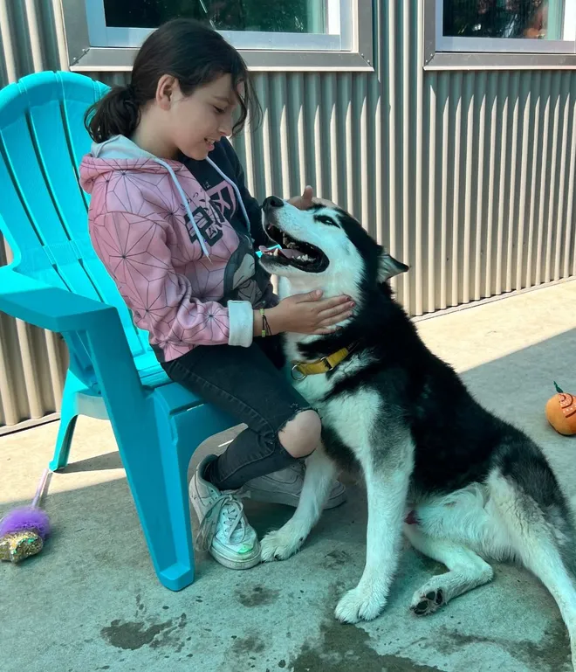
When we are gentle and friendly, animals feel safe and happy!
Notes:
Read slide with students. Ask students to talk about the photo. What do they see? How can they tell that the girl is being gentle and friendly?

Slide 8
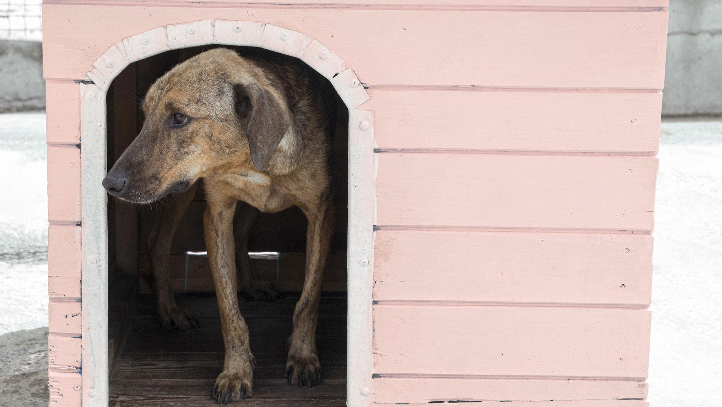

5 Ways to Be Kind
to Animals!
Notes:
Read slide with students. Explain that they’ll learn 5 ways to be kind to animals.

Slide 9
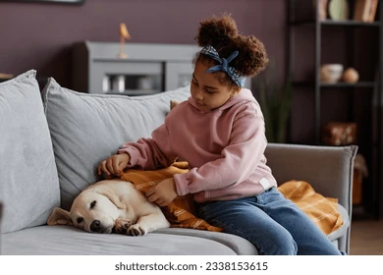
1. Use a soft voice and gentle touch
Notes:
Read slide with students. Talk about the photo. Practice using a soft voice and gentle touch with a stuffed animal.

Slide 10
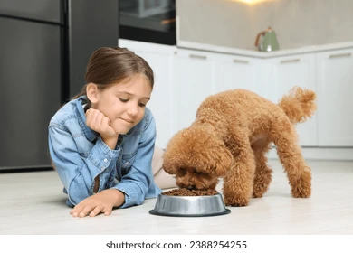
2. Feed them healthy food and clean water every day
Notes:
Read slide with students. Talk about the importance of feeding pets healthy food and giving them clean water every day.

Slide 11
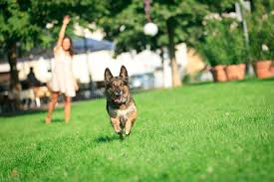
3. Never hurt animals or tease them
Play with them instead!
Notes:
Read slide with students. Talk about the photo. Explain that hurting or teasing animals make them afraid of us. It could also make them mad enough that they might bite us! Explain that it’s better to play with animals or just leave them alone if they look like they don’t want to be bothered.

Slide 12
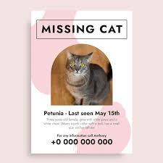
4. Tell an adult if an animal is lost or hurt
Notes:
Read slide with students. Explain that sometimes animals go missing and that it’s important to let an adult know so that they can help.

Slide 13
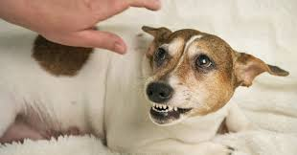
5. Give animals space when they need it
Notes:
Read slide with students. Talk about the photo. What is the dog’s behavior telling us? Does he want you to pet him right now? Why might he be acting this way?

Slide 14
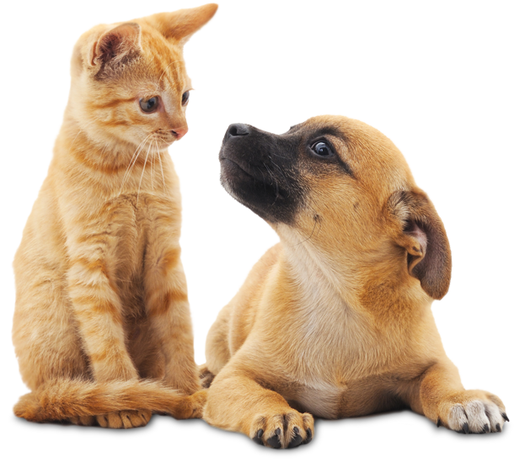
Remember: 5 Ways to Be Kind to Animals
Use a soft voice and gentle touch
Feed healthy food and clean water every day
Never hurt animals or tease them
Tell an adult if an animal is hurt or lost
Give animals space when they need it
slidesppt.net
Notes:
Read slide with students. Review the 5 ways to be kind to animals.

Slide 15
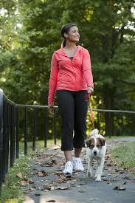
So…what do YOU think?
You’re playing in the park with friends and a woman is walking her dog nearby. You really like dogs and you want to pet it. What should you do?
Notes:
Read slide with students. Ask students for their ideas about what to do. Talk about the importance of asking the owner if it’s okay to pet their dog first. Never go up to a strange animal and try to pet it without checking with the owner. If now owner is around, it might be best to leave the animal alone. If you think the animal might be lost, ask an adult for help.

