Slide 1
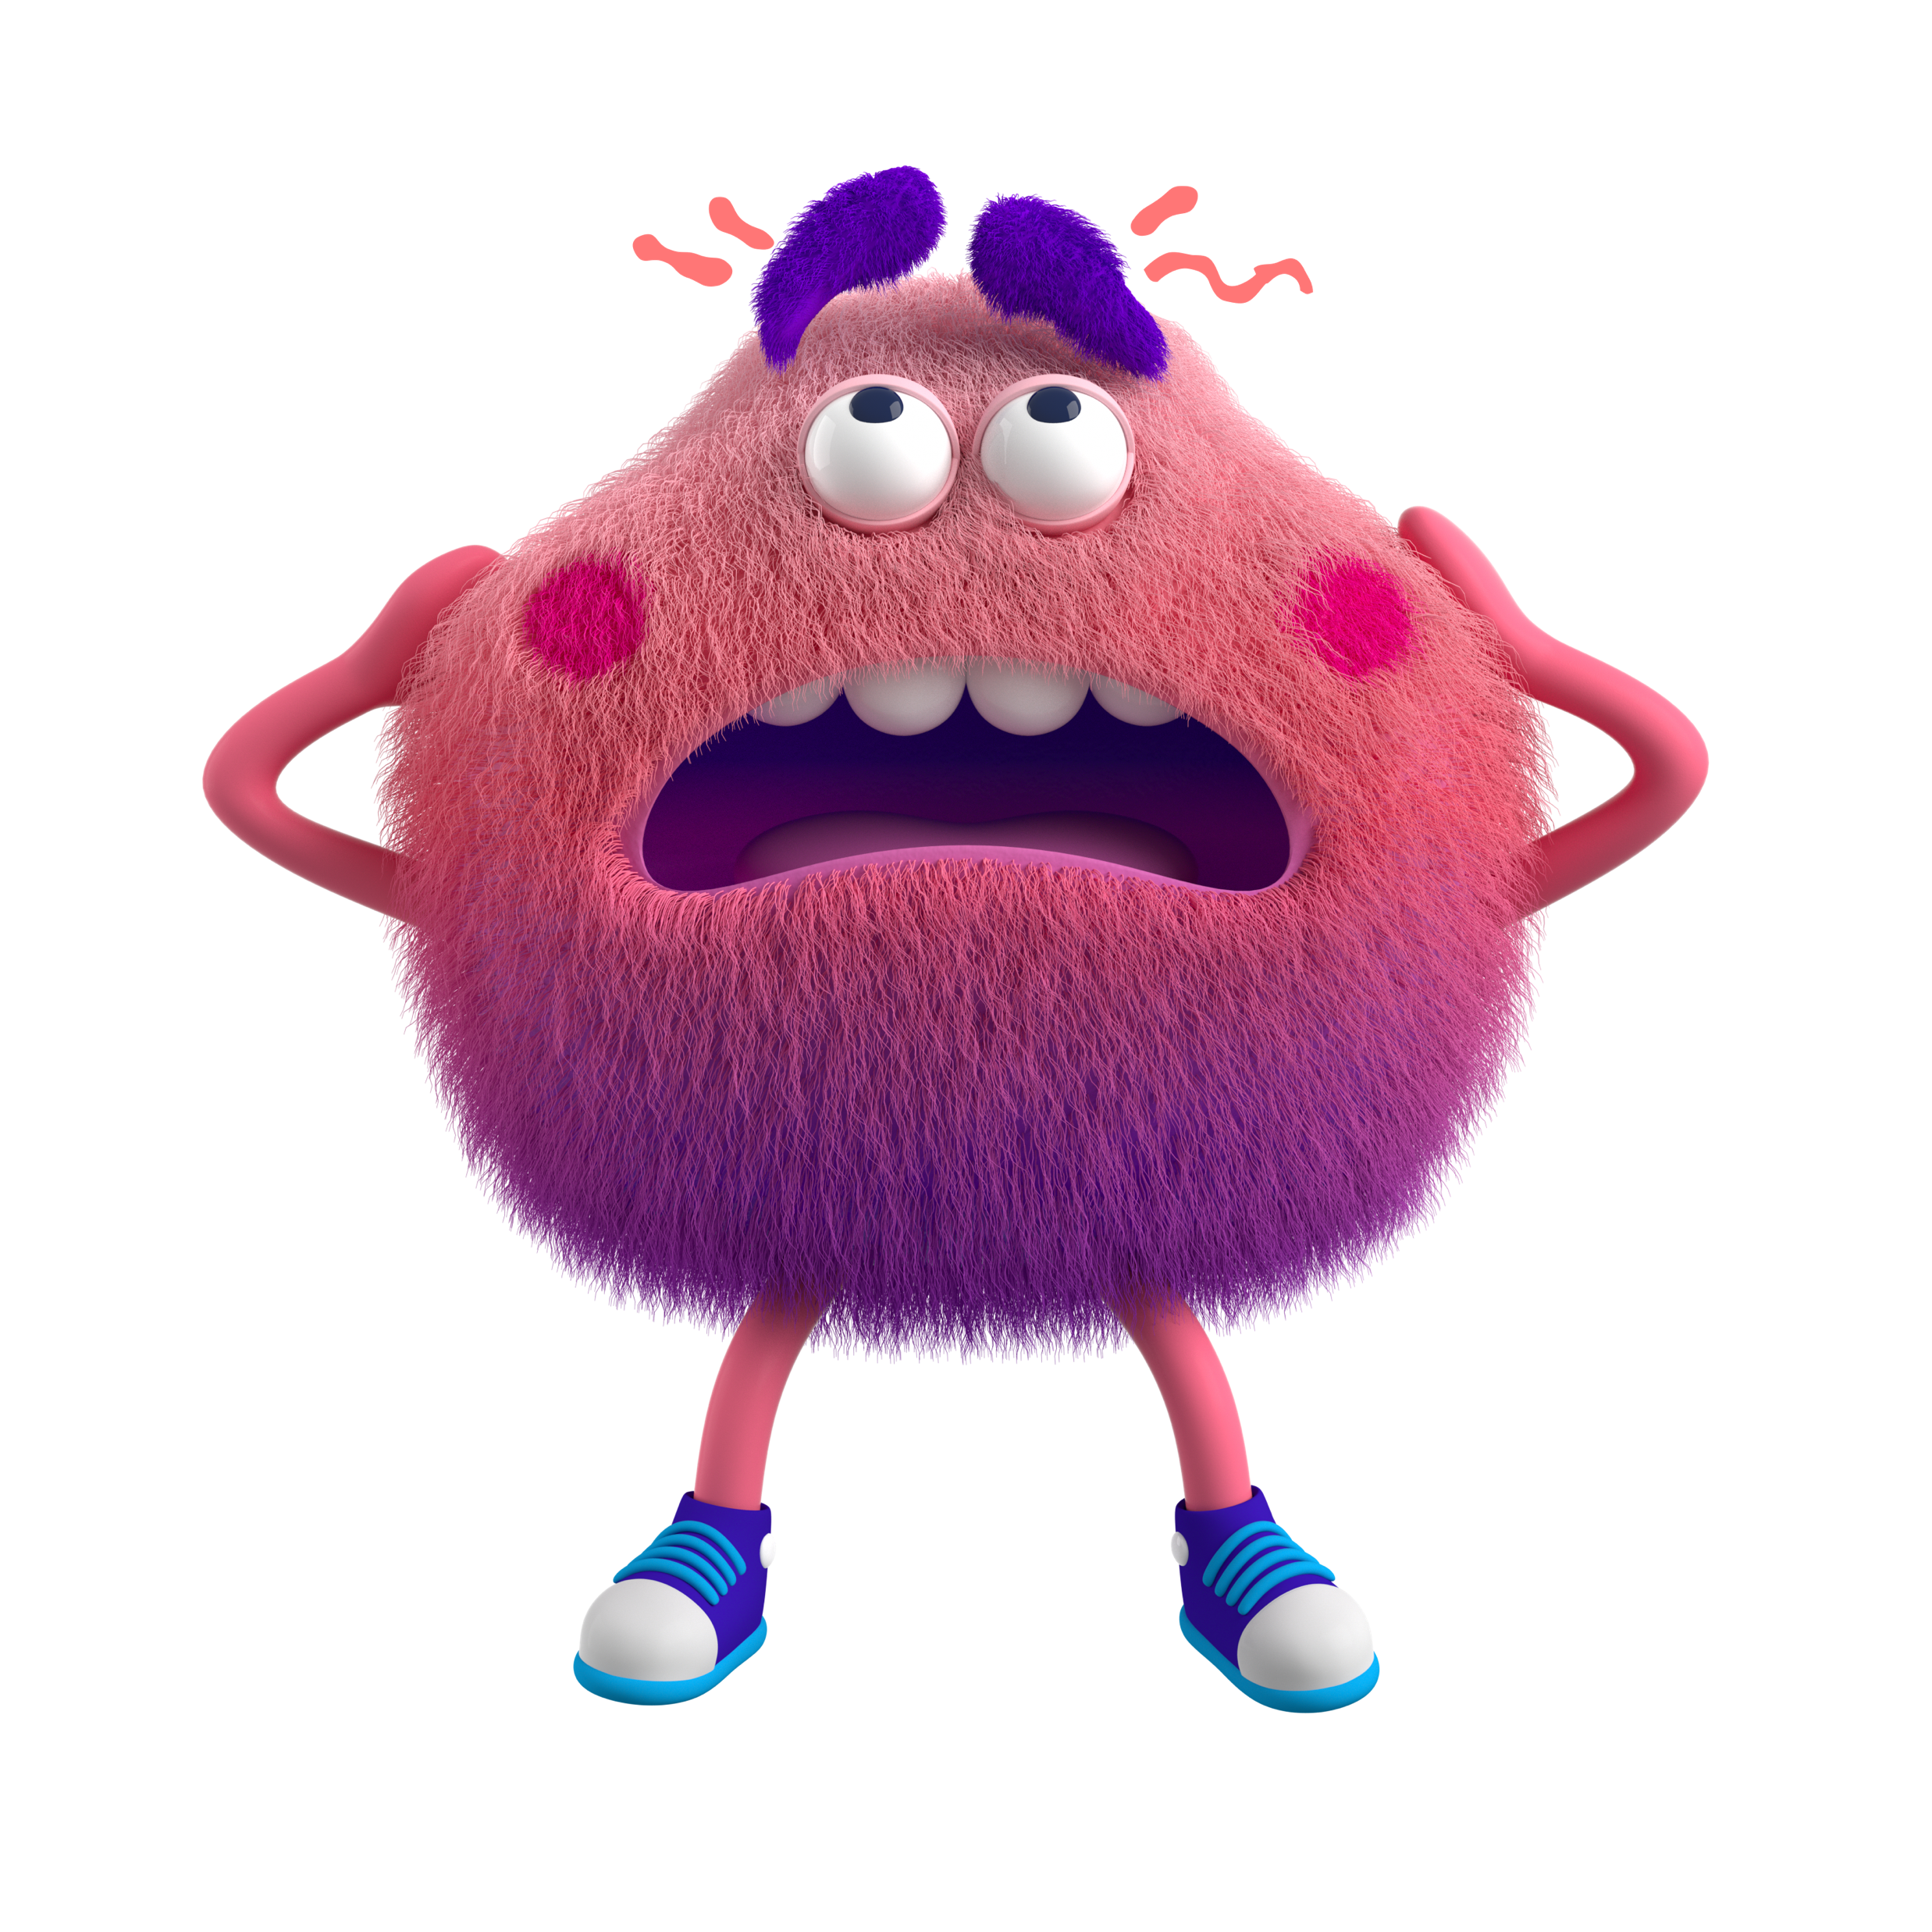

I Know What to Do When I’m Sick!
Notes:
Read slide with students. Explain that today’s lesson is learning about ways to take care of yourself and others when you’re sick. Ask students if they’ve ever been sick. What did they have? How did it feel?

Slide 2
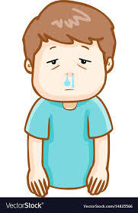
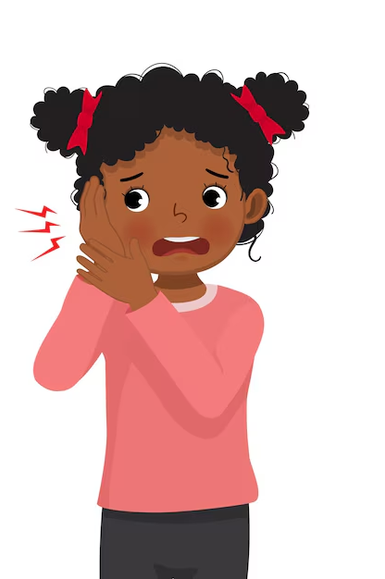
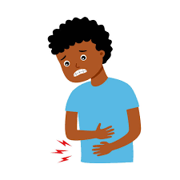
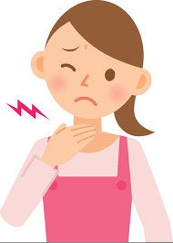
We all get sick sometimes
runny nose
ear ache
2
stomach ache
sore throat
Notes:
Read slide with students. Talk about the types of sickness. Ask for other examples (coughing, headache, “bathroom issues”, etc.)

Slide 3

When we get sick, it’s important to take care of ourselves!
We need to practice good health hygiene!
3
Notes:
Read slide with students. Ask if they know what “health hygiene” means. (taking care of ourselves through cleanliness and other good habits to prevent spreading germs)

Slide 4

Why is health hygiene important?
It helps us get better faster
We won’t spread germs so it keeps our friends, family, and teachers from getting sick
It makes our school a safe and happy place!
4
Notes:
Read slide with students. Emphasize that we can do things to help ourselves feel better and keep others from getting sick.

Slide 5

What should we do when we’re sick?
Notes:
Read slide with students. Ask for their examples of what to do when we’re sick. Explain that they’ll learn 5 things to do when we’re sick.

Slide 6
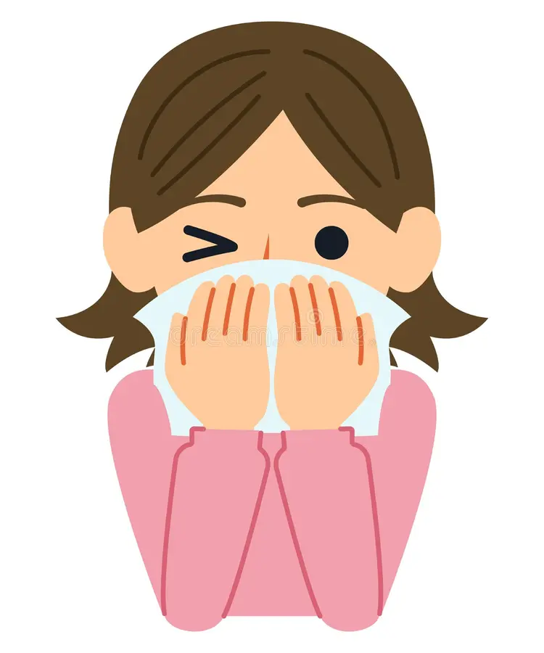
1. Cover your coughs and sneezes
use a tissue or your elbow
throw used tissues in the trash right away
Notes:
Read slide with students. Talk about how to cover coughs and sneezes. Point out where the tissues are in the classroom. Have students practice using their elbows to cover their nose or mouth.

Slide 7
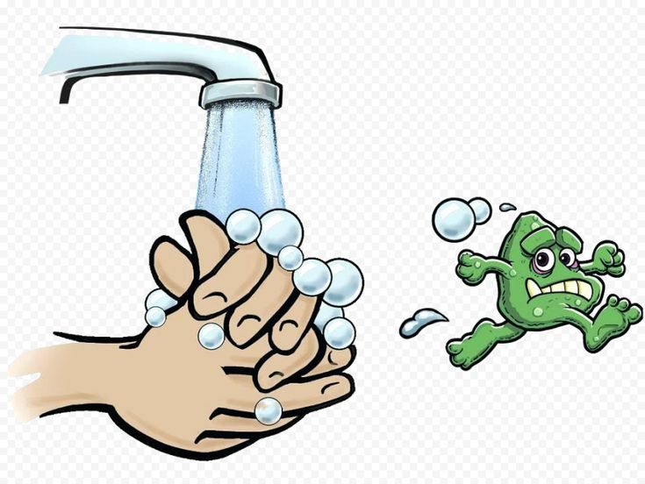
2. Wash your hands. A LOT!!
Use warm water and soap
Wash for at least 20 seconds
Wash after blowing your nose, sneezing, or coughing
Notes:
Read slide with students. Talk about handwashing and explain that they can sing the Happy Birthday song in their heads to time how long to wash.

Slide 8
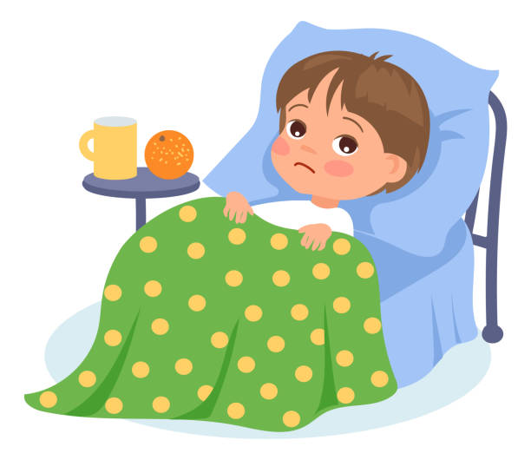
3. Stay home if needed
If you feel very sick, it’s best to stay home and rest
Getting some rest can help you feel better!
Notes:
Read slide with students. Talk about the importance of staying home when they’re truly sick so that they don’t spread germs. Plus resting can help them feel better faster.

Slide 9
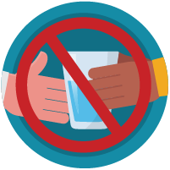
4. Don’t share personal items!
Don’t share water bottles, drinks, food, or towels with others when you’re sick
This can keep germs from spreading!
Notes:
Read slide with students. Explain that while sharing is a nice thing to do, we definitely should not do it when we’re sick. Ask for their examples of other things we shouldn’t be sharing when we’re sick. (clothes, pencils, etc.)

Slide 10
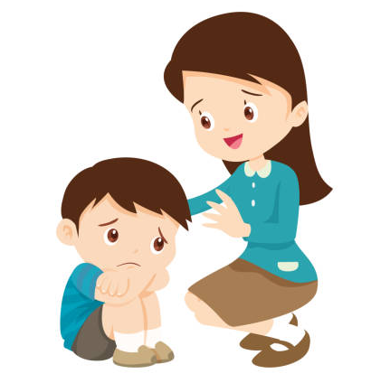
5. Ask for help if you need it
My stomach hurts
tell an adult when you don’t feel well
ask for help with hand washing, getting tissues, etc. if you need it
Notes:
Read slide with students. Explain that it’s important to let an adult (parent or teacher) know when you’re not feeling well so that they can help you. You might need to lie down, go to the bathroom, see the school nurse, etc. An adult can help with that.

Slide 11

Remember: When I’m Sick…
Cover coughs and sneezes
Wash hands often
Stay home if needed
Don’t share personal items
Ask for help
Notes:
Read slide with students. Review the 5 things to do when you’re sick.

Slide 12

So…what do YOU think?
You’re sitting with your friends at lunch and the boy next to you is sneezing and wiping his nose
on his sleeve.
He keeps doing it!
What can you do?
Notes:
Read slide with students. Ask for their ideas of how to handle this situation. Encourage them to remember the strategies they learned in the lesson and ask how they’d apply them to this problem.

