Slide 1

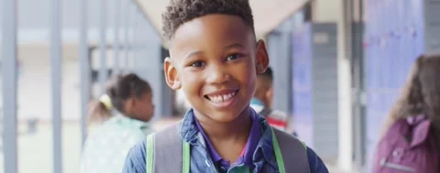
I Can Keep My Clothes on at School
Template copyright PresentationGO.com
Notes:
Read slide with students. Explain that today’s lesson is about the importance of keeping clothes on at school.

Slide 2

Why do we wear clothes?
We wear clothes to stay warm
We wear clothes to be comfortable
We wear clothes to keep our bodies private
Notes:
Read slide with students. Talk about the reasons for wearing clothes. You can add that wearing clothing is a “school rule”. Some students may do better with “school rules”.

Slide 3

At school, we keep our clothes on
in the classroom
on the playground
in the cafeteria
in the hallways
on the bus
in the gym
Notes:
Read slide with students. Review all the places where clothing must be worn. Ask students for additional examples.

Slide 4


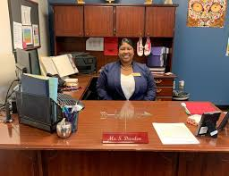
Everyone wears clothes at school!
friends
teachers
principal
Notes:
Read slide with students. Point out that everyone at school is wearing clothes.

Slide 5


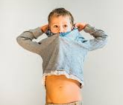


People are uncomfortable when I take off my clothes at school
Notes:
Read slide with students. Explain that people don’t feel comfortable around someone not wearing clothes. They may not want to be around you until you put your clothing back on.

Slide 6

At home, we can take clothes off in private spaces
in my bedroom
in the bathroom
Notes:
Read slide with students. Explain that it’s okay to remove your clothes when you’re at home in your bedroom or in the bathroom.

Slide 7
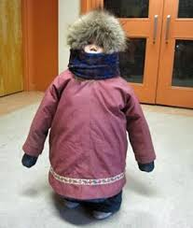
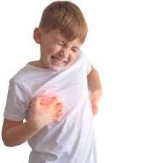
Sometimes my clothes don’t feel right
I’m too hot!
My shirt is itchy!
Notes:
Read slide with students. Talk about how sometimes are clothes bother us. Share examples.

Slide 8
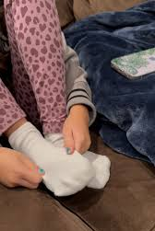
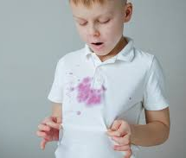
Sometimes my clothes don’t feel right
My socks get bunched up!
My shirt got wet!
Notes:
Read slide with students. Explain that these issues can make clothing uncomfortable to wear. Ask students for more examples.

Slide 9
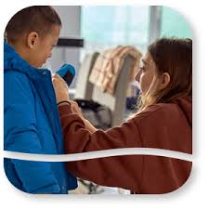
When my clothes are uncomfortable, I can tell a teacher or ask for help
My teacher can help me change my clothes or fix my socks!
Notes:
Read slide with students. Explain that telling a teacher when you’re uncomfortable is a good way to get help with the problem.

Slide 10
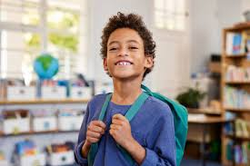
Remember:
Clothes ON at school
We wear clothes to keep warm, to stay comfortable, and to keep our bodies private
If I’m uncomfortable, I can ask for help if I need it
Clothes OFF at home in private spaces
I can keep my clothes on!
Notes:
Read slide with students. Highlight the importance of keeping clothes on at school and asking for help if needed. Remind students that they can remove clothing at home in private spaces.

Slide 11
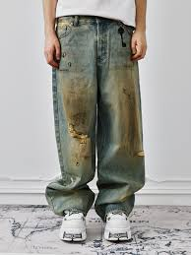
So…what do YOU think?
You were playing with friends on the playground and you got dirt on your pants.
What can you do?
Notes:
Read slide with students. Ask for their ideas on how to handle the problem.

