Slide 1
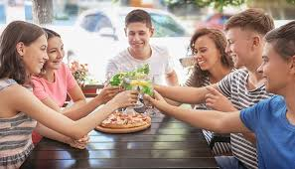

I Know How to Act in a Restaurant!
Notes:
Read slide with students. Explain that the lesson will help them understand the expectations for eating in a restaurant.

Slide 2
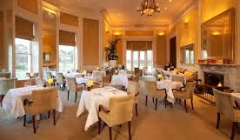

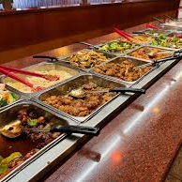
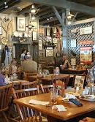
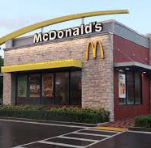
Have you ever been to a restaurant?
fancy/fine dining
coffee shop
buffet
chain restaurant
There are different kinds of places to eat. Where have you eaten?
fast food
Notes:
Read slide with students. Where did they go? With family or friends? What did they eat? Were there any issues?

Slide 3
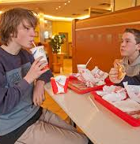
It’s fun to eat at restaurants!
Someone cooks food for you
In some restaurants, they bring the food to your table for you
The food is usually DELICIOUS!
The best part? You don’t have to wash the dishes!
Notes:
Read slide with students. Ask about other benefits to eating in a restaurant. (Unless you’re in a fast food restaurant where you’re supposed to clear your own table, usually someone takes the dishes away and cleans up after you; you get to try new foods; etc.)

Slide 4
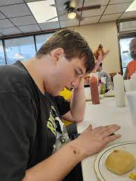
What to expect?
Restaurants can be busy or quiet
They might have new smells, sounds, or people
It’s okay if it feels different
I can take my time to get used to it!
Notes:
Read slide with students. Talk about the different sensory input the students might experience in a restaurant. Ask for their examples.

Slide 5
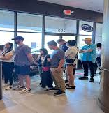
Sometimes we have to wait…
If the restaurant is busy, we may have to wait a bit before we sit down
I can stay with my classmates or my family until someone takes us to our table
If waiting feels hard, I can listen to music, look at a book, or play with a fidget while I wait
Notes:
Read slide with students. Talk about the need to wait to be seated if the restaurant is busy. Ask what else they could do while they wait for a table.

Slide 6
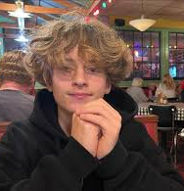
We get a table!
When we get to our table, I sit down next to my classmates or family
I stay in my seat so I can be safe and not get in the way of the servers doing their jobs
The server brings us menus and drinks
Notes:
Read slide with students. Talk about what happens once you get to your table.

Slide 7
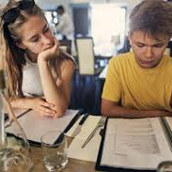
Time to look at the menu!
The menu tells me the different food choices
I can choose something I like
If I’m not sure, I can ask a trusted adult for help
Notes:
Read slide with students. Explain that sometimes all the different choices on the menu can make it hard to pick something. Talk about what they can do if they get overwhelmed.

Slide 8
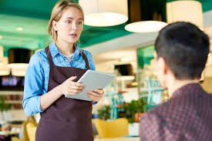
The server or waiter will come to take my order
I can tell him or her what I want myself OR I can let an adult order for me
Both ways are okay!
I can be polite and say “please” and “thank you” when talking to the server.
Notes:
Read slide with students. Talk about the importance of manners with speaking with the server.

Slide 9
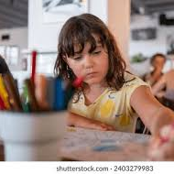
Waiting for my food…
Food takes a while to cook
It’s hard to wait – especially when I’m hungry!
While I wait for my food, I can talk quietly, play with my fidget, or draw
Waiting calmly helps everyone around me in the restaurant!
Notes:
Read slide with students. Acknowledge that it can be hard to wait for your food but there are things to do while waiting that might make it easier.

Slide 10
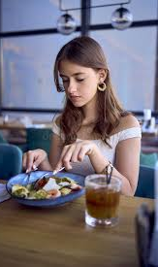
Time to eat!
When my food comes, I eat using my best manners:
I thank the server who brings my food
I keep my food on my plate
I use my fork or spoon (or my fingers – only if it’s finger food or a sandwich!)
I try to chew with my mouth closed
I take small bites and don’t stuff my mouth
I use a napkin to wipe my mouth
Notes:
Read slide with students. Talk about using good table manners while eating.

Slide 11
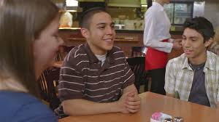
Talking in the restaurant…
Restaurants can have many people working and eating at once
It’s polite to use a quiet or indoor voice when I talk so I’m not bothering others
If I feel excited or upset, I can let an adult know and we can take a break
Notes:
Read slide with students. Explain that talking is okay as long as they use an indoor voice. Remind students that it’s okay to ask for a break if they feel overwhelmed.

Slide 12
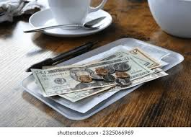
We’re finished eating…
When I’m done eating, I stay at the table until the adult says it’s time to leave
The server will come to take our plates and bring our bill
Once we pay for our food, we can leave
Notes:
Read slide with students. Talk about what to do when done eating.

Slide 13

Time to leave
When it’s time to go, I leave with my class or my family
I’m proud of myself – I know how to act in a restaurant!
Notes:
Read slide with students. Ask what they remember from the lesson about eating in a restaurant.

Slide 14
I remember how to act in a restaurant!
It’s okay to take time to get used to the different sights and smells
If we have to wait to be seated, I can keep busy with listening to music or looking at a book
Once we get to our table, I stay in my seat
When I get a menu, I can look at the different choices and pick something I like
It’s hard to wait for food when I’m hungry but I can draw or talk to my friends while I wait
When the food comes, I use my best manners while eating
If I want to talk, I use a quiet, indoor voice
We pay the bill when everyone is done eating
It’s fun to eat in restaurants!
Notes:
Read slide with students. Review each of the key points from the lesson.

Slide 15
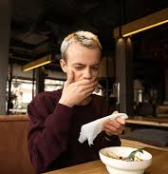
So…what do YOU think?
You’re so excited to go to the restaurant with your friends! All the food on the menu looks delicious – it’s hard to choose. You finally pick something but when the food comes, you taste it and you really don’t like it.
What can you do?
Notes:
Read slide with students. Get their ideas for what to do if they don’t like the food they ordered.

