Slide 1
I Can Choose the Right Clothes!
Notes:
Read slide with students. Explain that today’s lesson will focus on how to choose the right clothing depending on different factors.

Slide 2
Choosing the right clothes can be tricky!
Have you ever…
Notes:
Read slide with students. Ask if they’ve ever had difficulty choosing the right clothes to wear. What kind of problems did they have? Were they able to solve the problems? How?

Slide 3
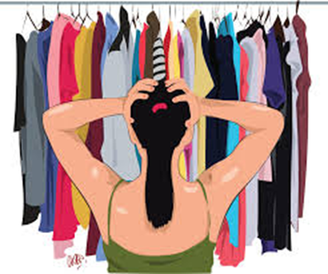
…looked in your closet and couldn’t find your favorite shirt?
how did you feel?
Notes:
Read slide with students. Ask if they every had this problem. Ask how it made them feel. Were they able to solve the problem? How?

Slide 4
…tried on a bunch of clothes and didn’t like how any of them looked?
Yuck!
Notes:
Read slide with students. Ask if they’ve ever had this problem. How did they feel? Were they able to solve the problem? How?

Slide 5
…wondered what you should wear to a certain event?
Can I wear jeans?
Should I wear a dress?
Notes:
Read slide with students. Ask if they’ve ever had this problem. How did they feel? Were they able to solve the problem? How?

Slide 6
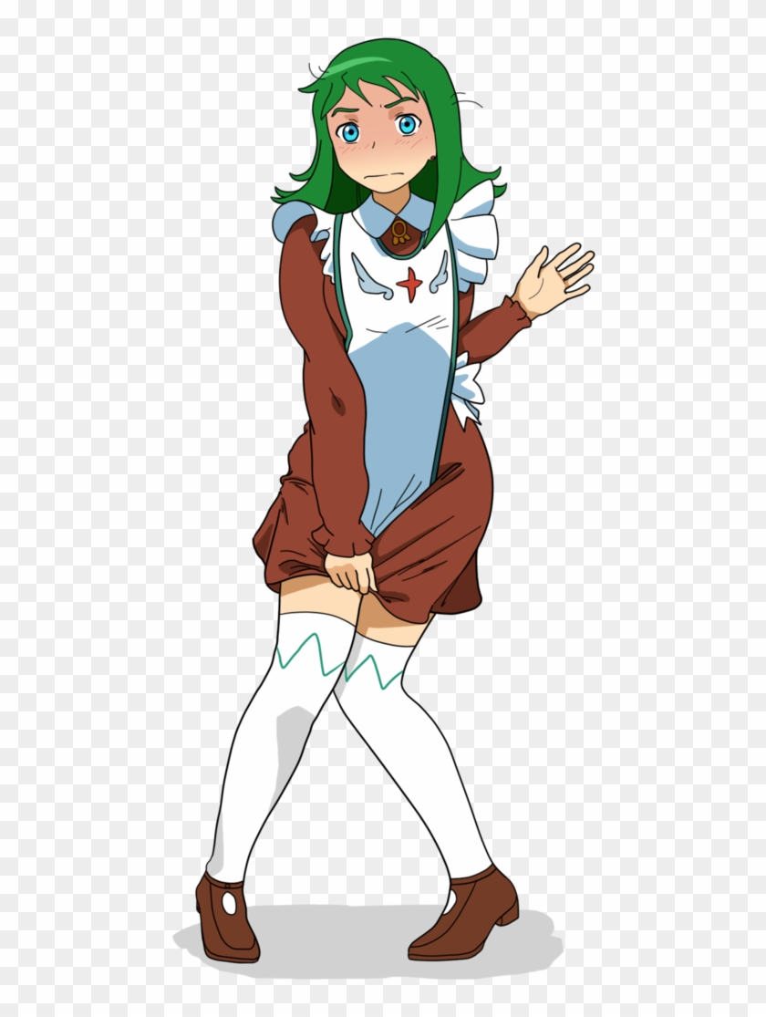
…worn something and regretted it later?
This dress is way too short!
Notes:
Read slide with students. Ask if they’ve ever had this problem. How did they feel? Were they able to solve the problem? How?

Slide 7
Trying to choose the right clothes can make us feel…
Notes:
Read slide with students. Talk about the different emotions represented. Ask students if they’ve ever felt any of these and why.

Slide 8
But there are tips that can help!
8 Tips to Help Choose the Right Clothes
Notes:
Read slide with students. Explain that they will learn 8 tips that can help them choose the right clothing.

Slide 9
1. Organize your closet and drawers
put your shirts together, your pants together, etc.
separate dress clothes from “every day” clothes
pair up your shoes and store them neatly
donate things that don’t fit or that you don’t wear anymore
take out items that need to be cleaned or repaired
Notes:
Read slide with students. Review each bullet point and talk about their importance in organizing one’s clothing.

Slide 10
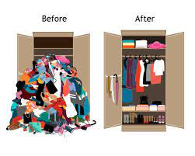
Much better!
Notes:
Read slide with students. Have students point out the differences between the two pictures. Ask how the “after” picture would help them find what they’re looking for.

Slide 11
2. Think about where you’re going
Does your school have a dress code? Wear clothes that follow the rules.
Are you going to a wedding or fancy party? Wear dressy or special occasion clothes.
Are you going to a funeral? Wear respectful clothes – nothing too bright or too casual.
Notes:
Read slide with students. Talk about how clothing choices need to fit the destination. Different clothes for different settings. Review each bullet point with students and discuss options.

Slide 12
Going to school?
what’s the dress code?
can you wear ripped jeans? how ripped?
what about shorts? how short?
how long do skirts and dresses need to be?
are sandals okay? what about flip flops?
Notes:
Read slide with students. Talk about each bullet point. Ask students for their experiences.

Slide 13
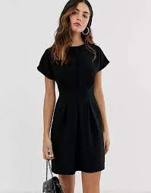
Going to a funeral?
Notes:
Read slide with students. Talk about the pictures and ask students for their thoughts. Why are the outfits on the right more appropriate?

Slide 14
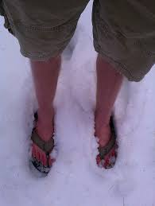
3. Check the weather!
What would make them more comfortable?
Notes:
Read slide with students. Discuss why the weather forecast can help us decide what to wear. What should the people in the pictures be wearing instead?

Slide 15
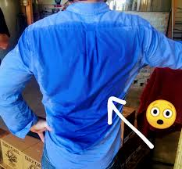
What would make them more comfortable?
Notes:
Read slide with students. Talk about each picture. What do the students notice. What would make the people more comfortable?

Slide 16
4. Check the fit
too small? too big?
too short? too long?
Notes:
Read slide with students. Talk about each picture. Ask if this has ever happened to them. Were they able to solve the problem? How?

Slide 17
5. Plan the night before
Mornings are so busy. You’re rushing around trying to eat breakfast, shower and brush your teeth, gather your school stuff – so much to do!
Wouldn’t it be easier to choose your outfit for the next day before you go to sleep?
Notes:
Read slide with students. Explain that being prepared can take the hassle out of the morning so planning clothing the night before is a good idea.

Slide 18
6. Choose comfort!
Who wants to wear clothing that is too scratchy, too hot, or too tight?
Pick clothes that let you move and sit comfortably.
Notes:
Read slide with students. Ask if they’ve ever been bothered by their clothing. Were they able to fix the problem? How?

Slide 19
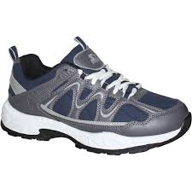
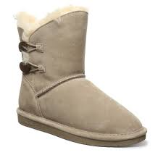
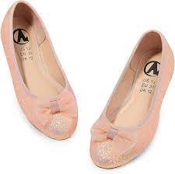
7. Pick the right shoes
will you be doing a lot of walking?
is it Gym day at school?
is it cold or rainy?
Which shoes should you choose for each?
Notes:
Read slide with students. Talk about each bullet point and how the right shoes can make each situation more comfortable. Ask which shoe picture would match the above situations.

Slide 20
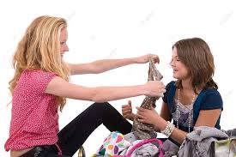
8. Ask family and friends
If you’re not sure about your clothes, ask your family and friends for feedback
Notes:
Read slide with students. Explain that getting other opinions can help you make the right clothing choices – especially if you’re uncertain.

Slide 21
8 Tips to Help Choose the Right Clothes
Organize your closet and drawers
Think about where you’re going
Check the weather
Check the fit
Plan the night before
Choose comfort
Pick the right shoes
Ask family and friends
Notes:
Read slide with students. Review each bullet point and ask students to explain the tips in their own words.

Slide 22
So…What do YOU think?
You’re going to your first school dance and you truly don’t know what to wear.
What can you do?
Notes:
Read slide with students. Remind them of the 8 tips they learned in the lesson to help them answer the question.

