Slide 1
I Can Learn Self-Advocacy!
Notes:
Read slide with students. Explain that today’s lesson is about self-advocacy. Ask students if they know what self-advocacy means.

Slide 2
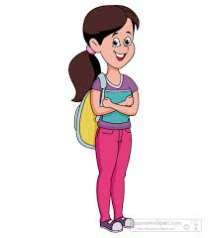
What is Self-Advocacy?
the ability to speak up for yourself!
Notes:
Read slide with students. Read the simple definition of self-advocacy. Ask students what “speaking up for yourself” means.

Slide 3
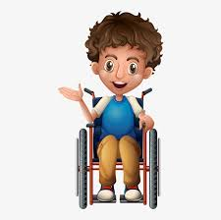
Speak up for myself??
Ask for what you need and want
Come up with a plan to achieve your goals
Notes:
Read slide with students. Click to bring in conversation balloons.

Slide 4
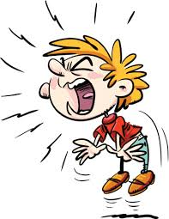
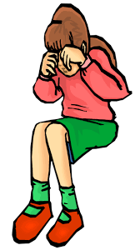
How do you speak up for yourself?
Do you…
cry or shut down?
yell?
say nothing?
Notes:
Read slide with students. Ask students to describe the pictures – what do they see? Ask if they’ve ever done any of these.

Slide 5
What happens if you yell, or cry, or shut down, or say nothing?
do you get what you need?
do you solve the problem?
do you help others understand what you want?
does it make you feel better?
or
Notes:
Read slide with students. Ask if these reactions help them get what they need or feel better. Yes or no?

Slide 6
So…
Speaking up for yourself
SELF-ADVOCACY!
Notes:
Read slide with students. Explain that speaking up for yourself can help you get what you need. That’s “self-advocacy”!

Slide 7
Did you know…?
People who self-advocate:
have more confidence in themselves
know how to properly express their feelings
are empowered to make their own decisions
enjoy life more!
adapted from covey.org
Notes:
Read slide with students. Explain the benefits of self-advocacy.

Slide 8
Sound good? Here’s how!
3 Parts of Self-Advocacy
adapted from covey.org
Notes:
Read slide with students. Explain that students will learn the 3 Parts of Self-Advocacy so that they can speak up for themselves.

Slide 9
1. Know Yourself
what are your strengths?
what are your challenges?
what do you need?
what are your goals?
learn about your disability
adapted from covey.org
Notes:
Read slide with students. Talk about “knowing yourself” so that you have a good understanding of your skills and challenges. Ask students about their goals – both near and far. Talk about educating yourself about your disability so that you learn as much as you can. Explain that understanding the disability helps you recognize its impact on your learning.

Slide 10
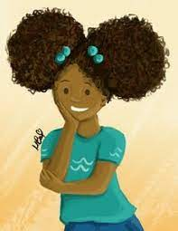
Hmm…I’m a good reader, but math is kind of hard for me. I should talk to my teacher and ask her for help with word problems. Those are tricky!
Notes:
Read slide with students. Point out how the girl acknowledges her strength in reading but also her challenge in math. Emphasize how she specifies her difficulty with word problems AND that she knows she should talk to her teacher for help.

Slide 11
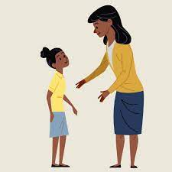
2. Know Your Needs
figure out what you need and want and ask for help
We can practice highlighting the important information in each word problem.
Word problems are hard for me. I need some tips. Can you please help?
Notes:
Read slide with students. Again, point out how the student specifically asks for help by stating what’s hard for her and what she needs. Also show how the teacher responds favorably because she understands what the student wants.

Slide 12
3. Know How to Get What You Need
who can help you?
where can you learn more about your disability?
how can you bridge the gap between your strengths and challenges?
Notes:
Read slide with students. Explain that these are the 3 things to figure out in order to self-advocate

Slide 13
Let’s practice with who to ask for help
Let’s say…
You could ask…
you want to try out for the football team
you want to learn how to make friends
you want to get a cell phone
the team coach or other football players
your family, teacher, guidance counselor, siblings
???
Notes:
Read slide with students. Talk about the different scenarios and ask students to suggest options for the last one.

Slide 14
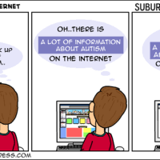
Where can you learn about a disability?
your family
websites
books
articles
Notes:
Read slide with students. Talk about the various resources available to learn about a disability. Ask students if they want to share what they know about their own disability. Where did they go to learn about it.

Slide 15
How can you bridge the gap between your strengths and challenges?
Talk with your family, teachers, and therapists about strategies that work for you
If you have an IEP, ask that these strategies be included
Request specific tools and accommodations that help you accomplish a task (like audio books if you’re not a strong reader, or a graphic organizer to help you with a writing assignment)
Notes:
Read slide with students. Explain that they are a valuable source of information that enables others to better understand their strengths and needs. Ask for examples of strategies that they find helpful. Encourage the students to share these with their families and teachers so that everyone is aware of how to help.

Slide 16
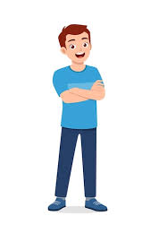
New challenges can happen any time. Don’t be afraid to self-advocate!
I know what I need and I know who to ask!
Notes:
Read slide with students. Remind them that new challenges can crop up at any time so they need to get comfortable advocating for themselves.

Slide 17
3 Parts of Self-Advocacy
Know yourself
Know your needs
Know how to get what you need
Notes:
Read slide with students. Remind students of these 3 key points for Self-Advocacy.

Slide 18
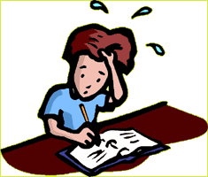
So…what do YOU think?
Lately it’s been really hard for you to keep up with taking notes in science class. Every one else seems to be doing okay but you’re really struggling.
What can you do?
Notes:
Read slide with students. Ask for their solutions to this situation. Remind them of the 3 Parts of Self-Advocacy they learned in today’s lesson and encourage them to apply these to the scenario.

