Slide 1

I Can Get Organized!
Notes:
Read slide with students. Explain that today’s lesson is about getting ORGANIZED.

Slide 2

What does “getting organized” mean?
keeping the things that I need handy
making sure my locker is neat
taking the right books to class
remembering to bring my homework back to school
Notes:
Read slide with students. Click to bring up the different quotes. Let students take turns reading them.

Slide 3

What do YOU think “getting organized” means?
Notes:
Read slide with students. Ask them to share their own examples.

Slide 4

the dictionary says
“getting organized”
means putting different parts of something in a certain order so that they can be found or used easily!
Notes:
Read slide with students. Define “getting organized” and talk about why this is important.

Slide 5
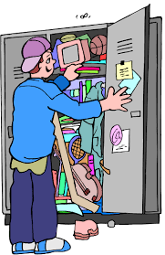
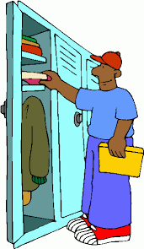
Which locker is organized?
this one?
or this one?
Notes:
Read slide with students. Ask them to choose which locker is organized. What do they see in each one? Ask them to share what their lockers look like.

Slide 6
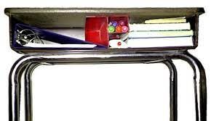
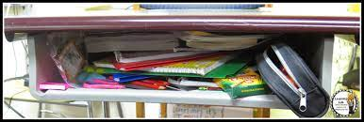
Which desk is organized?
Notes:
Read slide with students. Ask them to choose the organized desk. Ask them to share what their desks look like. Ask them why they think being organized is important.

Slide 7

if you have a messy locker, can you find what you need?
help!
Notes:
Read slide with students. Talk about the picture – what do they see? What does the expression on the girl’s face tell us?

Slide 8
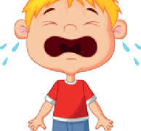
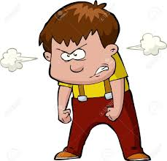
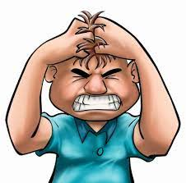
How do you feel when you can’t find what you need?
Notes:
Click to bring in pictures and ask students what the expressions tell us. Ask if they’ve ever felt like these people when they couldn’t find what they need. How did they handle it?

Slide 9
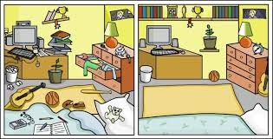
What about at home?
would you rather sleep here?
or here?
Where could you study or get your homework done
more easily?
Notes:
Read slide with students. Let them choose one of the bedrooms and tell why they chose it. Then ask them which room would make doing homework or studying easier. Why?

Slide 10
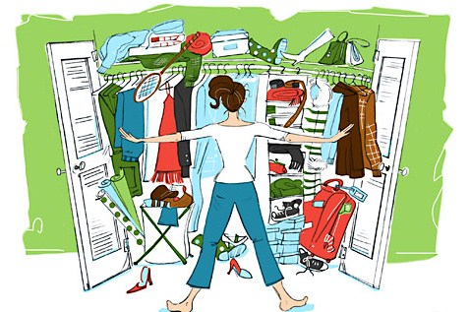

What about getting ready for school in the morning?
I can’t find my favorite jeans!
where’s my sweater?
what about my other boot?
Notes:
Read slide with students. Talk about the picture. What do they see? Ask how the girl might be feeling and why.

Slide 11
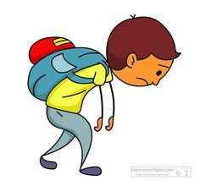
What happens when we’re not organized?
we can’t find things we need
we forget to bring materials to class
we may not hand in our work on time
we can get distracted
all of this can make us feel AWFUL!
Notes:
Read slide with students. Talk about the picture – how is the boy feeling? Ask them to share if this has ever happened to them and how did they feel.

Slide 12

7 Ways to Get Organized
Notes:
Read slide with students. Explain that they’ll learn 7 ways to get organized. Before going to next slide, ask the students to offer their own suggestions and write these down.

Slide 13

1. Get a pencil box or pouch!
keep your pencils, pens, scissors, glue sticks, highlighters etc. inside
keep track of your materials so that you can replace things when you run out
Notes:
Read slide with students. Ask if they use pencil boxes or pouches. What do they keep in them? Do they help?

Slide 14
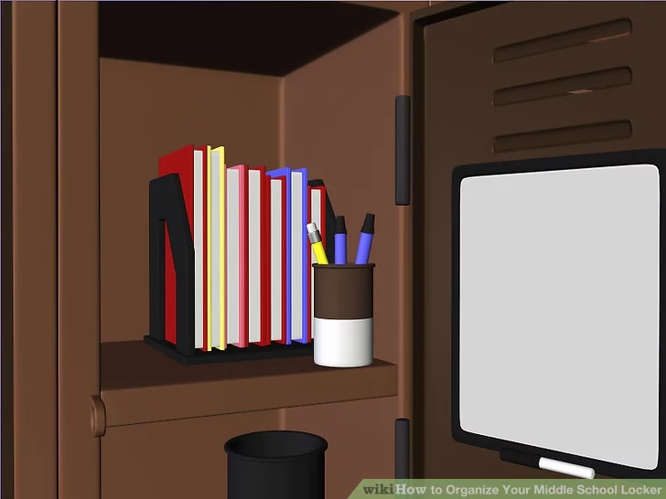
2. Keep your locker neat
use a cup for pencils and pens
add bookends to hold your books upright
put a dry-erase board and a marker on the inside of the door for notes to yourself
make sure to straighten out your locker frequently to keep it neat and tidy
Notes:
Read slide with students. Talk about the picture and ask if anyone has any of these organizers in their lockers. Do they help?

Slide 15
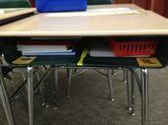
3. Keep your desk clean
try to keep your books on one side and your notebooks and folders on the other
ask if you can use tape to divide your desk into sections
keep your pencils and pens in a basket or pouch
clean out your desk regularly to keep it neat and tidy
Notes:
Read slide with students. Ask if they’ve ever tried to organize their desks this way. Did it help?

Slide 16
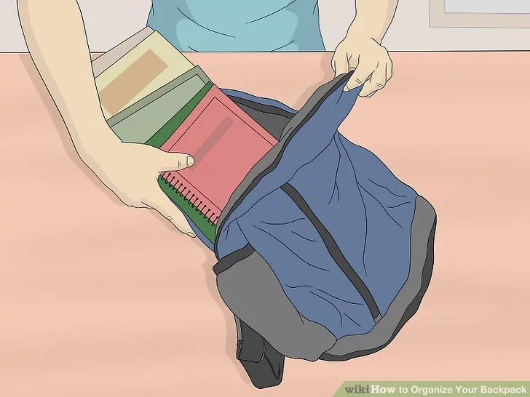
4. Manage your backpack
it’s easy for your backpack to get cluttered and out of control
try to check it every night – take out papers that are supposed to stay at home, throw away trash, and repack it for the next day
Notes:
Read slide with students. Ask how they take care of their backpacks. Does it help?

Slide 17
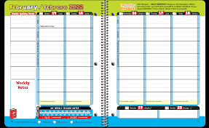
5. Use a planner or a checklist!
planners help you keep track of when assignments are due
you can also see upcoming test dates so you can study and be prepared
a checklist can help you stay on top of a lot of different tasks – cross off things as you complete them!
Notes:
Read slide with students. Ask if they use planners or agendas or checklists. Do they help?

Slide 18
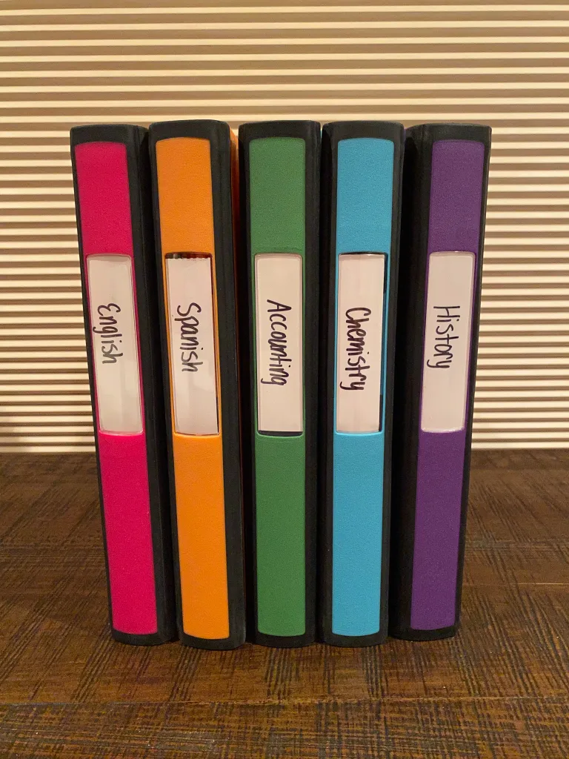
6. Color-code your binders or your notebooks
use different colors for different subjects
or use different colored dividers in one big binder
Notes:
Read slide with students. Ask if they’ve ever tried color-coding. Did it help?

Slide 19
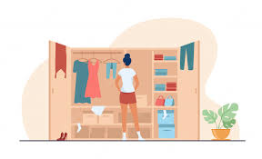
7. Pick out your clothes the night before
find out the weather for tomorrow
think about your classes – do you have gym the next day?
get everything ready so you can dress quickly in the morning
Notes:
Read slide with students. Ask if they make it a habit to choose their clothing the night before. How does that help the next morning?

Slide 20
7 Ways to Get Organized
Get a pencil box or pouch
Keep your locker neat
Keep your desk clean
Manage your backpack
Use a planner or a checklist
Color-code your binders or notebooks
Pick out your clothes the night before
ORGANIZE!
Notes:
Read summary slide with students. Ask if they plan to try any of these organizational strategies.

Slide 21

You did it! Now you’re organized!!
Notes:
Read slide with students. Talk about the picture and ask what the characters might be feeling now that they’re organized.

Slide 22
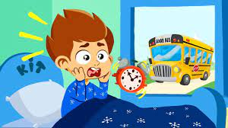
So…what do YOU think?
You slept through your alarm and now you’ll miss the school bus. Your mom will take you to school but she needs you to hurry because she has to get to work. What would make getting ready easier?
Notes:
Read slide with students. Ask them to apply the things they’ve learned in the lesson to this situation.

