Slide 1
ESY-Theme: Around the world- week of July 13th
Reading lesson – Katie Schmidt

Slide 2
Birthday traditions around the world
Birthday traditions are usually a family affair in the United States.
Whether it is a for a child or an adult there is usually a birthday cake.
The same number of candles will be on the cake which will be same age of the person.
Guests and family will sing to the honoree, Happy Birthday to you!
It is a special celebration with cake and ice cream and children will play games.

Slide 3
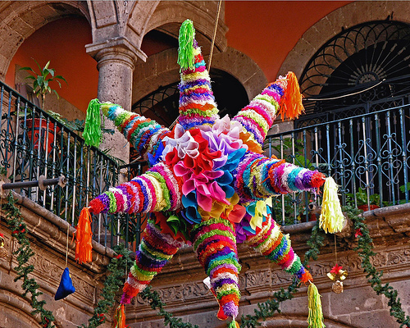
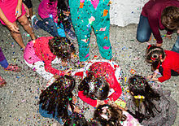
Birthday traditions around the world -Mexico
In Mexico, children celebrate their birthday with a pinata which is a large paper mâché shaped animal or favorite shape.
The pinata is filled with candy and treats.
The children are blind folded and hit the pinata with a stick until it breaks and gather up the treats on the ground.
This Photo by Unknown Author is licensed under CC BY-SA
This Photo by Unknown Author is licensed under CC BY-SA-NC

Slide 4
Birthday traditions around the world -china
Many citizens in China celebrate two birthdays-one on the solar calendar and one on the lunar calendar.
The Chinese think the first birthday is important-at the celebration they will put the baby in the group and which toy/object they will pick up is their future.
They eat noodles on their birthday to symbolize long life.

Slide 5
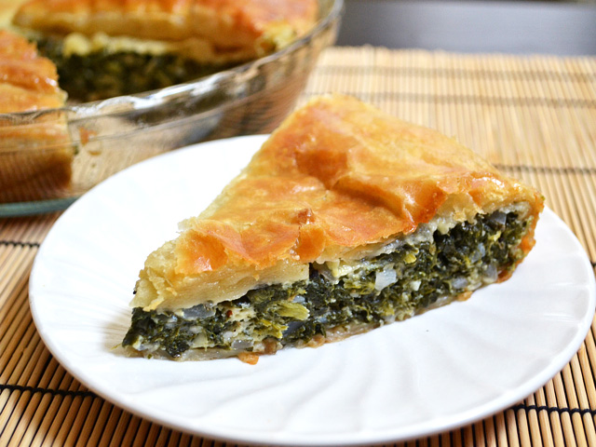
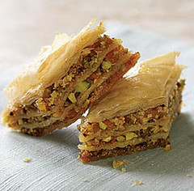
Birthday traditions around the world-Greece
A Greek family celebrates each month the baby is born until they are one year old.
They serve Greek deserts like baklava and spinach pie and celebrate birthdays like American traditions.
This Photo by Unknown Author is licensed under CC BY-NC
This Photo by Unknown Author is licensed under CC BY-NC

Slide 6
Birthday traditions around the world- Denmark & Australia
Flags are flown outside of the window’s whose birthday it is for that day.
Presents are placed at the bed too.
Big celebrations for “round birthdays” which are the ages of twenty, thirty, forty and so on.
In Australia –Barbeques are birthday celebrations with fairy bread for the children covered with butter and sprinkles.

Slide 7
Birthday traditions around the world-Africa
In Kenya- a mother gives the name of the baby when she straps the baby around her back and is inside the cattle enclosure.
Children learn dancing, singing, customs and beliefs of their tribes when they reach a certain age.
Lots of singing and dancing in the Egyptian home for birthday celebrations.

Slide 8
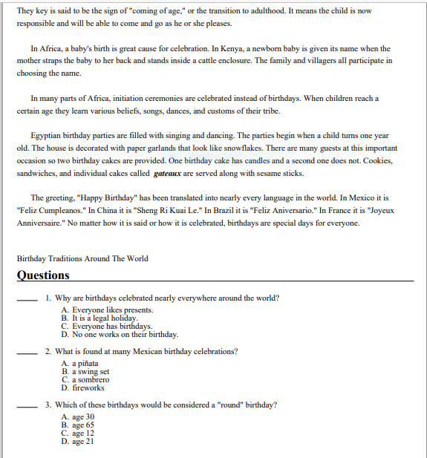
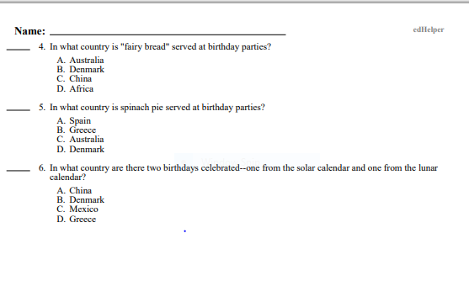
Birthday traditions around the world reading comprehension and questions

Slide 9
Resources and references
www.edhelper.com/birthdaytraditionsaroundtheworld
Email completed work to – kschmidt@thewatsoninstitute-fa.org

