Slide 1
Solid Figures
Geometry

Slide 2
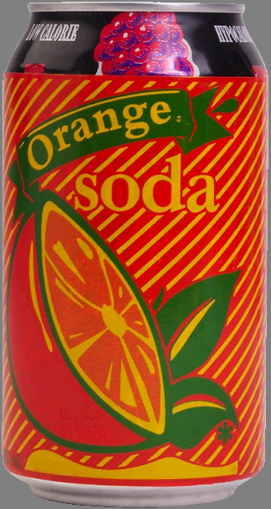
What solid figure is shown?
cylinder

Slide 3
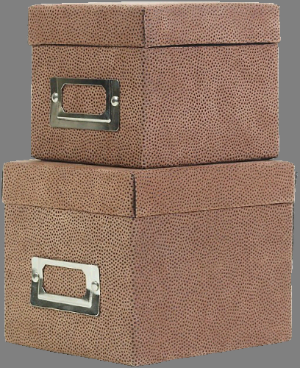
What solid figure is shown?
Rectangular prism

Slide 4
What solid figure is shown?
sphere

Slide 5
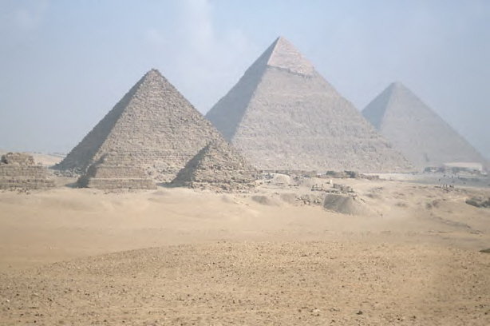
What solid figure is shown?
pyramid

Slide 6
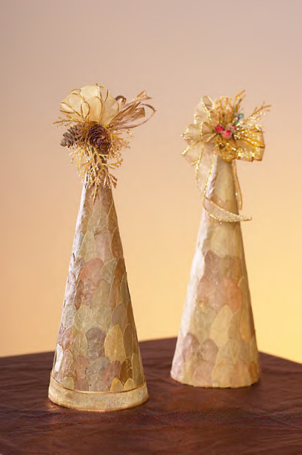
What solid figure is shown?
cone

Slide 7
sphere
What solid figure is shown?

Slide 8
What solid figure is shown?
Rectangular prism

Slide 9
sphere
What solid figure is shown?

Slide 10
What solid figure is shown?
cube

Slide 11
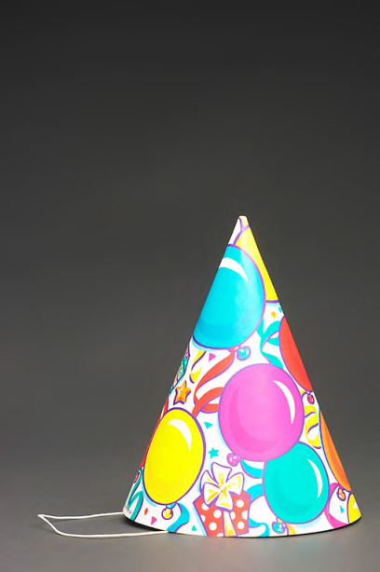
What solid figure is shown?
cone

Slide 12
What solid figure is shown?
sphere

Slide 13
What solid figure is shown?
cube

Slide 14
Look for geometric solids all around you!

