Slide 1
Calculating Perimeter
ESY High School Math
July 20th-July 23rd

Slide 2
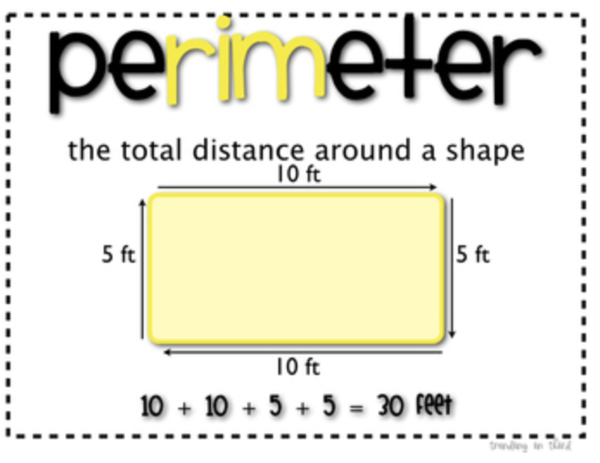
What is Perimeter
A perimeter is a path that encompasses/surrounds a two-dimensional shape. The term may be used either for the path, or its length—in one dimension. It can be thought of as the length of the outline of a shape. The perimeter of a circle or ellipse is called its circumference. Wikipedia

Slide 3
What is the formula for calculating perimeter
The formula for the perimeter of a rectangle is often written as P = 2l + 2w, where l is the length of the rectangle and w is the width of the rectangle. The area of a two-dimensional figure describes the amount of surface the shape covers. You measure area in square units of a fixed size.

Slide 4
The perimeter of a circle
Circumference of the circle or perimeter of the circle is the measurement of the boundary across any two-dimensional circular shape including circle. ... If we open a circle and make a straight line out of it, then its length is the circumference.

Slide 5
Perimeter of a triangle
Perimeter of a triangle. The perimeter of a triangle is the sum of all its three sides. We can work out the perimeter using the following formula: Perimeter of a triangle = sum of all three sides.

Slide 6
Examples of perimeters of polygons

