Slide 1
Calculating Area
ESY High School Math
July 13th-July 16th

Slide 2
What is area
The simplest (and most commonly used) area calculations are for squares and rectangles. To find the area of a rectangle, multiply its height by its width. For a square you only need to find the length of one of the sides (as each side is the same length) and then multiply this by itself to find the area.

Slide 3
What is Calculating Area good for
Area is a measure of how much space there is inside a shape. Calculating the area of a shape or surface can be useful in everyday life – for example you may need to know how much paint to buy to cover a wall or how much grass seed you need to sow a lawn.

Slide 4
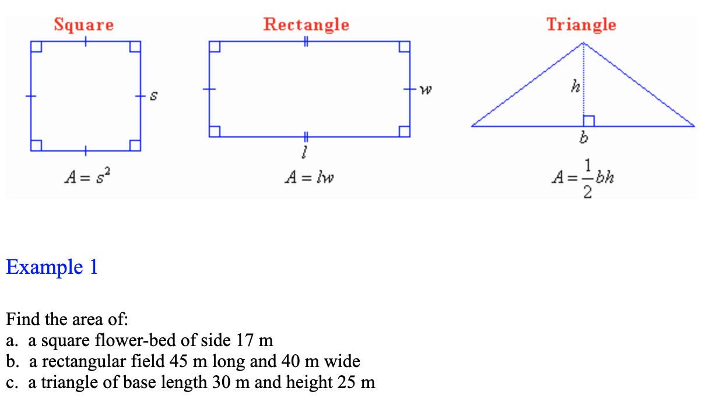
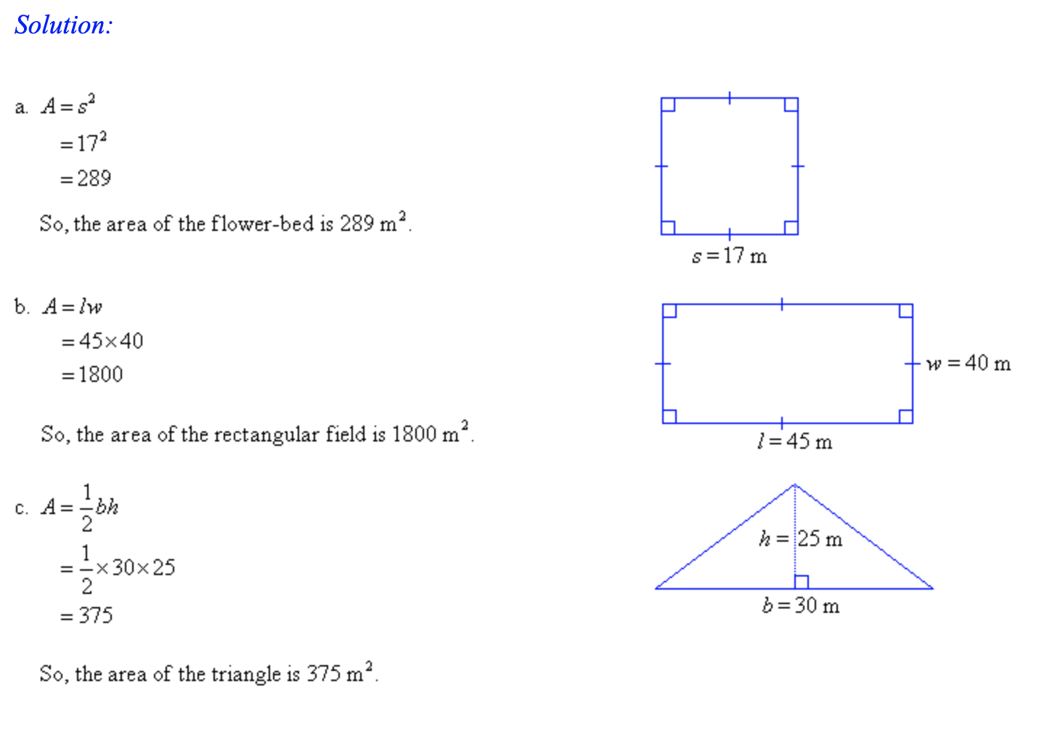
Calculating the Area of a Square, Rectangle and Triangle

Slide 5
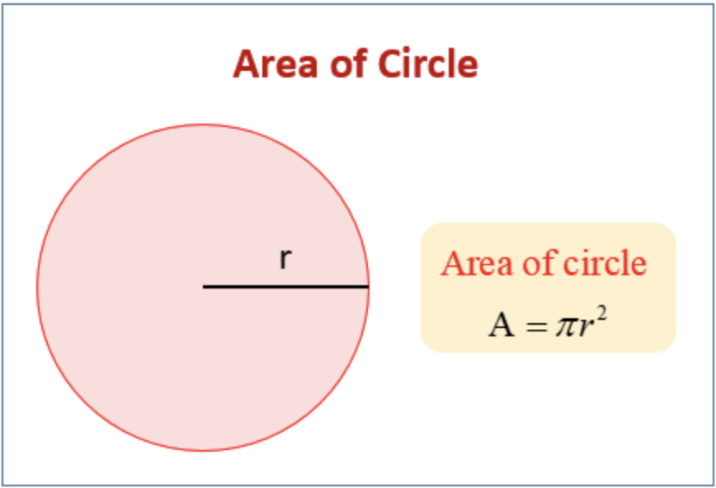
Calculating the Area of a Circle
To find the area of a circle with the radius, square the radius, or multiply it by itself. Then, multiply the squared radius by pi, or 3.14, to get the area. To find the area with the diameter, simply divide the diameter by 2, plug it into the radius formula, and solve as before.

