Slide 1
Science Lesson 7
LS Classrooms – 229 and 311
Ms. O office hours – Monday, Wednesday, Thursday 11-12 Email – koslosky@thewatsoninstitute-fa.org
Phone – 412-307-7054

Slide 2
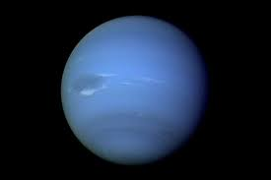
Uranus 7th planet from the sun

Slide 3
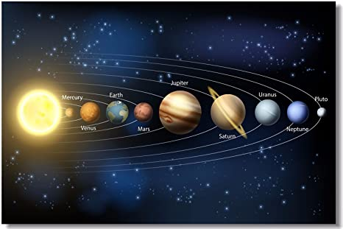
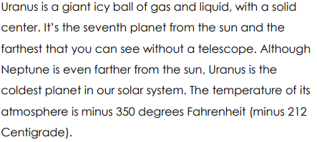

Slide 4
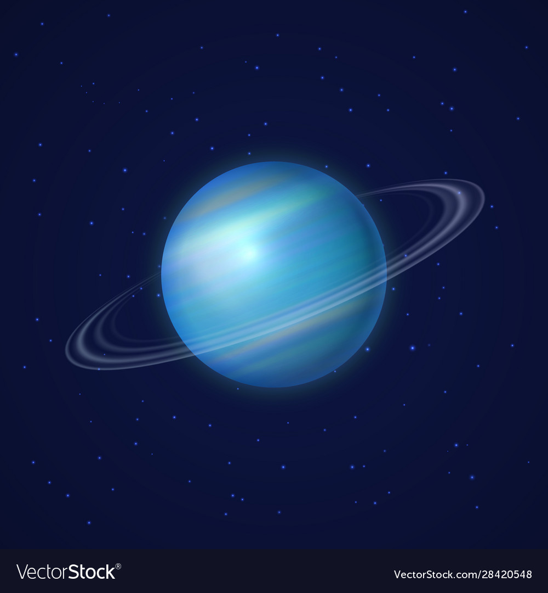

Slide 5
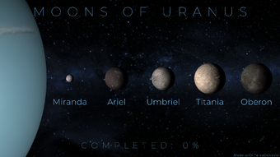
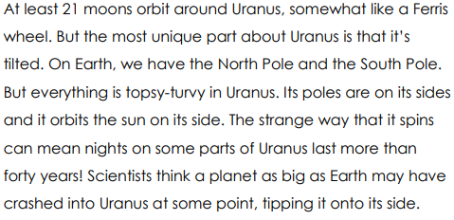

Slide 6
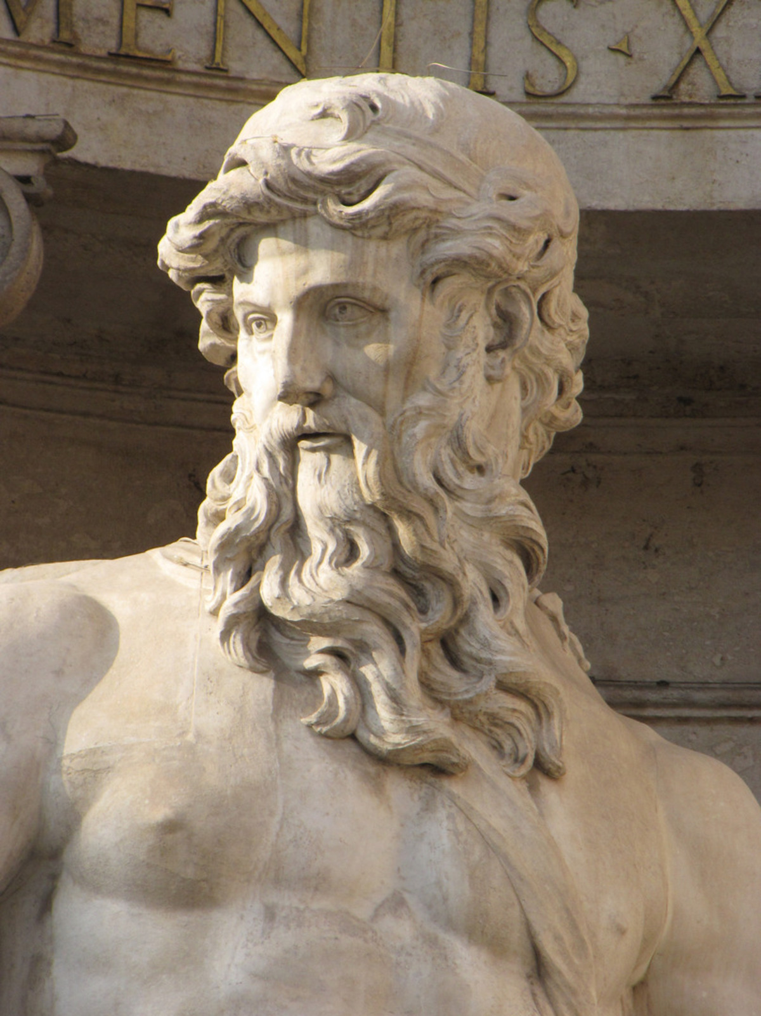

Slide 7
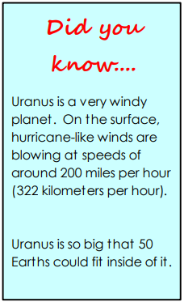

Slide 9
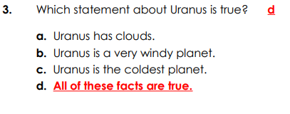

Slide 10
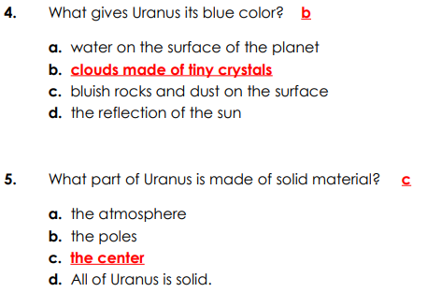

Slide 11
Thank you and stay safe!

