Slide 1
Science Lesson 5
LS Classrooms – 229 and 311
Ms. O office hours – Monday, Wednesday, Thursday 11-12 Email – koslosky@thewatsoninstitute-fa.org
Phone – 412-307-7054

Slide 2
Jupiter

Slide 4
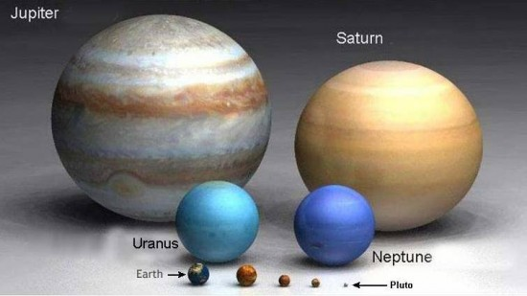

Slide 5
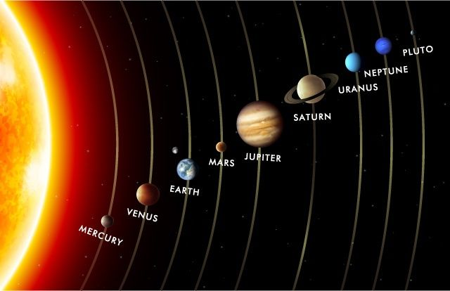

Slide 6
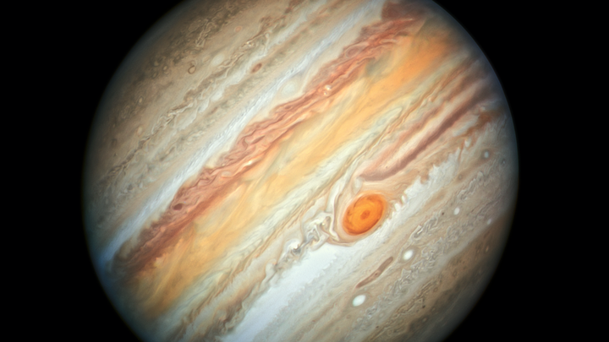

Slide 7
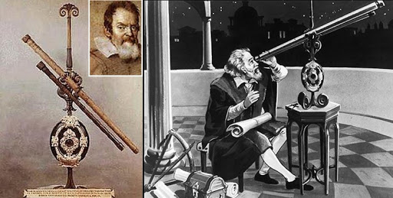
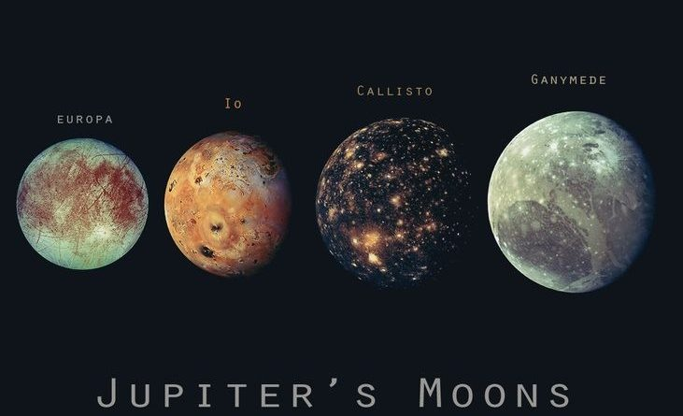

Slide 8
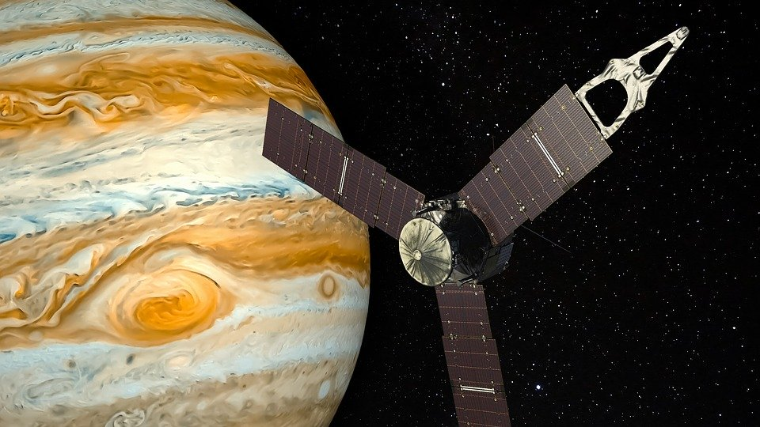

Slide 9
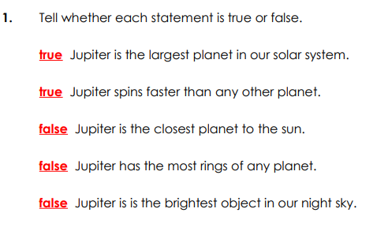

Slide 10
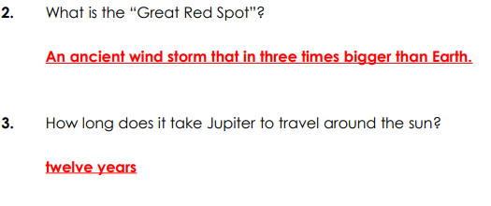

Slide 11
410 years ago

Slide 12
Thank you and stay safe

