Slide 1
Math Lesson 7
LS Classrooms – 229 and 311
Ms. O office hours – Monday, Wednesday, Thursday 11-12 Email – koslosky@thewatsoninstitute-fa.org
Phone – 412-307-7054

Slide 2
Fractions

Slide 4
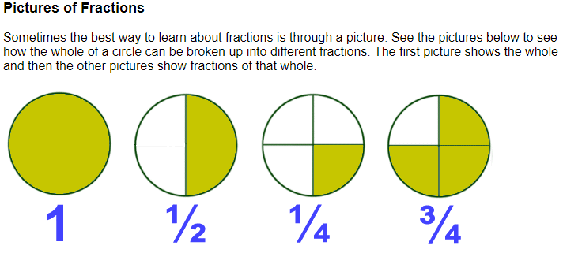

Slide 9
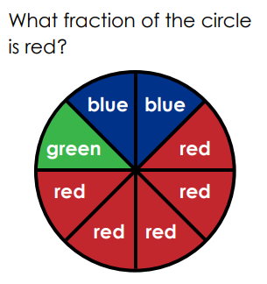
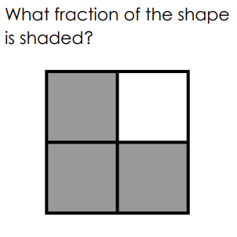
5 8
3 4

Slide 10
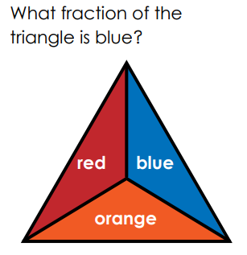
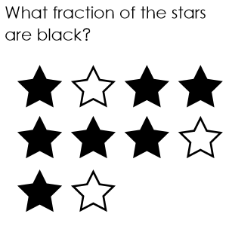
1 3
7 10

Slide 11
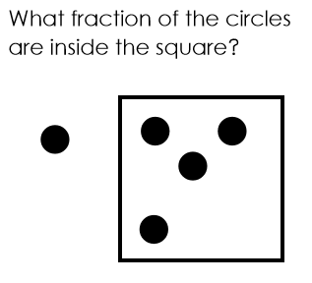
7 10
4
5

Slide 12
Thank you and stay safe

