Slide 1
Math – Analog Clock
Ms. Caristo – Office Hours – Monday 10-11; Wednesday 11-12; Thursday 1-2
Phone Number – 412-400-7350

Slide 2
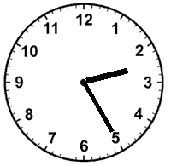
How to tell what hour it is?
We look at the shortest hand. What number is it at of just past? All hands will move from the smaller numbers to the larger numbers, except when they reach 12. Then they go toward the 1. Look at the clock – What number is the shortest hand at or just past? Did you say 2?
Yes, the shortest hand is pointing just past the 2.. We are in the 2nd hour.

Slide 3
How to tell minutes?
We do not use the numbers to tell minutes, we count the small tick marks. There are 4 tick marks between each of the numbers – this is 4 minutes. The numbers on the clock are 5 minutes –
1=5, 2=10, 3=15, 4=20, 5=25, 6=30, 7=35, 8=40, 9=45, 10=50, 11=55 and 12 = 0 also called o’clock. Look at the clock. How many minutes is the longer hand saying?
Did you say 20? Yes, it is pointing to the 5 which is 20 minutes (count the small ticks.

Slide 4
So what time does the clock say?
The shortest hand is pointing just past the 2 and the longer hand is pointing to the 5. This reads as 2:20.
Let’s practice a few more together.

Slide 5
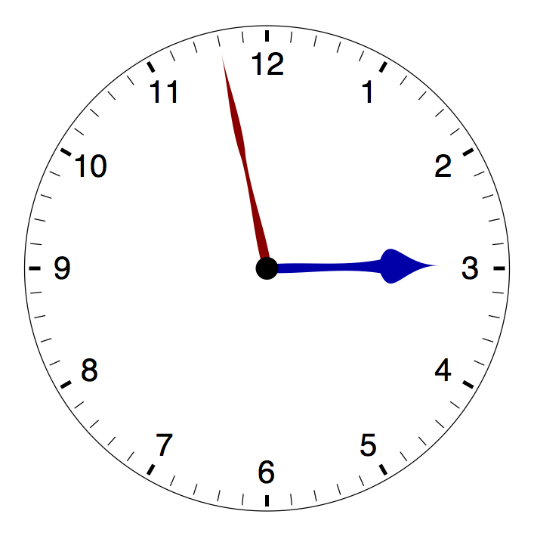
What time does the clock say?
The shortest hand is pointing to or just past? Did you say 2? Yes, it is the 2nd hour. The minute hand has not yet reached the 12.
The longer hand is pointing to or just past? Remember to count by 5’s around the numbers 1=5, 2=10, etc. 11=55 then count the small ticks – 56, 57, 58. That’s right 58 minutes.
The clock says 2:58 or 2 minutes to 3:00.

Slide 6
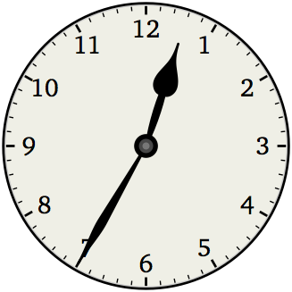
What time does the clock say?
The shortest hand is pointing to or just past? Did you say 12? That is right it is the 12th hour.
The longer hand is pointing to or just past? The 7 – remember to count by 5’s starting at the 1. How many minutes? Did you say 35? That’s right!
The clock says 12:35.
Great Job! Practice on your own using the 4 pages in the work packet. Call me during my office hour if you need help and remember to return your work by mail, drop-off or emailed photos. See you next week – Have a good one!

