Slide 1
Math K-2
Shapes

Slide 2
Name That Shape!!
I have four sides. Two of my sides are short. Two are long.
Circle
Rectangle
I have no sides at all. I go round and round.
I have three sides.
Triangle

Slide 3
Name That Shape!!
Diamond
I have four sides. You can find me in a deck of cards or on a baseball field.
I have four sides. Each side is the same.
Square

Slide 4
Symmetry!
https://www.youtube.com/watch?v=YFzktJNmnPU
Symmetry – what is symmetry? Symmetry is is when a shape or object has two completely identical sides that are either facing each other or are around an axis. A line of symmetry is the line that divides the two identical parts, each part being a mirror reflection of the other

Slide 5
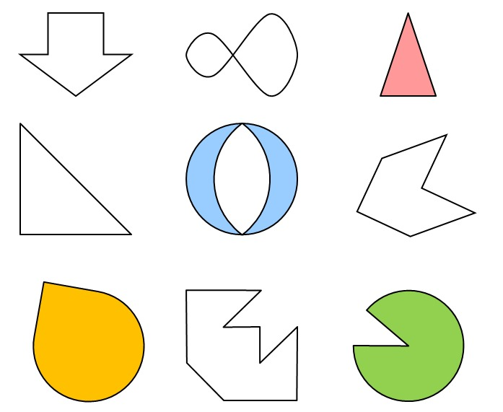
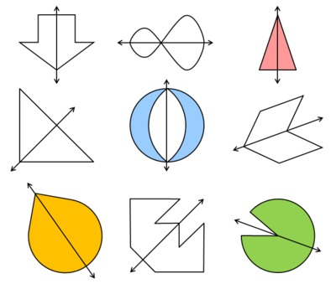
How Many Shapes Are Symmetrical?
If you said ALL of the shapes you are correct!!!

Slide 6
To Do:
Work
Contact Info
Two math worksheets
Name That Shape!
Same Shape
Ms. Ostrander
nostrander@thewatsoninstitute-fa.org
724-278-3545
Office Hours
T – W – R @ 10-11am

