Slide 1
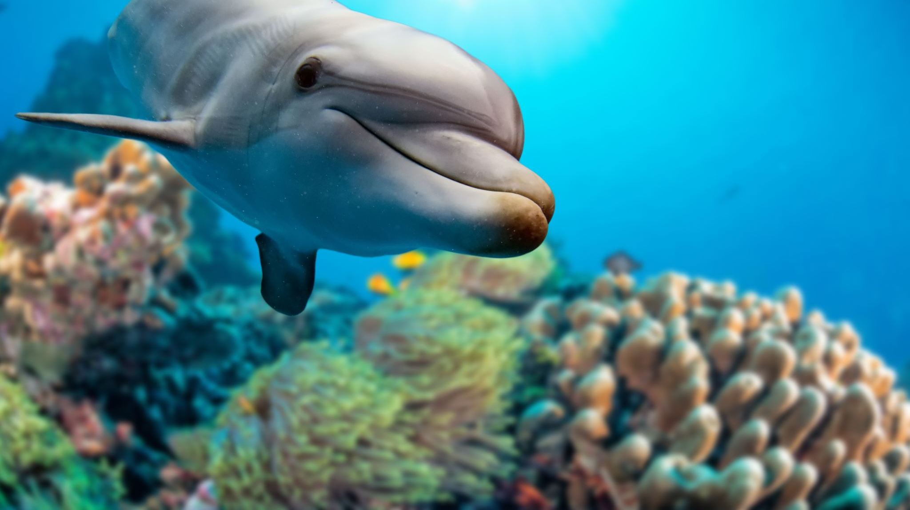
The Dolphin
ESY High school Science
Week of June 29th-July 2nd
This lesson is all about Dolphins…Enjoy!!!!

Slide 2
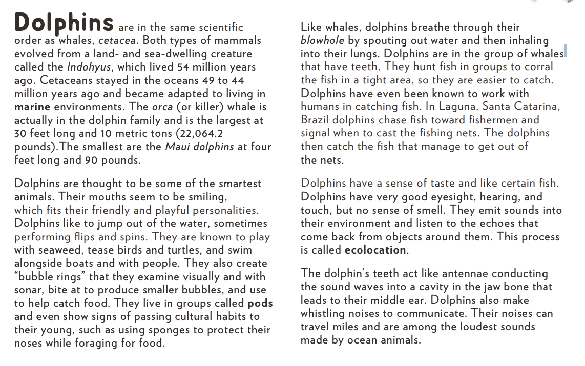
Facts About Dolphins

Slide 3
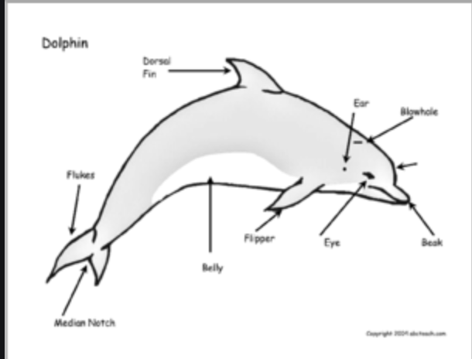
Dolphin
Anatomy

Slide 4
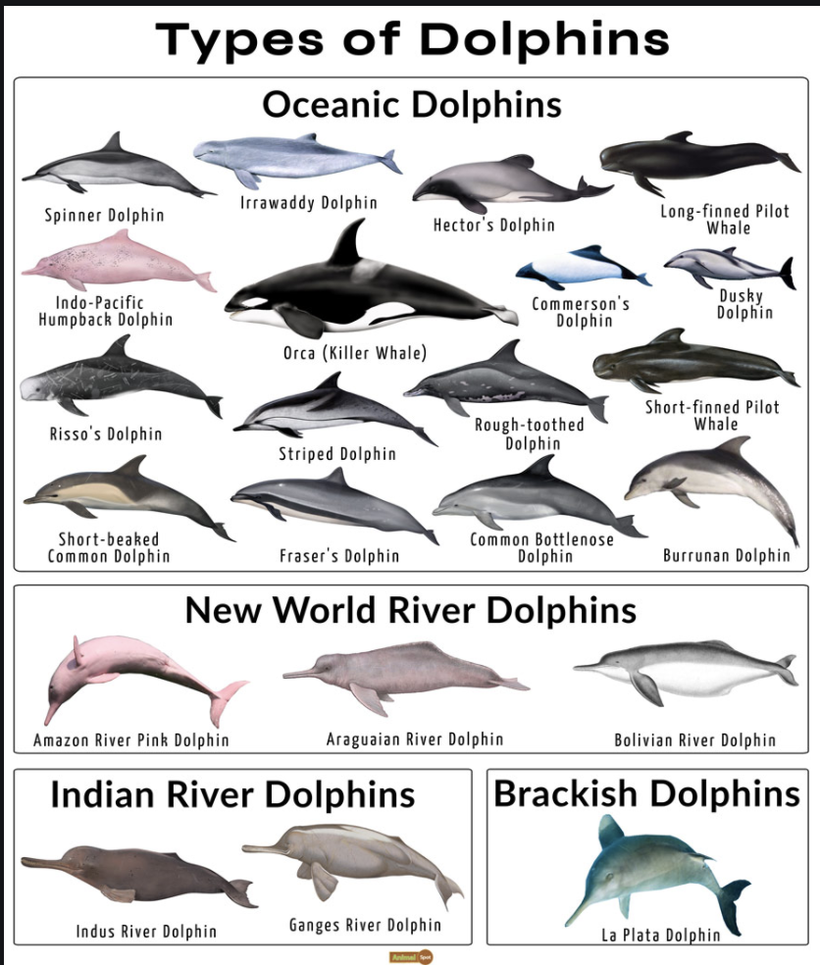
How Many Types of Dolphins are there???

Slide 5
Is the Porpoise the same as the dolphin?

