Slide 1
Mrs. Smyda’s office hours Monday 12-1pm Tuesday 12-1pm Thursday 12-1pm
Phone: 412 437-8451

Slide 2
What can I say??
and how to say it…

Slide 3
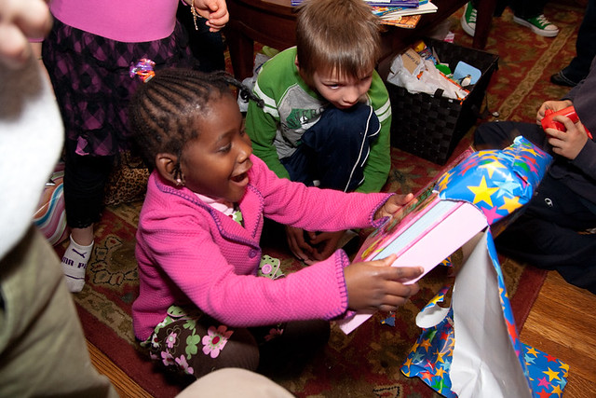
“How do I feel when……” A friend or a classmate gets something that I really want

Slide 4
Some of us feel

Slide 5
When we are SAD and MAD
We have a mean look or we
yell, hit, and run away

Slide 6
THEN..
A grown up tell us that we are wrong to feel like that and now, we get embarrassed

Slide 7
Just remember that it is OK to have these feelings
OK

Slide 8
We can say or think….
I want that for myself!!!

Slide 9
We need to remember to use our words to tell someone how we are feeling

Slide 10
When we are real with our own feelings we use the word “I”
I am sad my friend got something I wanted
I want that for myself
I am embarrassed in how I acted and that makes it worse

Slide 11
When we are real with our feelings
I am mad
I am afraid
I am scared
I need help

Slide 12
Our grown up will understand
And… they can help

Slide 13
They will help us feel better

