Slide 1
Animals of land and water
Ms. Martis
Elementary science lesson – June 29th - July 3rd

Slide 2
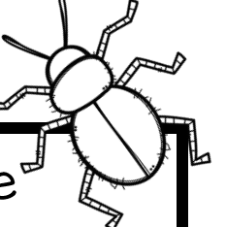
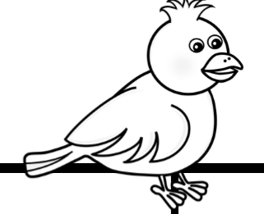
Directions
Fill out can/have/are chart with provided words
Write parts of the animal’s body
Turn it in: drop off, mail, or text/email photo

Slide 3
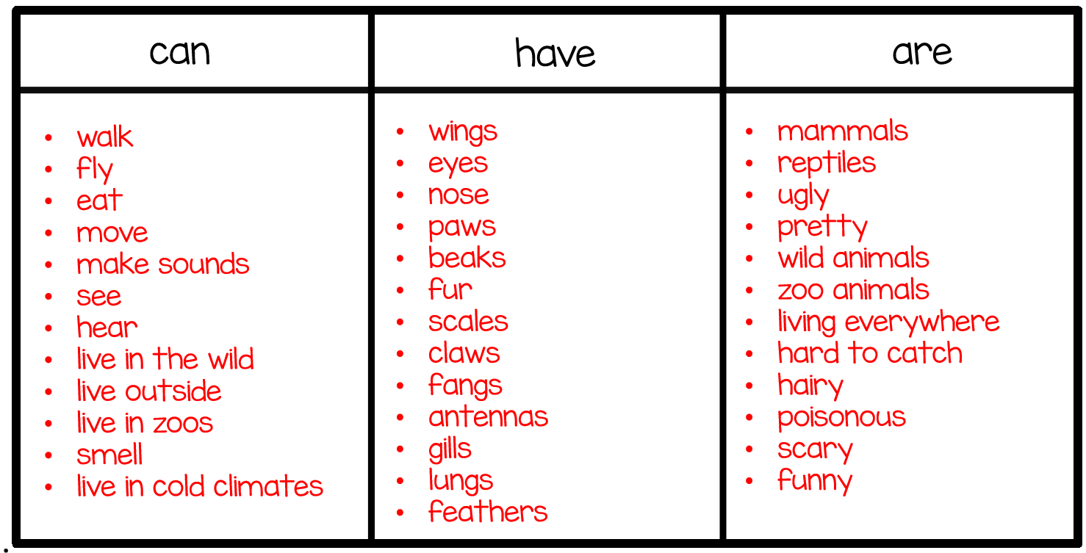
Use the words in this chart to fill out your own can/have/are chart. Choose 3 words from each chart to describe your animal.

Slide 4
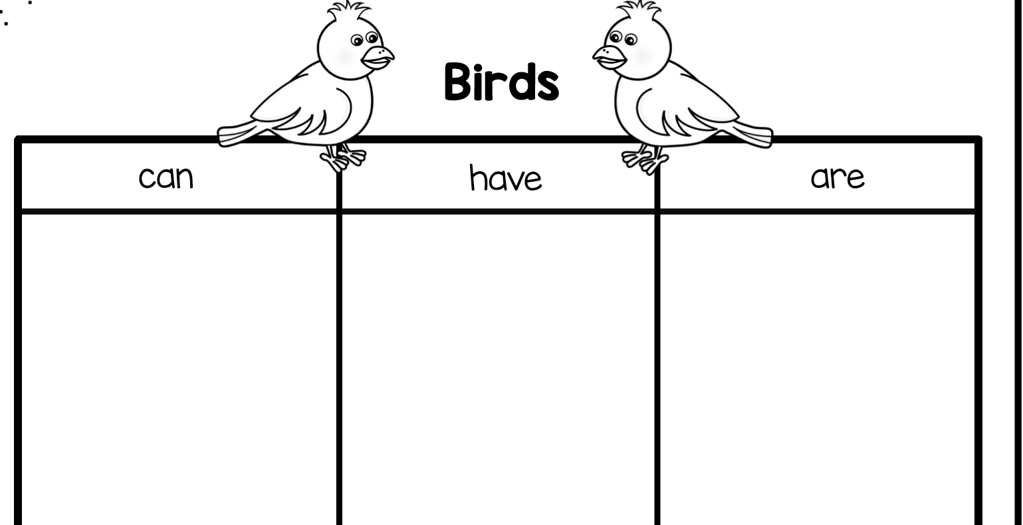
CAN/HAVE/ARE CHART FOR BIRDS
FLY
EAT
LIVE OUTSIDE
WINGS
BEAKS
FEATHERS
WILD ANIMALS
ZOO ANIMALS
HARD TO CATCH

Slide 5
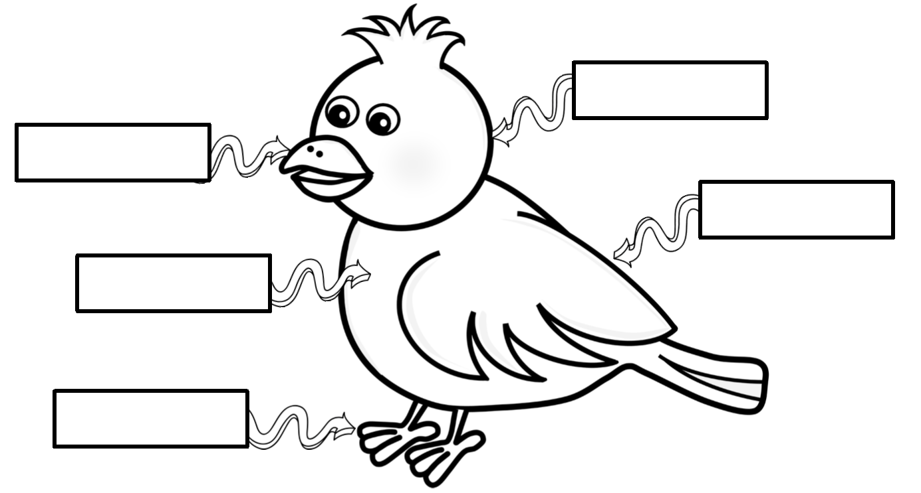
Word bank: foot, beak, body, wing head
HEAD
BEAK
WING
BODY
FOOT

Slide 6
YOUR TURN
FILL OUT YOUR CAN/HAVE/ARE CHART FOR THE PENGUIN AND FOR INSECTS (FOUND IN YOUR WORK PACKET)
FILL OUT THE PARTS OF THE ANIMAL’S BODY (FOUND IN YOUR WORK PACKET)
TURN IT IN (DROP OFF, MAIL IN, OR TEXT/EMAIL PICTURE)

