Slide 1
Science ESY Lesson 2
LS Classrooms – 229 and 311
Ms. O office hours – Monday, Wednesday, Thursday 11-12 Email – koslosky@thewatsoninstitute-fa.org
Phone – 412-307-7054

Slide 2
Venus
^{2nd} planet closest to our sun

Slide 3
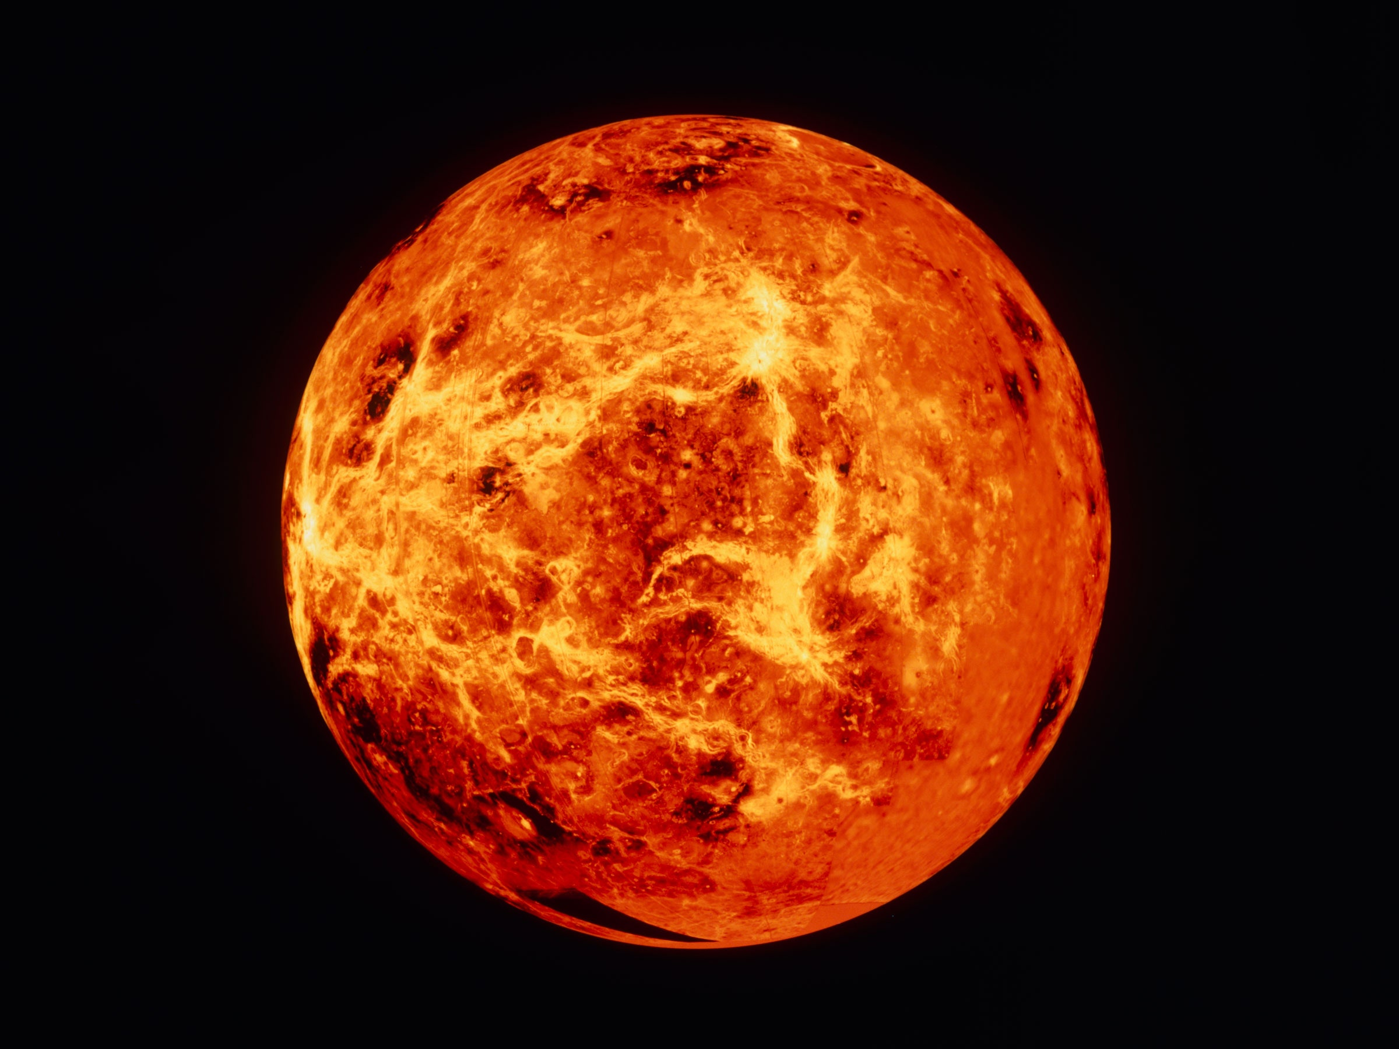

Slide 4
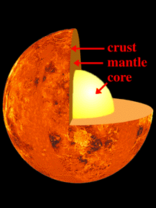

Slide 5
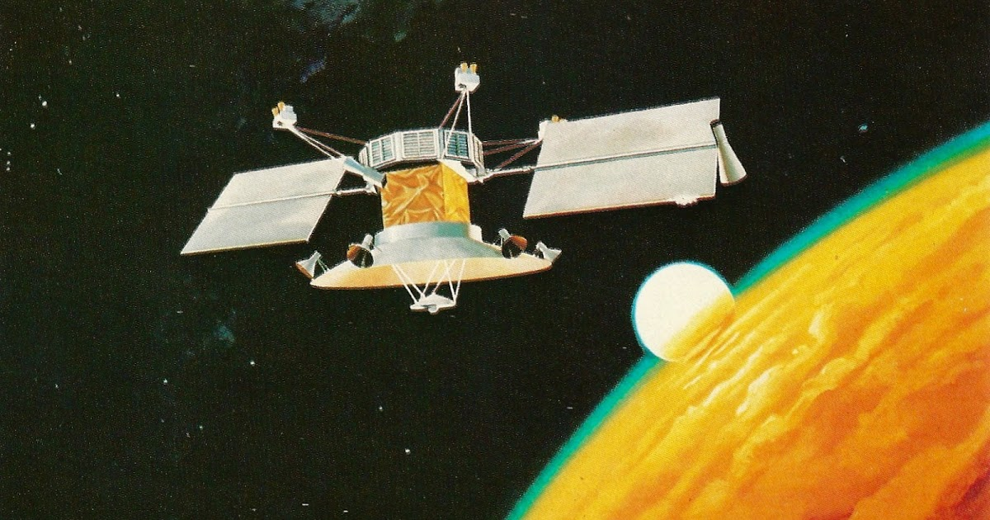

Slide 7
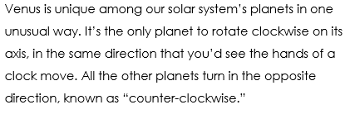

Slide 8
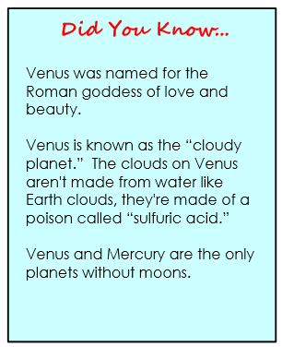
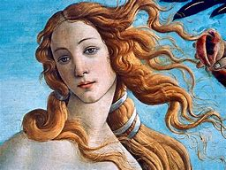

Slide 9
Questions

Slide 10
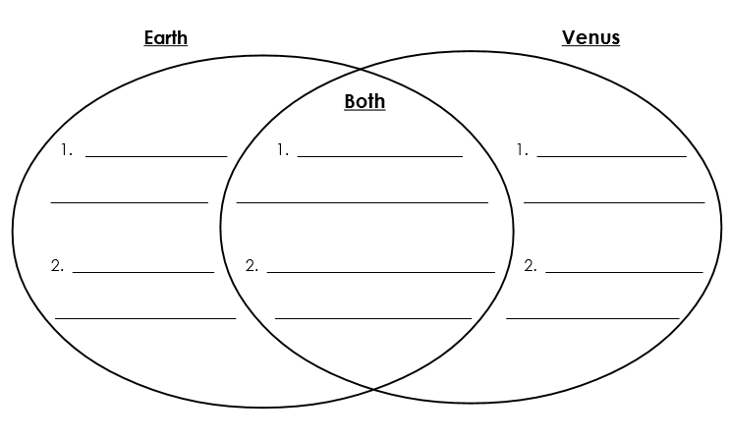
colder
Hotter
Has volcanos
Has water
About the
same size
No water

Slide 12
Thank you and stay safe!

