Slide 1
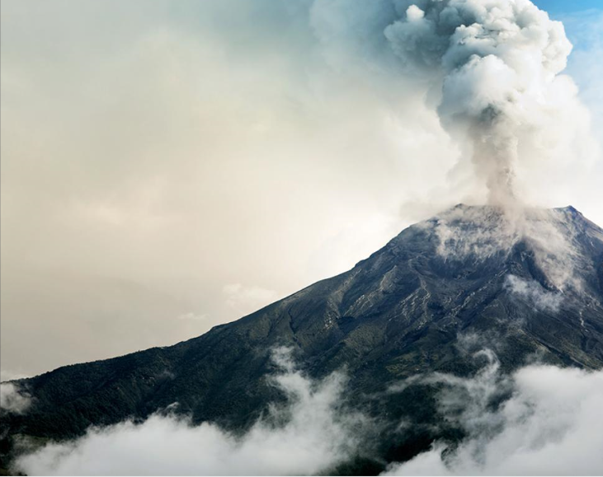
Volcanoes
LC2 Science By: Mrs. Bernsdorff

Slide 2
Day 1

Slide 4
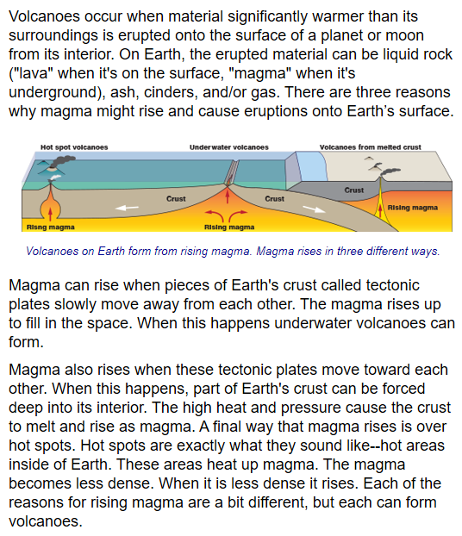

Slide 5
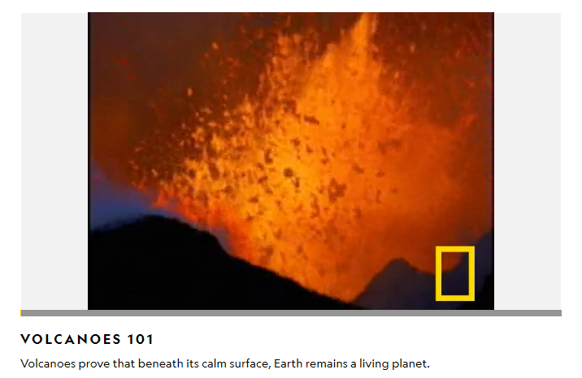
https://kids.nationalgeographic.com/explore/science/volcano/

Slide 6
Name ____________________
Volcanoes
1
2
3

Slide 7
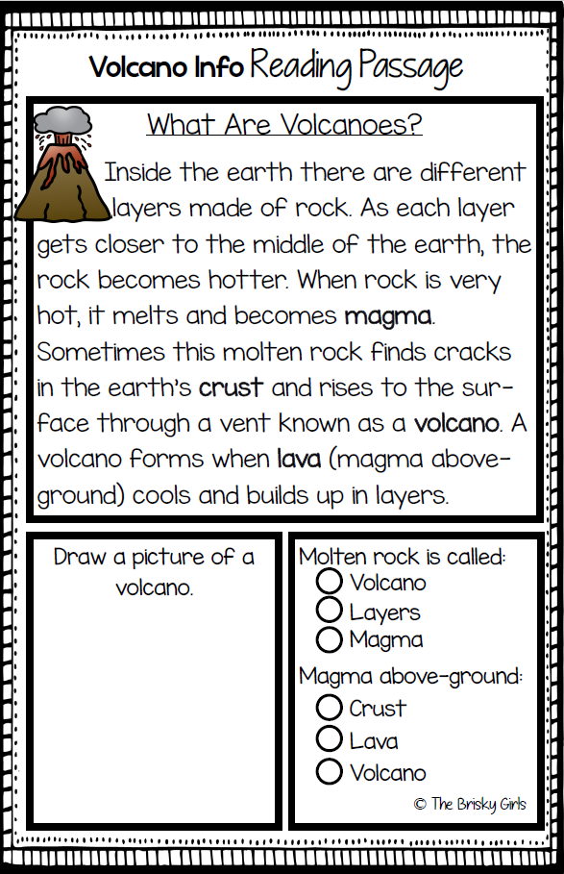

Slide 8
Mrs. Bernsdorff
Volcanoes
Name ____________________
1
2
3
Magma
Lava

