Slide 1
Physical Education
Mr. Moyer
May 11 – May 15, 2020
Classes 226, 227, 228, 229, 230, 231

Slide 2
Phys. Ed.
Standard 2: The physically literate individual applies knowledge of concepts, principles, strategies and tactics related to movement and performance.
Purpose of Event: Cardiovascular endurance, Strength training
Materials Needed: None
Objective: Students will work individually to develop strategies and strength in order to finish the workout – NO EQUIPMENT BICEPS featuring Coach Moyer.

Slide 3
Phys. Ed.
Instructions
Play my intro/exercise video
Watch the exercise video
The video is accompanied with instructions on how to complete the tasks. Watch the video once without performing the exercise
Complete the exit slip on a separate piece of paper
Exit slips are 3 questions usually answered in one sentence or less. Questions relate to the previous two weeks work.
Have fun!

Slide 4
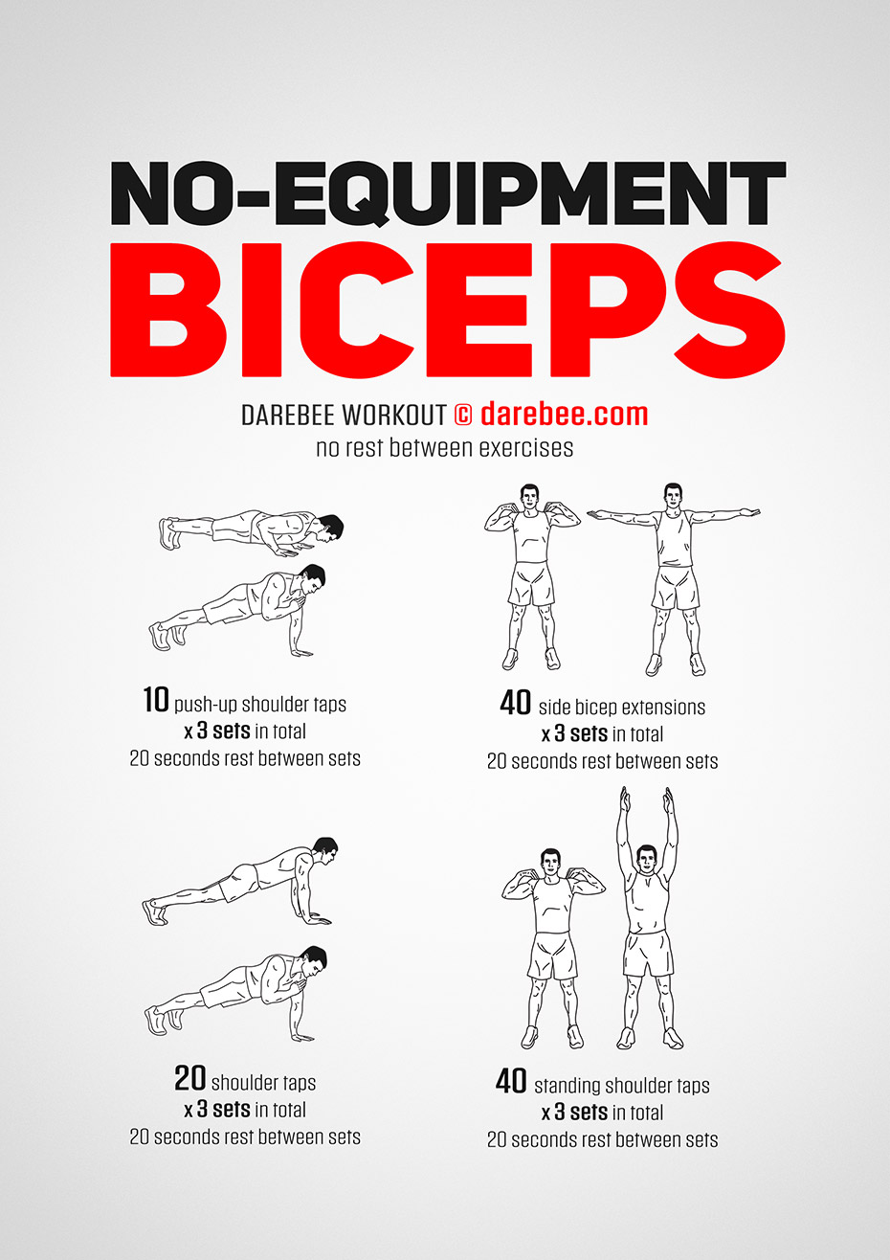

Slide 5
Intro Video​/Exercise Video
Mr. Moyer contact information
Phone – 724.949.0068
Office Hours – Monday to Friday, 8am to 9m
2. Email – jmoyer@thewatsoninstitute-fa.org

Slide 6
Phys. Ed.
Exit Slip Questions
Did you do additional squats?
Who was one of your partners for an exercise?
What was/is your favorite exercise?

Slide 7
Phys. Ed.
The END!
Stay active
Stay healthy
Stay tuned for more!

