Slide 1
Physical Education
Mr. Moyer
May 4 – May 8, 2020
Classes 147, 148

Slide 2
Phys. Ed.
Standard 2: The physically literate individual applies knowledge of concepts, principles, strategies and tactics related to movement and performance.
Purpose of Event: Locomotor Movements
Materials Needed: None
Objective: Students will work individually to develop better locomotor movements as well as some basic exercises to complete the workout MAGICIAN featuring Coach Moyer.

Slide 3
Phys. Ed.
Instructions
Play my intro video
Watch the exercise videos.
The video is accompanied with instructions on how to complete the tasks/exercises. Watch the video once without performing the exercise
Complete the exit slip on a separate piece of paper
Exit slips are 3 questions usually answered in one sentence or less. Questions relate to the previous two weeks work.
Have fun!

Slide 4
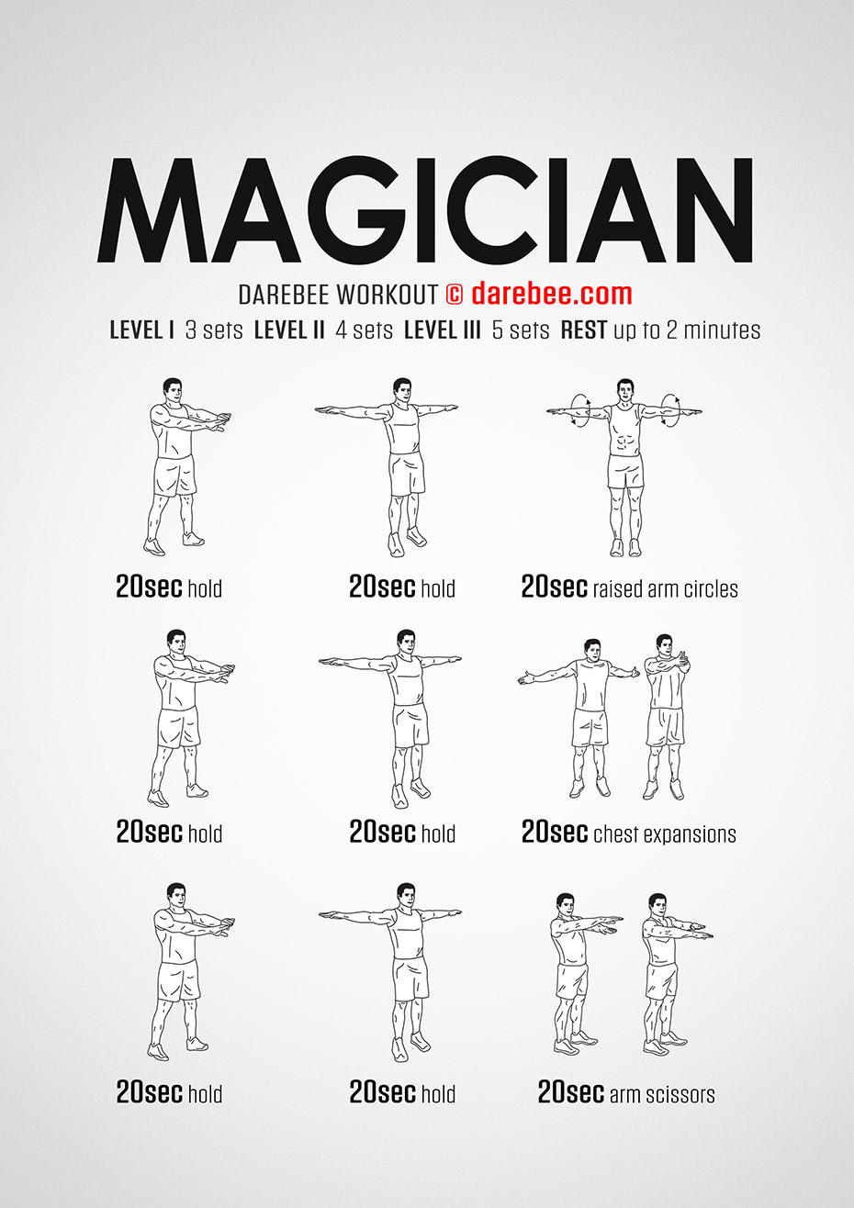

Slide 5
Phys. Ed.
Intro Video/Exercise Video #1
Mr. Moyer contact information
Phone – 724.949.0068
Office Hours – Monday to Friday, 8am to 9m
2. Email – jmoyer@thewatsoninstitute-fa.org

Slide 6
Phys. Ed.
Exit Slip Questions
Did you use any weight with the chest expansions or just body weight?
Who was one of your partners for an exercise?
What was/is your favorite exercise?

Slide 7
Phys. Ed.
The END!
Stay active
Stay healthy
Stay tuned for more!

