Slide 1
Social Skills

Slide 2
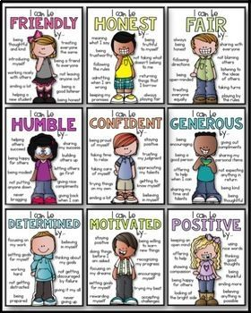

Slide 6
Activity Sheet

Slide 8
Empathy

