Slide 1
Health Week 5 Lesson 3
Classrooms 226-227-228-229-230-231-311
Standards 10.1.3, 10.1.6, 10.2.3, 10.2.6

Slide 2
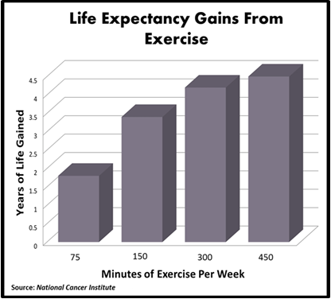
Benefits of Exercise

Slide 3
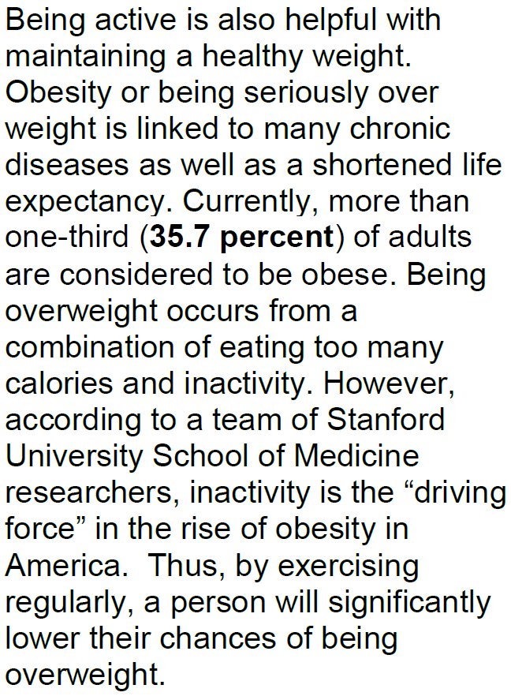

Slide 4
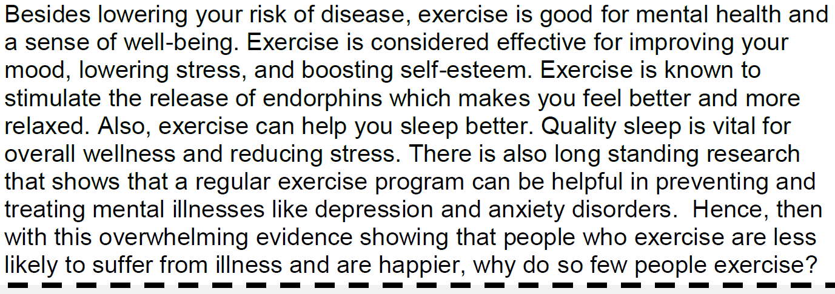

Slide 5
Question and Answers
What can being active help people maintain or lose? - Maintaining a healthy weight
What is obesity linked to? - Many chronic diseases as well as a shortened life span.
What percent of adults are considered obese? - 35.7% or over 1/3 of adults
What is the main reason for the rise in obesity? - inactivity

Slide 6
Question and Answers
Besides lowering the risk of many diseases, what else is exercise good for? - Mental health and a sense of well-being
What does exercise stimulate that makes us feel good and more relaxed? - Endorphins, which makes you feel better and more relaxed
What types of mental illnesses can regular exercise help treat? - Depression and anxiety disorders

Slide 7
We have learned that there is a long list of benefits gained from
exercising. In addition, what is clear from this list is that people that
decide to exercise are more likely to live longer, healthier,
and happier lives.
Exercise
LONGER, HEALTHIER, &
HAPPIER LIFE

Slide 8
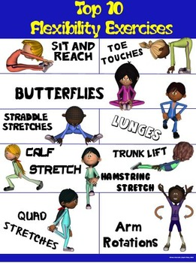
Get Moving!

Slide 9
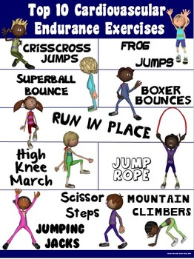
Get Moving!

Slide 10
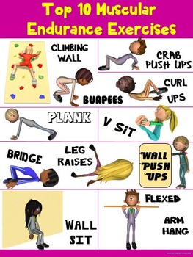
Get Moving!

Slide 11
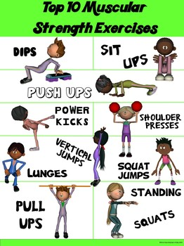
Get Moving!

Slide 12
Thank you and be safe!

