Slide 1
Health Today vs Health in the Past
HEALTH
LESSON 9
BY: MS. MILLER

Slide 2
Questions
What do you think the leading cause of death was in In the late 1800 and early 1900's?
What do you think is the leading cause of death in 2017?
What do you think the leading cause of death is for people your age?
What are some reasons why health today is better then the health of people in the past?
What are some reasons why health today is worse then the health of people in the past?

Slide 3
Health in the Past
Prior to the twentieth century, Infectious diseases were most significant health problems in the past. Infectious disease was the leading cause of death.
Why?

Slide 4
Infectious diseases
Infectious diseases are disorders caused by organisms — such as bacteria, viruses, fungi or parasites. Many organisms live in and on our bodies. They're normally harmless or even helpful, but under certain conditions, some organisms may cause disease.
Signs and symptoms vary depending on the organism causing the infection, but often include fever and fatigue.
Many infectious diseases, such as measles and chickenpox, can be prevented by vaccines.

Slide 5
Health Today
Medical advances have increased the health of people today. (vaccines, antibiotics AND access to health care).
Many health problems today are caused in part by unhealthy lifestyle choices.
Example: Diabetes, heart disease, and cancer are examples of lifestyle diseases: They are a result of YOUR life choices!

Slide 6
Health Risk Factors
A risk factor: is anything that increases the likelihood of injury, disease, or other health problems.
Controllable risk factors: What you CAN CONTROL some risk factors by making choices about your behavior. (smoking, physical activity, drugs)
Uncontrollable risk factors: Things you CANNOT CONTROL such as gender, age, race, and heredity.

Slide 7
RISK FACTORS….What is…
the single leading preventable cause of death in the United States?
TOBACCO USE
1200 people die a day
Lifespan shortened by 11 minutes

Slide 8
RISK FACTORS….What is…
the second leading preventable cause of death in the United States?
Lifestyle diseases linked to obesity

Slide 9
RISK FACTORS….What is…
The third leading preventable cause of death?
ALCOHOL USE
Yearly 88,000 people die from alcohol related causes
1 in 10 teens affected will be injured, harmed or killed in an alcohol related incident.

Slide 10
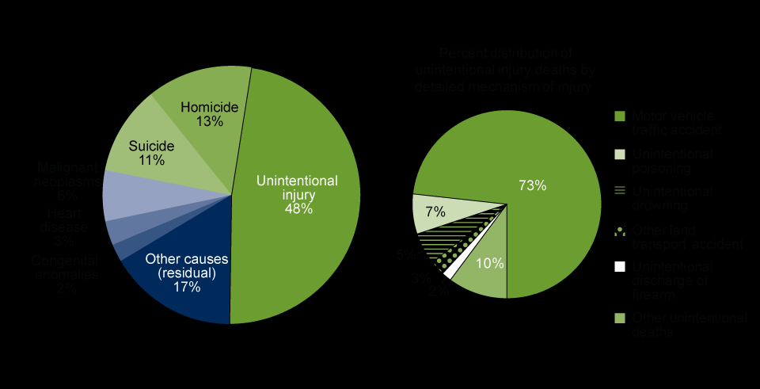
Major Causes of Death for Teens

Slide 12
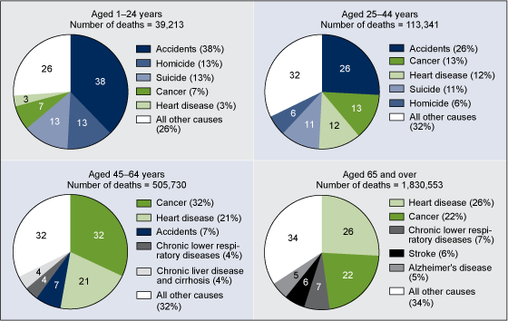
Major Causes of Death All Ages (cdc.gov)

Slide 13
TEENS VS ALL AGES
TEENS: Injuries and Violence are the leading causes of death (CAR ACCIDENTS)
As your age increases; accident rates decrease and cancer and stroke rates increase!

Slide 14
6 Health Risk Behaviors
Sedentary Lifestyle
Alcohol & Drug Use
Sexual Activity
Behaviors that cause injuries
Tobacco use
Poor Eating Habits

Slide 15
Influences on Wellness
Heredity
Social Influences
Cultural Influences
Environmental Influences

Slide 16
What do you think the average life expectancy is for males? For females?
the average number of years that a person or animal can expect to live.

Slide 17
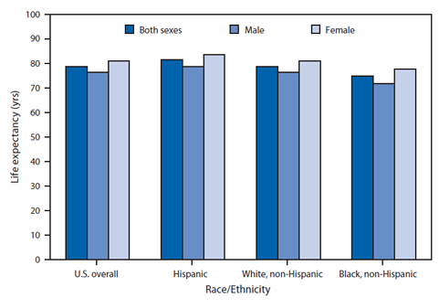
Cdc.Gov life expectancy

Slide 19
assignment
1. What did you observe about the average life expectancy between males and females? Why do you think this is?
2. Write down what you observed and why you think there is a difference.
3. Name one health risk behavior.
4. In the slide (slide 12) with the graphs, for ages 1-24, what is the major cause of death?
5. What is the difference between controllable and uncontrollable risk factors?
6. What is the third leading preventable cause of death?
7. What is an infections disease? Name some of them.
8. What is the single leading preventable cause of death in the United States?

