Slide 1
Growth & change
Understanding growth and change
(Click the in bottom right corner to continue to next slide)

Slide 2
Materials needed
Pen or Pencil
This presentation
for the growth and change worksheet that goes along with this activity.
An open mind
CLICK HERE

Slide 3
Instructions:
Please watch the video on the next slide. This video will help you better understand the worksheet. If you would rather read Alice in wonderland please skip the next slide and go to slide 5.
Once done with video and/or readings, answer questions on worksheet.
That’s it! Enjoy!

Slide 4
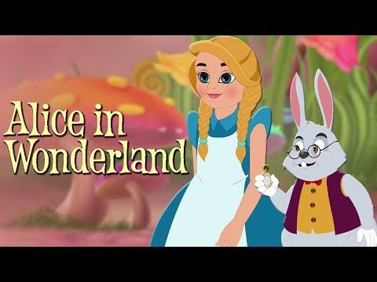
Alice in Wonderland
Please take some time and watch this short video.
Watching this video will help you to better understand the worksheet.

Slide 5
Alice in wonderland (readings)
Chapter 1
Chapter 2
Chapter 3
Chapter 4
Chapter 5
Chapter 6
Chapter 7
Chapter 8
Chapter 9
Chapter 10
Chapter 11
Chapter 12

Slide 6
Hopefully after completing this activity you have a better understanding of Growth and Change. Feel free to come back and reference this activity as needed.

