Slide 1
Feeling Emoji

Slide 2
History of Emoji’s
Emoticons
:-)
Emoticons were first used in 1881 by Puck Magazine

Slide 3
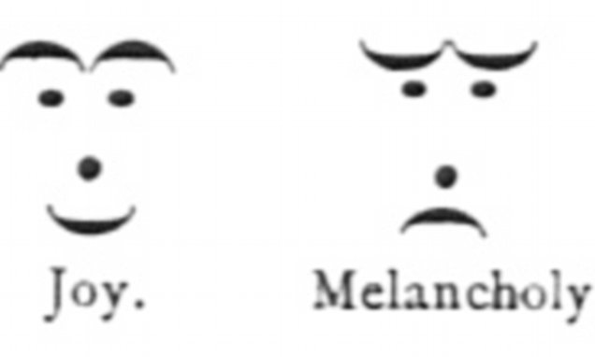
Puck Magazine Emoticons

Slide 4
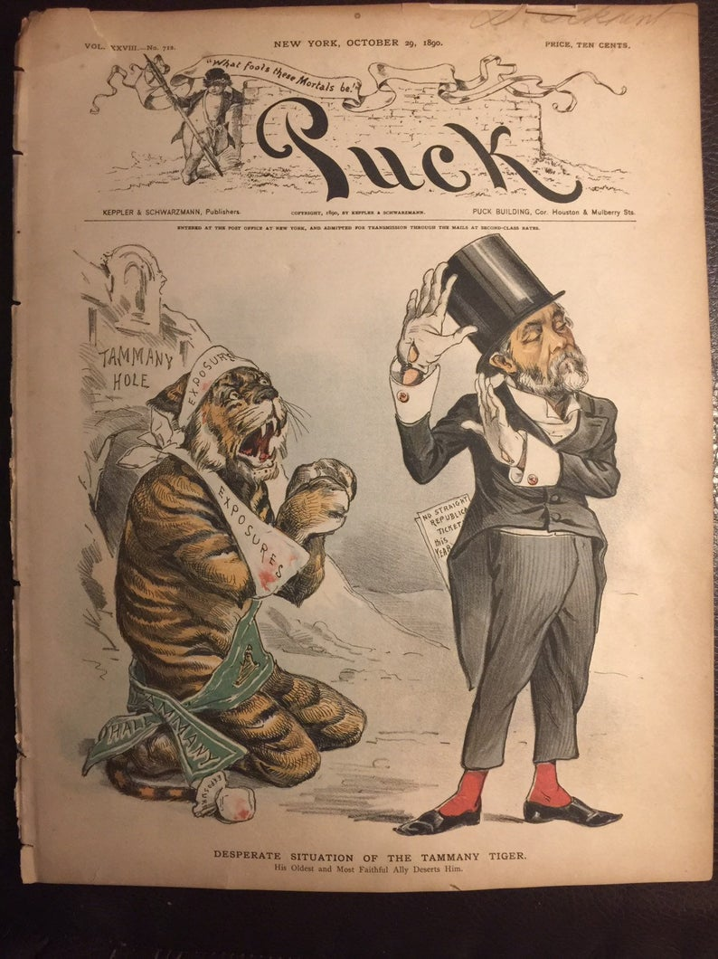
Puck Magazines showed humor and satire in 1871

Slide 5
History of Emoji
Emoji has been used since 2010, and there are over 1,800 emoji.
Carnegie Mellon University began communicating emotions to tell the difference between serious posts and jokes in 1982.
:-) :-(

Slide 6
Creating Emoji
There is an approved list of emoji by the Unicode Consortium who add emoji each year.
Maybe the one you create will be used!
Good luck!
See the next slide for your assignment.

Slide 7
Assignment
Your assignment is to create an emoji on one of the worksheets nest to the presentation, and show what the emoji means on the other worksheet.
Have Fun! Cant wait to see your work!
;-)
Send your work to goliastro@thewatsoninstitute-fa.org or return the work with your work packets!

