Slide 1
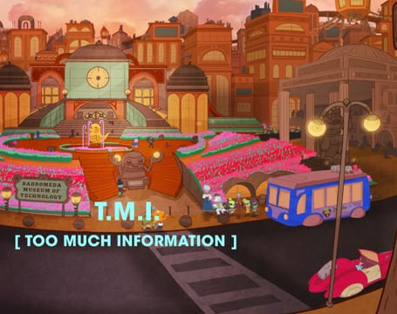
Elementary Technology Lesson
Dr. Sproull
May 11
Notes:
Hi everyone and welcome to Technology with Dr. Sproull. We are continuing to study good netiquette for using the Internet. Today we will learn about too much information or tmi. We will travel into the cloud with Nettie and Webster to learn the dangers of giving out too much information.

Slide 2
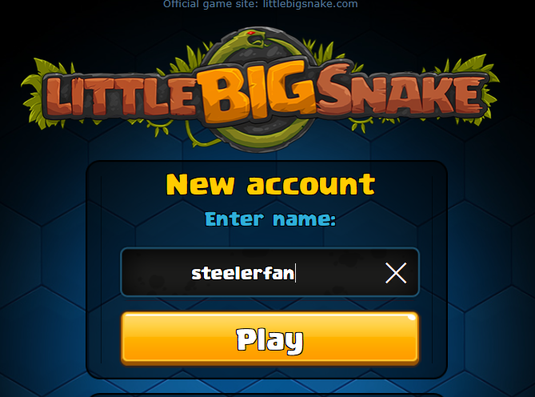
Notes:
You're always you, of course. But if you use a smartphone, tablet, or computer to play games and text with friends, you also have an online identity. Games and websites might let you create a profile picture that represents you. It's fun to dress up that character and maybe give it a sense of style you'd never try at school. Apps and websites also let you choose your own username. The game little big snake has you create an account name to play. If you want to be known as steelerfan, that's your new name. Should you tell your new online friends how much you like the Steelers or living in Pittsburgh? How much should you share about your real self online?

Slide 3
Notes:
Nettie and Webster help a young Badromedan boy understand why privacy is as important online as it is offline.

Slide 4
Notes:
Just as Webster and Nettie warned don’t post any personal information like your full name, where you live, your phone number, or email address on-line. That is Too much information.

Slide 5
Notes:
Remember that anything you put online or post on a site is there forever, even if you try to delete it. If you wouldn't want your entire class to know or see something, you shouldn't share it with anyone online. So think carefully before posting pictures of yourself. That is too much information.

Slide 6
Notes:
Remember never give out your password to anyone other than your parents. Sharing passwords is too much information.

Slide 7
Notes:
Don’t share too much information because remember that not everyone online is who they say they.

Slide 8
Notes:
There are rules about being online, just like there are rules about what you do and say in other places. It's important you know the rules so you can play safely online. Everything you say and do online reflects on your character and can expose you to others who may try to take advantage of you, so leave a footprint you can be proud of later. Be careful what you post for others to learn, know, or assume about you. Take care of yourself this week. Don’t share TMI! Have fun doing your work. I miss you and look forward to talking with you next week.

