Slide 1
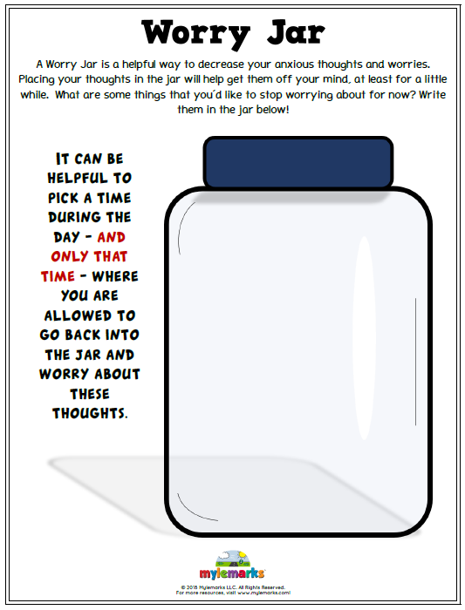
Worry Jar
A Worry Jar is a helpful way to decrease your anxious thoughts and worries. Placing your thoughts in the jar will help get them off your mind at least for a little while. What are some things that you’d like to stop worrying about for now? Wrote them in jar below!

Slide 2
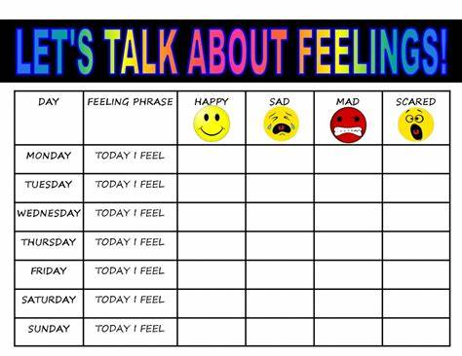

Slide 3
What can you do at home to relax your mind and body?
Take slow deep breaths
Soak in a warm bath
Listen to smooth music
Read a book
Write in a note book
Color
Call a friend
Do a crossword puzzle
Take a walk
Play an instrument
Play a game

Slide 4
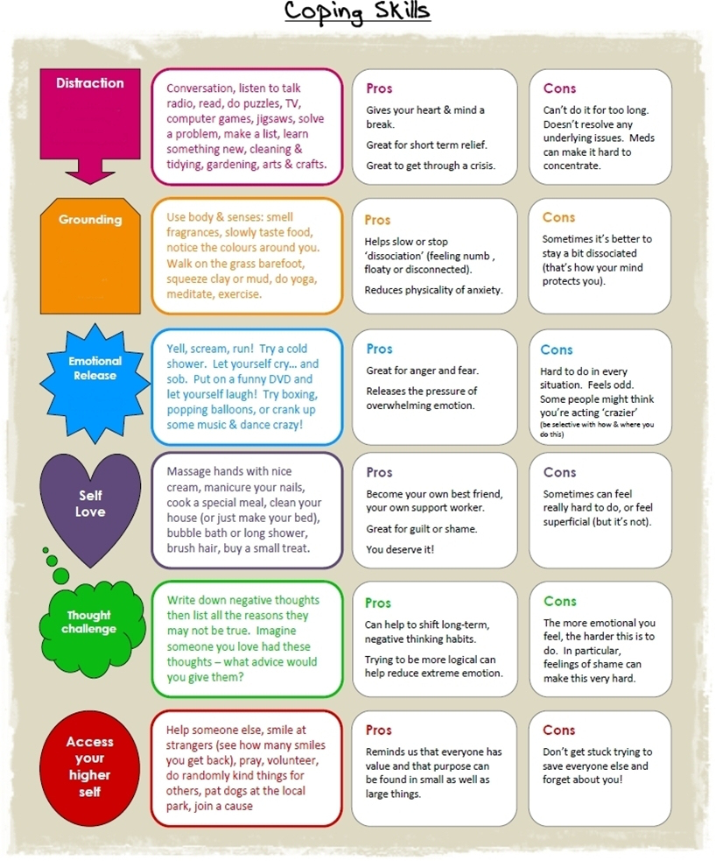

Slide 5
