Slide 1
Physical Education
Mr. Moyer
April 13 – 24, 2020
Classes 307, 308, 309, 310, 311, 312

Slide 2
Phys. Ed.
Standard 2: The physically literate individual applies knowledge of concepts, principles, strategies and tactics related to movement and performance.
Purpose of Event: Cardiovascular endurance, Strength training
Materials Needed: None
Objective: Students will work individually to develop strategies and strength in order to finish the workout – UPPERBODY.

Slide 3
Phys. Ed.
Instructions
Play my intro video
Watch the exercise video
The video is accompanied with instructions on how to complete the tasks. Watch the video once without performing the exercise
Complete the exit slip on a separate piece of paper
Exit slips are 3 questions usually answered in one sentence or less. Questions relate to the previous two weeks work.
Have fun!

Slide 4
Phys. Ed.
Exercise Video #1
UPPERBODY WORKOUT
Choose your own level (Level I, II, or III)
A "set" consists of completing all 9 exercises
Rest up to 2 minutes between each set. No more than 2 minutes
Regular Push-Ups can be substituted for Knee Push-Ups
Continued on next page...

Slide 5
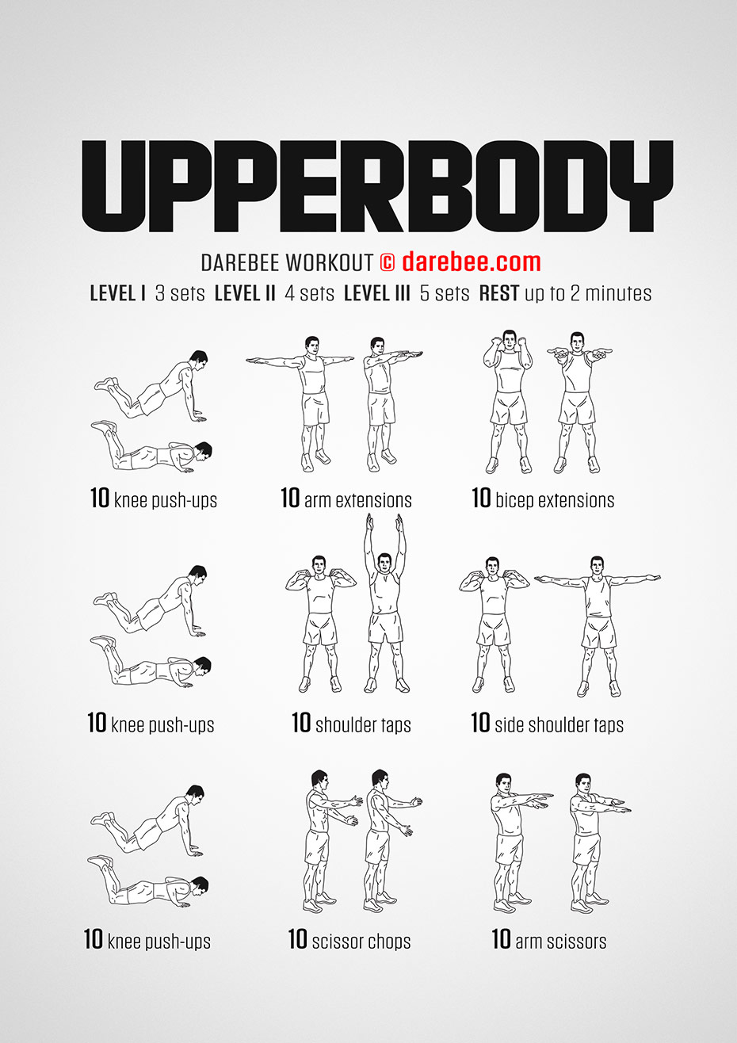

Slide 6
Intro Video​
Coach Moyer Intro Video
UPPERBODY #1​
UPPERBOD #2​
UPPERBODY #3​
UPPERBODY #4

Slide 7
Phys. Ed.
Exit Slip Questions
How many days did you complete of the 14?
Who was one of your partners for an exercise?
What was/is your favorite exercise?

Slide 8
Phys. Ed.
The END!
Stay safe
Stay healthy
Stay tuned for more!

