Slide 1

Good morning Miss you all
MS.J

Slide 2

What is bullying?
abuse and mistreatment of someone vulnerable by someone stronger, more powerful, etc. : the actions and behavior of a bully

Slide 3
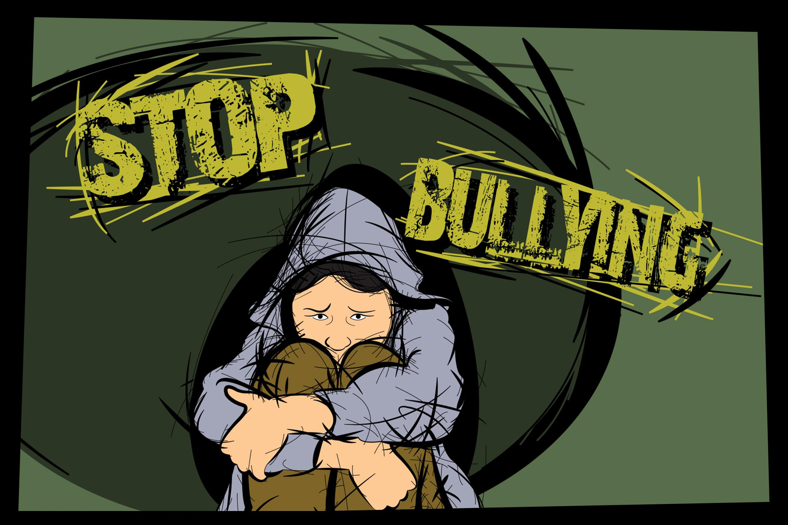
Today your going to watch the 2 videos down below answer the following questions
If you seen somebody getting bullied how would you react?
Do you think its ok to bully someone, why or why not?
How would you react if your friend was a bully

Slide 4

Here are the videos
https://youtu.be/7-X3Pu20w24
https://youtu.be/FYVvE4tr2BI

