Slide 1
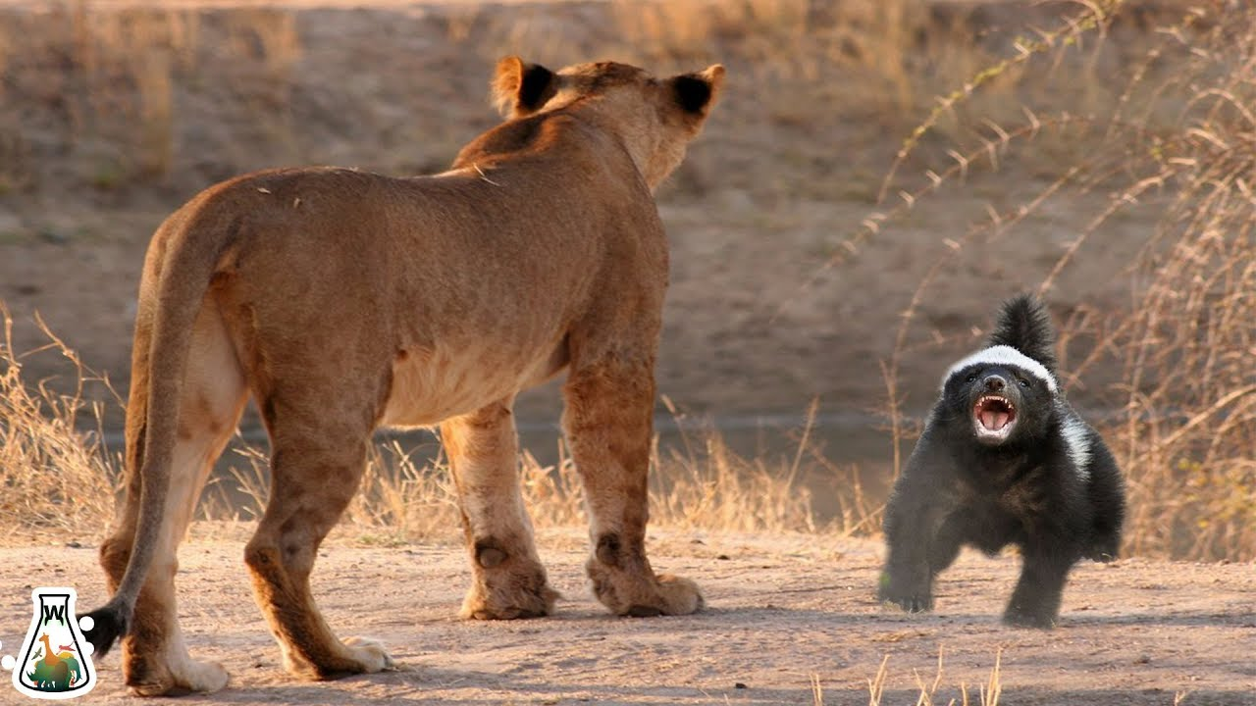
The Honey Badger
Finding The Main Idea
April 20th-April 24th

Slide 2
Paragraph 1
What's fiercer than a lion but smaller than a beagle? The honey badger, one of the toughest mammals in Africa and western Asia. Honey badgers stand less than a foot high. They are only a couple feet long. They weigh just over 20 pounds. Yet they have a reputation for toughness that is far greater than their size. Some honey badgers will chase away lions and take their kills. I guess that goes to show you that size isn't the only thing that matters in a fight.

Slide 3
Paragraph 2
So what makes the honey badger so tough? They have speed, stamina, and agility, but so do many animals. They aren't stronger than lions, so how do they stop them? The thing that sets the honey badger apart is their skin. Their skin is thick and tough. Arrows, spears, and bites from other animals can rarely pierce it. Small bullets can't even penetrate it. Not only is their skin thick and tough, it is also loose. This allows them to twist and turn to attack while another animal is gripping them. The only safe grip one can get on a honey badger is on the back of their necks.

Slide 4
Paragraph 3
Honey badgers have long, sharp claws. These claws are good for attacking and even better for digging. Honey badgers are some of nature's most skilled diggers. They can dig a nine-foot tunnel into hard ground in about 10 minutes. They love to catch a meal by digging up the burrows of frogs, rodents, and cobras. They also use their digging skills to create their homes. They live in small chambers in the ground and defend them fiercely. They will attack horses, cows, and even water buffalo if they are foolish enough to poke around a honey badger's den.

Slide 5
Paragraph 4
You don't get a reputation like the honey badger by running from danger. The honey badger is fearless and a tireless fighter. They will attack any creature that threatens them, man included. Because of the honey badger's reputation, most predators avoid them. Some animals use the honey badger's rep to their advantage. Adult cheetahs have spotted coats, but their kittens have silver manes and look like honey badgers. Some scientists believe that their coloring tricks predators into avoiding them. Wouldn't you walk the other way if you saw a honey badger?

Slide 6
Paragraph 5
You might be wondering: "If honey badgers are so tough, how did they get a name that makes them sound like a piece of candy?" The answer makes sense. Since honey badgers have such thick skin, bee stings rarely harm them. So honey badgers love to raid beehives. I can't blame them. Who doesn't like free honey? Honey badgers chase after honey aggressively. So much so that beekeepers in Africa have to use electric fencing to hold them back. There's nothing sweet about that.

Slide 7
Paragraph 6
Beekeepers aren't the only people who have grown to hate honey badgers. Honey badgers may be fun to read about, but they are nasty neighbors. They attack chickens, livestock, and some say children, though they usually leave people alone. But if a honey badger moves in your backyard, there's not a whole lot that you can do about it. I mean, are you going to go and tangle with an animal that eats the bones of its prey? An animal with teeth strong enough to crunch through turtle shells? An animal that never tires, gives up, or backs down? Yeah, I wouldn't either...

Slide 8
What is the main idea?
The main idea is the central point or thought the author wants to communicate to readers.

Slide 9
Clues to identify the main idea
The easiest way to identify the main idea is to look at the title of the piece.
The main idea could be in the first sentence of the article or the last sentence in the article.
Pay attention to any idea that is repeated in different ways.

Slide 10
1. Which best expresses the main idea of the third paragraph?
Honey badgers have sharp claws that they use for fighting.
Honey badgers digging skills assist them in many ways.
Honey badgers use their claws to defend their homes.
Honey badgers will defend their homes to the death against any animal.

Slide 11
2. Which statement would the author most likely agree with?
What makes the honey badger so tough is their speed and strength.
Honey badgers are large in size and tireless in fighting spirit.
What makes honey badgers so tough is their thick, loose skin.
Honey badgers got their name from the sweet taste of their meat.

Slide 12
3. Which best defines the meaning of the word burrows as it is used in the third paragraph?
Lily pads or other seaweeds in which animals hide
Holes or tunnels in which animals live
A nest or animal dwelling in a tree or bush
A water supply where small animals come to drink

Slide 13
4. Which best expresses the main idea of the last paragraph?
Honey badgers are a nuisance to the neighborhood.
Beekeepers and honey badgers do not get along well.
Honey badgers have very strong jaws and teeth.
Honey badgers eat chicken and livestock.

Slide 14
5. Which best describes one of the author's main purposes in writing this text?
To persuade readers to join the efforts to protect honey badgers
To compare and contrast honey badgers with beagles and lions
To describe how honey badgers select their partners
To explain why honey badgers are so tough

Slide 15
6. Which statement would the author most likely disagree with?
Honey badgers like to raid beehives to eat honey.
Honey badgers are not the biggest animals, but they may be the toughest.
Honey badgers disguise their young to look like cheetah kittens.
Honey badgers are not afraid to fight with humans.

Slide 16
7. Which person is most likely to be disturbed by a honey badger moving in next door?
A beekeeper
A biologist
A bus driver
A salesman

Slide 17
8. Which animal is the honey badger afraid to attack?
Lion
Water buffalo
Poisonous snake
None of these

Slide 18
9. Which is not one of the honey badger's strengths?
Thick skin
Powerful jaws and strong teeth
Poisonous claws
Tireless fighting spirit

Slide 19
10. Which title best expresses the main idea of this text?
Battle on the Savannah: Honey Badgers Vs. Lions
Little Badger, Big Fight: One of Nature's Toughest Scrappers
Ace in the Hole: How Honey Badgers Build and Protect Their Homes
Little Game: Interesting Animals That Live in Africa

Slide 20
Please answer the following questions in your notebook
How do cheetah kittens' silver manes help them to survive? Quote evidence from the text to support your response and explain your answer completely.
What would be the safest thing to do if you encountered a honey badger? Cite evidence from the text to support your argument.
What is the honey badger's greatest asset or quality? Quote evidence from the text to support your response and explain what the text that you are quoting shows.

