Slide 1

Health
Exercise and Fitness
Week 2 Lesson 2
For Classrooms
226, 227, 228, 229, 230, 231, and 311
Standards 10.1.3, 10.1.6, 10.2.3, 10.2.6

Slide 2
Vocabulary Review
Fitness – working out and being healthy
Exercise – activities that make you sweat and raise your heart rate
Weight – how heavy or light something is
Calories – found in food, it can be burned off with exercise
Diet – Stopping yourself from eating too much of certain foods

Slide 3
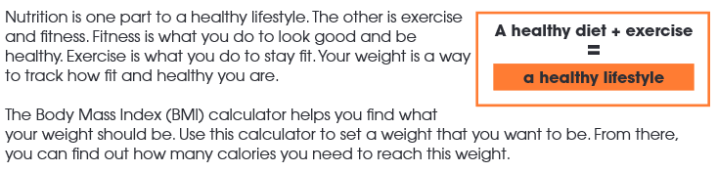
Reading Activity

Slide 4
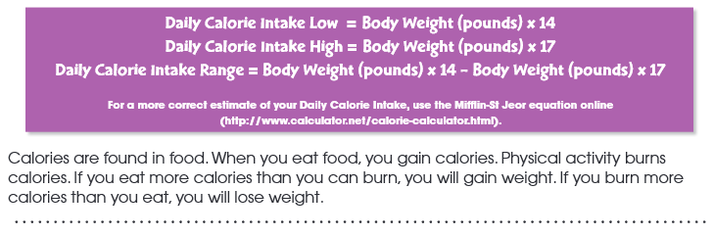
https://www.calculator.net/bmi-calculator.html

Slide 5
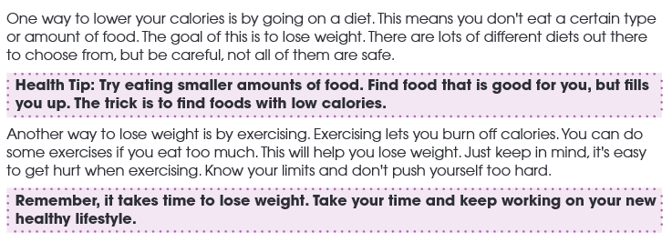

Slide 6
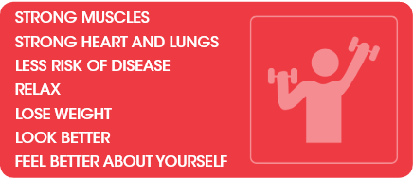
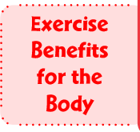

Slide 7
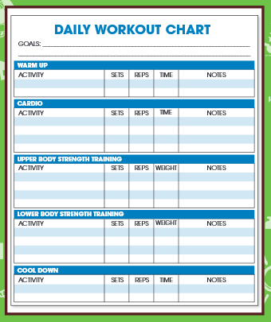

Slide 8
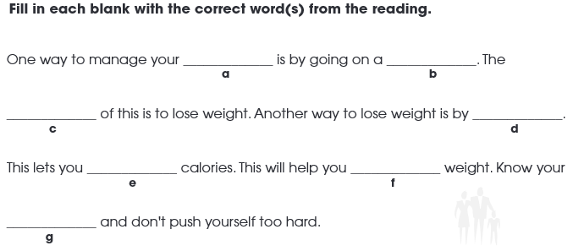
After you Read
calories
diet
goal
exercising
burn off
lose
limits

Slide 9
Thank You,
Enjoy your Day!

