Slide 1
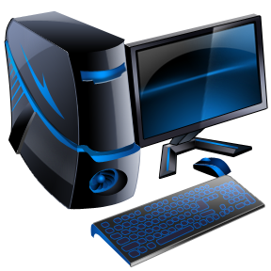
Computer Pre-Test
What do you know about computers?

Slide 2
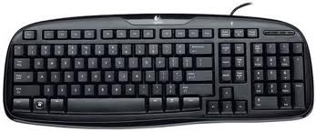
iRespond Question
Multiple Choice
F
Question #1 This is a picture of a:
A.) Keyboard
B.) Mouse
C.) Monitor
D.) Central Processing Unit
E.)

Slide 3
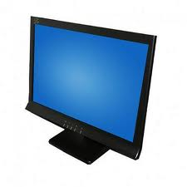
iRespond Question
Multiple Choice
F
Question #2 This is a picture of a:
A.) Keyboard
B.) Mouse
C.) Monitor
D.) Central Processing Unit
E.)

Slide 4
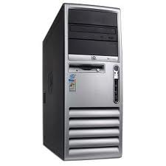
iRespond Question
Multiple Choice
F
Question #3 This is a picture of a:
A.) Keyboard
B.) Mouse
C.) Monitor
D.) Central Processing Unit
E.)

Slide 5
iRespond Question
Multiple Choice
F
Question #4 This is a picture of a:
A.) Keyboard
B.) Mouse
C.) Monitor
D.) Central Processing Unit
E.)

Slide 6
iRespond Question
Multiple Choice
F
Question #5 I use email to:
A.) Mail a letter with the mailman
B.) Send a message on the computer
C.) Type a story on the computer
D.) Play a game on the computer
E.)

Slide 7
iRespond Question
Multiple Choice
F
Question #6 If I want to go to a website, I have to go to the:
A.) Mall
B.) Store
C.) Internet
D.) Car
E.)

Slide 8
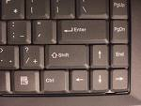
iRespond Question
Multiple Choice
F
Question #7 This key is used to:
A.) Go to the next line
B.) Make the letters capitals
C.) Make a space between words
D.) Erase what you have typed
E.)

Slide 9
iRespond Question
Multiple Choice
F
Question #8 This key is used to:
A.) Go to the next line
B.) Make the letters capitals
C.) Make a space between words
D.) Erase what you have typed
E.)

Slide 10
iRespond Question
Multiple Choice
F
Question #9 This key is used to:
A.) Go to the next line
B.) Make the letters capitals
C.) Make a space between words
D.) Erase what you have typed
E.)

Slide 11
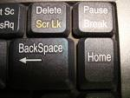
iRespond Question
Multiple Choice
F
Question #10 This key is used to:
A.) Go to the next line
B.) Make the letters capitals
C.) Make a space between words
D.) Erase what you have typed
E.)

Slide 12
iRespond Question
Multiple Choice
F
Question #11 When I am on the internet, what information should I share?
A.) My address and phone number
B.) My first name
C.) The name of my school
D.) My full name
E.)

Slide 13
iRespond Question
Multiple Choice
F
Question #12 If someone I am talking to on the computer is mean to me, what should I do?
A.) Be mean to them back
B.) Get off the computer and never tell anyone
C.) Tell my friend to talk to them
D.) Get off the computer and tell an adult
E.)

Slide 14
iRespond Question
Multiple Choice
F
Question #13 If I want to add more text to a document I already started typing, which direction do I use?
A.) Open
B.) Save
C.) Print
E.)
D.) New

Slide 15
iRespond Question
Multiple Choice
F
Question #14 If I want to start typing a brand new story, which direction do I use?
A.) Open
B.) Save
C.) Print
E.)
D.) New

Slide 16
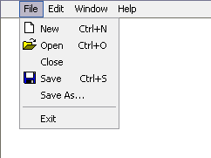
iRespond Question
Multiple Choice
F
Question #15 If I want to make sure nothing changes in my story, which direction do I use?
A.) Open
B.) Save
C.) Print
E.)
D.) New

Slide 17
iRespond Question
Multiple Choice
F
Question #16 If I want to print out a copy of my story, which direction do I use?
A.) Open
B.) Save
C.) Print
D.) New
E.)

Slide 18
iRespond Question
Multiple Choice
F
Question #17 If I want to find information using the internet, I will use:
A.) An encyclopedia
B.) A book
C.) A search engine
E.)
D.) A computer game

Slide 19
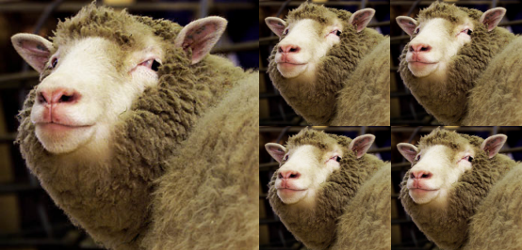
iRespond Question
Multiple Choice
F
Question #18 If I want to move words or pictures from document ONE to document TWO, and NOT have the words on document ONE, which direction do I use?
A.) Copy and paste
B.) Cut and paste
D.)
C.) Delete
E.)

Slide 20
iRespond Question
Multiple Choice
F
Question #19 If I want to move words or pictures from document ONE to document TWO, and KEEP the words on document ONE too, which direction do I use?
A.) Copy and paste
B.) Cut and paste
D.)
C.) Delete
E.)

Slide 21
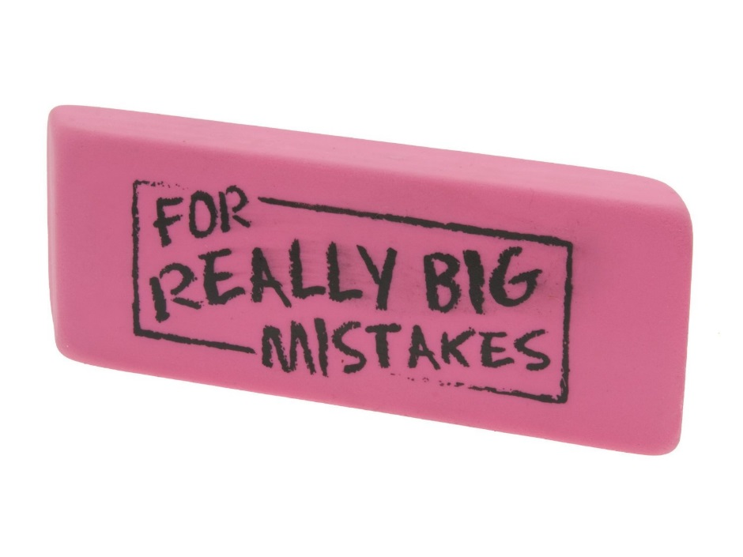
iRespond Question
Multiple Choice
F
Question #20 If I want to get rid of words I have typed, which direction will I use?
A.) Copy and paste
B.) Cut and paste
D.)
C.) Delete
E.)

Slide 22
iRespond Question
Multiple Choice
F
Question #21 True or False
Everything on the internet is true.
C.)
A.) True
D.)
B.) False
E.)

Slide 23
iRespond Question
Multiple Choice
F
Question #22 True or False
When I am using a website, I should always check my information with another source.
C.)
A.) True
D.)
B.) False
E.)

Slide 24
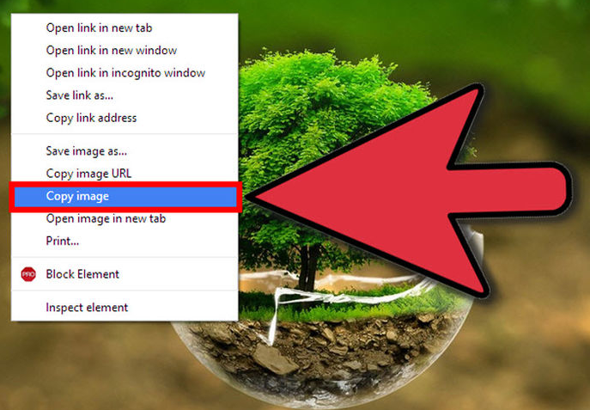
iRespond Question
Multiple Choice
F
Question #23 True or False
I can copy from a website and use the information in my paper, without changing it into my own words.
C.)
D.)
A.) True
E.)
B.) False

Slide 25
iRespond Question
Multiple Choice
F
Question #24 True or False
If information is on the internet, I can use it anyway I want to.
C.)
A.) True
D.)
B.) False
E.)

Slide 26
iRespond Question
Multiple Choice
F
Question #25 The internet helps people to:
A.) Connect with each other
B.) Find information quickly
C.) Stream music / video
D.) All of the above
E.)

Slide 27
Answer Key
iRespond Question
Multiple Choice
F
1. A 9. C 17. C
2. C 10. D 18. B
3. D 11. B 19. A
4. B 12. D 20. C
5. B 13. A 21. False
6. C 14. D 22. True
7. B 15. B 23. False
8. A 16. C 24. False
25. D
E.)

Slide 28
Name_________________________
iRespond Question
Multiple Choice
F
1. | 2. | 3. | 4. | 5.
6. | 7. | 8. | 9. | 10.
11. | 12. | 13. | 14. | 15.
16. | 17. | 18. | 19. | 20.
21. | 22. | 23. | 24. | 25.
E.)

