Slide 1
I Can Stress Less at School!
adapted from www.kidshealth.org

Slide 2
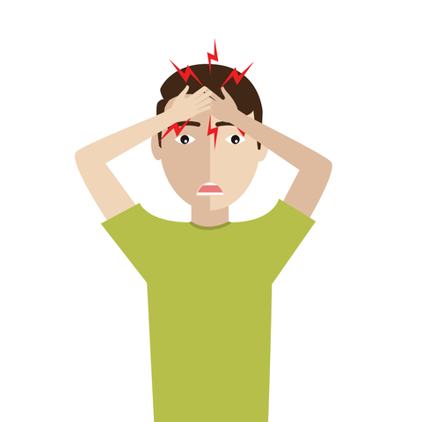
What is “stress”?
stress is what you feel when you are worried or uncomfortable about something
stress can make you feel angry, frustrated, scared – even sick!
when you’re stressed, you may not feel like eating or sleeping
OR
you may eat or sleep too much
you can also feel cranky and have trouble paying attention in class

Slide 3
Have YOU ever felt stressed?
how did your body feel when you were stressed?
what happened to make you feel this way?
what did you do to help you feel better?
did it work?

Slide 4
Did you know: There are really 2 kinds of stress:
Good Stress…
Bad Stress…
can help you get things done – like work on your book report that’s due in 3 days
can help you prepare better – like study for a tough test coming up on Friday
can help you practice more – like work on your ball control before trying out for the soccer team
can make you upset – like having too much homework
can make you feel sick – like hearing your parents fight
can make you mad – like misplacing your reading book
can make you frustrated – like trying to get your science project to work

Slide 5
Everybody feels stressed sometimes
It’s what we DO about our stress that’s important!
Ready for some ideas?

Slide 6
Ways to Handle Stress
Ask for help
Stay calm
Go easy on yourself
Try to solve the problem
Stay positive – this stress will pass

Slide 7
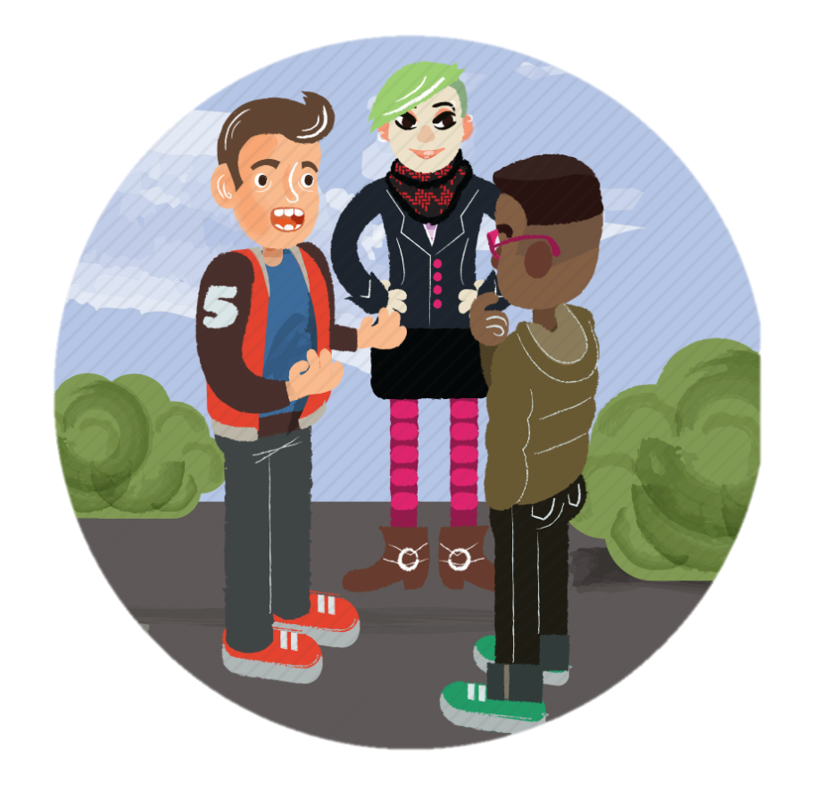
1. Ask for help
talk to a trusted adult – your parents, your teacher, your school counselor, etc.
talk to your friends – they might be going through the same thing!
sometimes we all need help getting through tough situations

Slide 8
2. Stay calm
our feelings can be overwhelming when we’re upset
really think about how you feel – and why you feel that way
now name it! (“I’m really mad” or “I feel scared”)
then think about ways to calm down

Slide 9
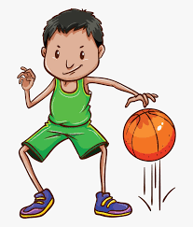
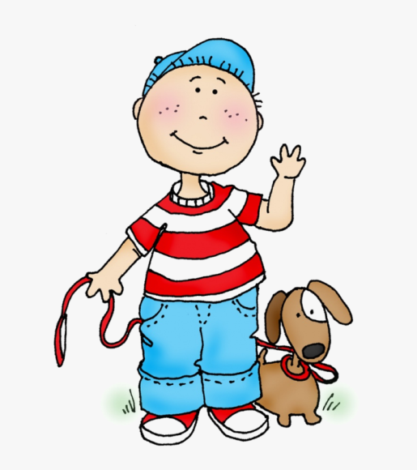
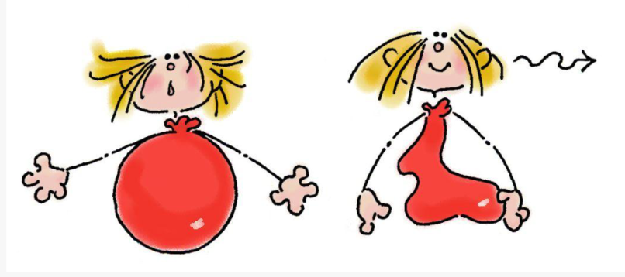
What do YOU do to calm down?

Slide 10
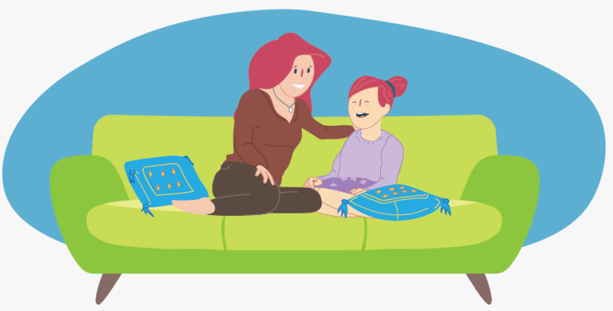
3. Go easy on yourself
don’t take it out on yourself – you already feel bad enough, don’t you?
remember to reach out to people who care about you
it’s okay to ask someone to listen to your troubles – you can do the same for them sometime!

Slide 11
4. Try to solve the problem
once you’re calm and have talked with your family or your friends, you can focus on solving the problem
maybe you can’t solve the whole problem, but you can start with solving a piece of it
what advice did you get when you talked to others?
pick something to try and see what happens!

Slide 12
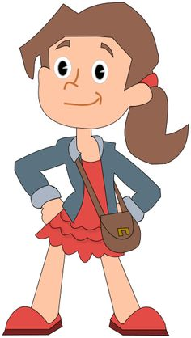
5. Stay positive – this stress will pass
most stress is temporary
it might not seem like it when you’re in the middle of a stressful situation but stress does go away
usually this happens when you start working to solve the problem
this is you taking control of your stress!

Slide 13
Ways to Handle Stress
Ask for help
Stay calm
Go easy on yourself
Try to solve the problem
Stay positive – this stress will pass

Slide 14
So…what do YOU think?
Everyone in your family is so excited about the new baby – everyone but you, that is. Sure you love your new little brother but now you have to share your bedroom with him. He cries a lot! It’s so hard to get a good night’s sleep!
(And he doesn’t always smell that great either.)
What can you do?

