Slide 1
I Can Handle Waiting
adapted from Super Skills, 2005 – J. Coucouvanis
Notes:
Read slide with students. Explain that today’s lesson will help them learn ways to handle waiting.

Slide 2
What does “waiting” mean?
staying where you are
stopping what you’re doing
delaying what you want to do or get
Notes:
Read heading with students. Ask students for their definition of “waiting”. Read bullet points together to define “waiting”.

Slide 3
Waiting can be hard, but we have to do it every day…
we have to wait in lines
we have to wait to eat
we have to wait to talk to someone
we have to wait to be called on in class
we have to wait for help
what else???
adapted from Super Skills, 2005 – J. Coucouvanis
Notes:
Read slide with students. Talk about the fact that we all have to wait and that waiting can be difficult. Read examples of times when we have to wait. Ask students for other examples.

Slide 4
What do YOU do to make waiting easier?
Notes:
Read slide with students. Ask students for their wait time strategies. What works for them and what doesn’t?

Slide 5
Let’s talk about some tips
to help with waiting!
Notes:
Read slide with students. Explain that they’ll learn some tips to make waiting easier.

Slide 6
steps to help with waiting
Stay still, quiet, and calm
Think: “It’s hard to wait but I can do it”
Make a waiting plan
Try your plan
Notes:
Read slide with students. Explain that there are 4 steps that kids can do that can help with waiting. Read each step.

Slide 7
1. Let’s practice staying still, calm, and quiet
relax and get comfortable in your chair
take slow, deep breaths
slowly count to 20 in your head
1,2,3,4,5,6 ……
Notes:
Read slide with students. Explain that practicing these skills can make it easier to use them when the time comes. Have students relax in their chairs, then lead them in taking slow, deep breaths. Encourage them to count to 20 slowly in their heads while they practice their calm breathing.

Slide 8
2. Think “It’s hard to wait but I can do it”
Let’s say it out loud together
Now try saying it to yourself in your head
It’s hard to wait but I can do it!
Notes:
Read slide with students. Explain that “self-talk” like this can really help to coach yourself through a challenge. Practice saying the words all together, then silently to themselves.

Slide 9
3. Make a “waiting plan”
Think about things you can do when you have to wait
When you keep busy, the waiting time seems to go faster
Notes:
Read slide with students. Talk about how having a waiting plan allows us to prepare for those times when we just have to wait. Click to bring in animation. Explain that keeping busy like this can make the time seem to go faster.

Slide 10
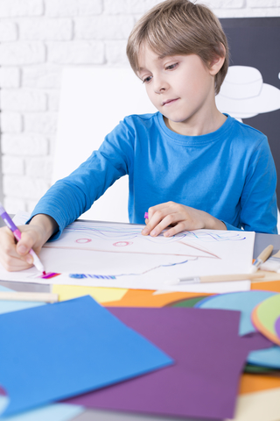
What can you do while you wait?
listen to music
read a book
draw or color
What else??
get a head start on your homework
Notes:
Read slide with students. Talk about the different activities pictured and ask students which ones they would choose to keep busy during wait times. Then ask students for their own ideas.

Slide 11
4. Try your plan
I have to wait to get picked up after school.
I’ll take my book to read!
Now that you have some ideas of things to do while you wait, give them a try
Is there one activity you like to do more than the others?
Make sure you have what you need with you to do that activity when you have to wait!
Notes:
Read slide with students. Emphasize the importance of planning ahead so that they have what they need with them when they have to wait.

Slide 12
steps to help with waiting
Stay still, quiet, and calm
Think: “It’s hard to wait but I can do it”
Make a waiting plan
Try your plan
Notes:
Read slide with students. Review the 4 steps to help with waiting.

Slide 13
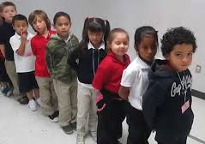
So…what do YOU think?
There’s a line at the water fountain and you’re really thirsty! You didn’t know there would be so many kids there. Of course you didn’t bring anything with you to help you wait. What can you do?
Notes:
Read slide with students. Talk about how sometimes you have to wait unexpectedly, so you won’t have a book or music handy to keep you busy. What else can you do? Give your own examples or refer students to the Mindfulness lesson if done previously. Have students brainstorm creative ways to help with unexpected waiting time.

