Slide 1
I Can Show Compassion
adapted from www.kidshealth.org
Notes:
Read slide with students. Ask for their definitions of “compassion”. Tell them that today’s lesson is learning about what compassion is and how to be compassionate with others.

Slide 2
What is compassion?
showing care and concern for someone else and wanting to help
maybe that person is hurt or upset and you want to help them feel better
Notes:
Read slide with students. Talk about the picture. How can you tell the girl is upset? How is the other girl showing compassion to her?

Slide 3
What might have happened to cause someone to feel hurt or upset?
being left out
being teased or bullied
being embarrassed
doing badly on a test
not making the team
having a fight with a friend
trouble at home
What else??
Notes:
Read slide with students. Talk about what’s happening in the picture. Discuss the various reasons someone might be hurt of upset and ask students for other examples. Ask students if any of these have ever happened to them. How did they feel? Did anyone show compassion and help them? How did they feel then?

Slide 4
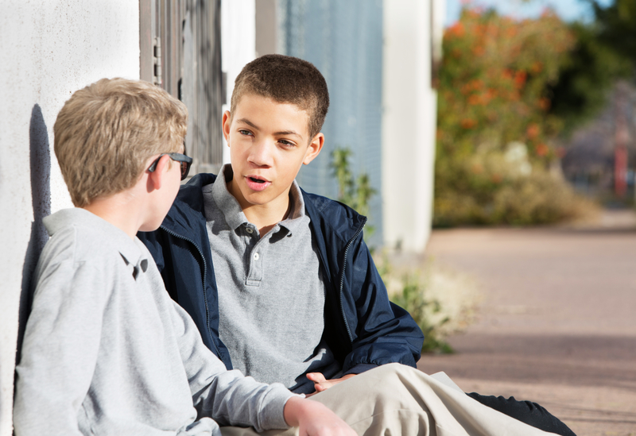
Understanding why someone is hurt or upset can help us figure out what to do next!
you can ask “Are you okay?
OR
you can ask “What happened?”
Everything alright??
Notes:
Read slide with students. Talk about the importance of asking the right questions to figure out what to do next to help the other person.

Slide 5
What else can you do?
Show compassion to help and support the people you care about!
Notes:
Read slide with students. Explain that after you find out what happened or what’s wrong, then you can show compassion to help the other person.

Slide 6
3 Ways to Show Compassion
Ask what they need
Show sincere interest in others
Act with kindness
Notes:
Read slide with students. List the 3 ways to show compassion to others and tell students they’ll learn more about each one.

Slide 7
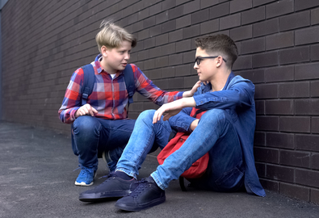
1. Ask what they need
How can I help?
if your friend says
“I don’t know”,
think about what would help you in that situation and offer that suggestion
Notes:
Read slide with students. Talk about what’s happening in the picture. Discuss how sometimes your friend might not seem to want to talk about it but you can try putting yourself in his place and offer a suggestion that would help you in that same situation.

Slide 8
2. Show sincere interest in others
try to get to know people better
find out about the things they like to do
ask them about their feelings, ideas, and opinions
you’re not trying to be nosy – you just want to understand your friend better!
Understanding others helps you to show more compassion!
Notes:
Read slide with students. Talk about how showing interest in others helps you to understand more details about your friend which can help you figure out how to support them when/if the time comes.

Slide 9
3. Act with kindness
if you hear gossip or see unkind teasing, try to imagine how you would feel in that person’s place
this helps you tune in to other people’s feelings and treat them the way you would want to be treated
Notes:
Read slide with students. Talk about what’s happening in the picture. What’s happening in the background? How is the boy feeling? How is the girl showing compassion? Discuss how showing kindness in these moments can really help a person deal with feeling hurt or upset.

Slide 10
Remember: 3 Ways to Show Compassion
Ask what they need
Show sincere interest in others
Act with kindness
Notes:
Read slide with students. Review the 3 Ways to Show Compassion. Ask students to explain each point.

Slide 11
So…what do YOU think?
You see a new student in the hallway looking lost and alone. It’s time for lunch but he doesn’t seem to know where to go, and he’s not asking directions. If he waits much longer, he’ll miss the whole lunch period.
What can you do?
Notes:
Read slide with students. Talk about what’s happening in the picture. Ask students to think back to the lesson and use the 3 Ways to Show Compassion to help this student.

