Slide 1
I Can Practice Mindfulness
adapted from www.blissfulkids.org and www.stackpathcdn.com
Notes:
Introduce today’s lesson. Ask students if they know what “mindfulness” is – listen to their definitions.

Slide 2
What is Mindfulness?
noticing what is happening right now
paying attention to how your body feels, what you see, smell, and taste
you can even feel emotions in your body – like a tightness when you’re upset, or a fluttery feeling when you’re excited
mindfulness is also noticing what your mind is doing
Notes:
Read slide with students. Emphasize that mindfulness involves ‘being present’ by focusing on what’s happening right now inside their bodies and all around them. Talk about the role the senses play in mindfulness. Ask students to describe how they feel on the inside when they’re happy or sad or frustrated. Share your own examples.

Slide 3
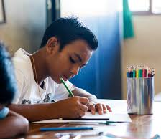
What happens when you pay attention to these things – when you’re mindful?
you focus more deeply
better focus can help you do better in school, sports, music
we all do better when we pay attention to what we are doing!
Notes:
Read slide with students. Talk about the benefits of mindfulness – helping us do better at school, home, and elsewhere because we’ll be paying attention and focusing.

Slide 4
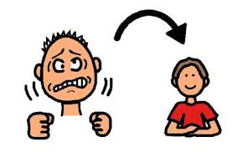
Another cool thing…
noticing what is happening around you
– being mindful –
can help you calm down when you’re mad or upset
Notes:
Read slide with students. Emphasize that mindfulness can also help us to calm down when we’re upset. Ask students to guess how mindfulness might be helpful.

Slide 5
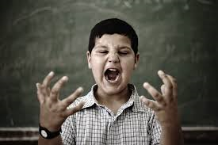
Mindfulness helps you deal with tough emotions
Have you ever felt like this?
Mindfulness can help you feel better again!
Notes:
Read slide with students. Ask students to talk about the boy in the picture – what might he be feeling? Have they ever felt this way? Ask students about the strategies they use to calm down. (Refer them to previous social skills strategies they might have already learned.) Share your own examples.

Slide 6
Let’s learn how to be MINDFUL!
Notes:
Read slide with students. Explain that today’s lesson will teach them steps to practicing mindfulness.

Slide 7
5 Steps to being Mindful
1. body still
eyes closed
stay quiet – listen
breathe slowly
focus your mind
Notes:
Read slide with students. Explain that there are 5 easy steps to being mindful. As you read each point, have the students look at the girl in the picture. Let them describe what they see. Make sure to point out things they might have missed: relaxed body (shoulders, hands, etc.), peaceful face, etc.

Slide 8
1. Is your body still?
a still body is sitting without moving around
arms and legs are relaxed
let’s try it!
Notes:
Read slide with students. Define having a still body and refer students to the picture. What do they see? Lead students in a practice session, prompting them to get comfortable and relax their arms and legs while they sit.

Slide 9
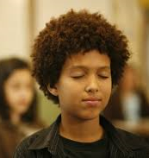
2. Now let’s close our eyes
Notes:
Read slide with students. Talk about how closing our eyes can help us block out distractions which makes it easier to focus.

Slide 10
3. Next, stay quiet and listen
Notes:
Read slide with students. Talk about the picture of the girl sitting quietly listening to the sounds around her. Have the students sit quietly and listen for a minute. When the time is up, ask them what they heard around them. Did they hear their neighbors breathing? Did they hear any sounds from outside the building or in the hallway outside the classroom?

Slide 11
4. Breathe slowly
take a slow deep breath in
pay attention as you inhale
now exhale out – focus as you breathe out
pay close attention as you keep breathing slowly in and out
if you start to lose focus, remind yourself to pay attention to your breathing again
Notes:
Read slide with students. Lead them in the breathing exercise described on the slide, breathing slowly in and out while paying attention to their inhales and exhales. Remind students to pull their attention back to their breathing if their attention starts to wander.

Slide 12
5. Focus your mind
sometimes our minds may start thinking about other things
that can be stressful and will distract you from mindfulness
bring your attention back to the present – what’s happening in me and all around me right now
Notes:
Read slide with students. Emphasize the importance of staying focused because if our minds drift, we may start thinking about stressful things which will distract us from mindfulness. Encourage them to use the phrase: “What’s happening in me and all around me right now” as a way to refocus.

Slide 13
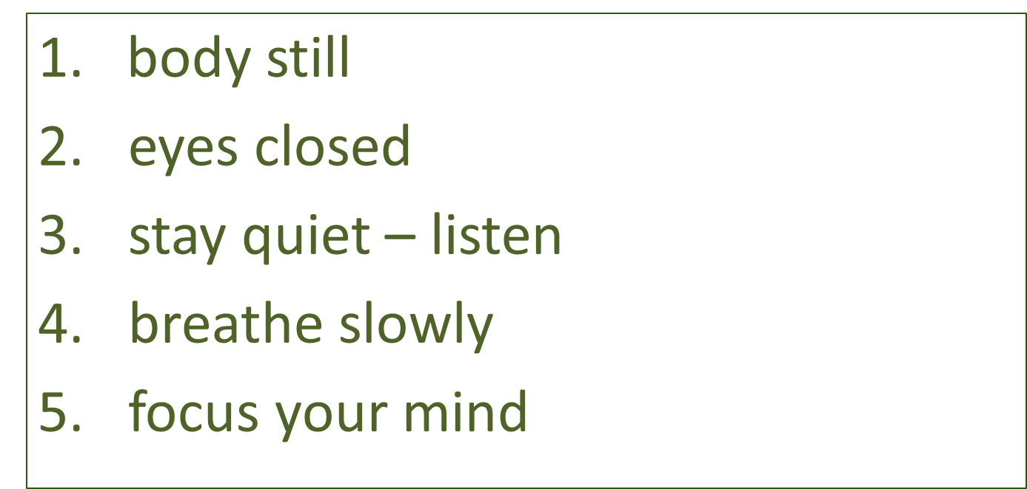
Remember the 5 Steps to Practicing Mindfulness
Notes:
Read slide with students. Review the 5 steps and lead the students in another practice session, putting all 5 steps together. Do this for several minutes, then ask them how they feel. Did they like the process? Was it easy or hard? If some students say that they found it difficult, reassure them that practicing mindfulness will help them get better at it – just like practicing an instrument or a sport can make us better.

Slide 14
Using these steps can help us take control of our thoughts and emotions, feel better AND do better!
Stay Mindful
Notes:
Read slide with students. Summarize the lesson by reminding them of the benefits of mindfulness.

Slide 15
So…what do YOU think?
It’s almost the end of the school day and you’re trying out for the soccer team in 10 minutes! Your classmates are pretty noisy as they joke around while packing up their things to head home. You’re really nervous and you know you need to calm down before you try out for the team.
What can you do?
Notes:
Read slide with students. Ask for their solutions to the situation. Explain that it might be easier to be mindful when the whole class is practicing, but that they’ve learned the steps so now they can try it anywhere, all by themselves, when they need to.

