Slide 1
I Can Handle Homework!
adapted from www.kidshealth.org

Slide 2
Homework – ugh!
Everybody gets homework – and not too many students like it. Homework is part of school life
But there are ways to make homework a little easier!

Slide 3
Ready for some homework tips?
Yes please!!!

Slide 4
1. Get Organized
Being organized means having the things you need and knowing were to find them
Organize your stuff:
- label binders and folders; keep papers where they belong
- clean out your backpack every day
- have a “go spot” to put things you need for school so they’re easy to find

Slide 5
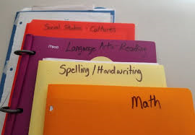
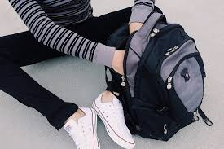
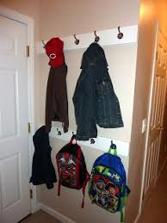
Organize your stuff

Slide 6
Organize your space
have a spot like a desk or table where you can spread out your work
get together everything you need before you start (pencils, paper, markers)
don’t use your bed – you might snooze or play instead of work!

Slide 7
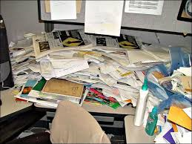
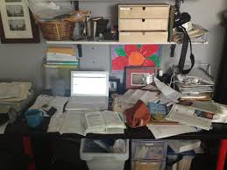
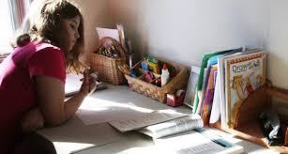
Organized or not?

Slide 8
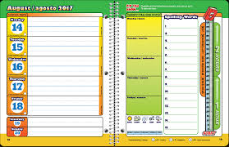
Organize your time
use a planner!
mark test dates and when you’ll study for them
mark dates for sports practice, music or karate lessons –you get the idea
write down your homework every day
check your planner every day!

Slide 9
2. Stay Focused
Being focused means keeping your attention on your work
Get rid of distractions
- keep the TV and music off
- remind yourself that it’s time to focus on homework
- give yourself free time when your homework is done

Slide 10
Focused or not?

Slide 11
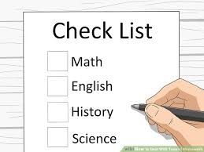
Get started
make a quick list of what you’ll work on
talk yourself through each item on the list
focus on each task as you work through your list

Slide 12
Take short breaks
get up and move around if your attention starts to wander
stand up or have a good stretch
moving around keeps your brain alert and helps you focus

Slide 13
Refocus
after a break, get back to work
go to the next task on your list and work through it
check off the things you’ve already done
stay focused so that you can finish your list

Slide 14
3. Get It Done!
You’re almost there! It’s time to check your work and finish up:
make sure it’s neat
check for mistakes and fix them
make sure your name is on it

Slide 15
Be proud of yourself
it’s okay to tell yourself that you did a good job
it feels good to know that you did your best!

Slide 16
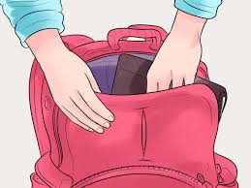
Now put it where it belongs
put your homework in the right folder
put your folder in your backpack
put your backpack in your “go spot”!

Slide 17
Now you’re done!

Slide 18
I Can Handle Homework
Get Organized
Stay Focused
Get It Done!

Slide 19
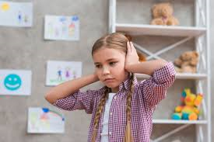
So…what do YOU think?
It’s pretty noisy at home when you’re trying to do your homework. Your brother wants to watch TV and your sister is practicing her flute.
What can you do?

