Slide 1
I Can Handle Homework!
adapted from www.kidshealth.org
Notes:
Read slide with students. Introduce the lesson topic. Ask students how they feel about homework – is it easy? Hard? What makes it harder??

Slide 2
Homework – ugh!
Everybody gets homework – and not too many students like it. Homework is part of school life
But there are ways to make homework a little easier!
Notes:
Read slide with students. Talk about homework as a fact of school life. Tell students there is good news though: There are ways to make homework easier.

Slide 3
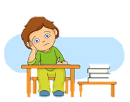
Ready for some homework tips?
Yes please!!!
Notes:
Read slide with students. Explain that today’s lesson will give them easy tips to make doing homework easier. Before proceeding, ask students for strategies they use to get their homework done.

Slide 4
1. Get Organized
Being organized means having the things you need and knowing were to find them
Organize your stuff:
- label binders and folders; keep papers where they belong
- clean out your backpack every day
- have a “go spot” to put things you need for school so they’re easy to find
Notes:
Read slide with students. Ask students if they do any/all of these strategies. Where do they put things at night to remember to bring them to school the next morning?

Slide 5
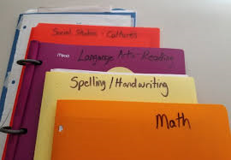
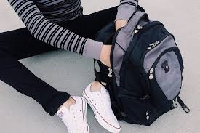
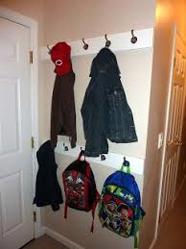
Organize your stuff
Notes:
Read slide with students. Discuss each picture – what do they see?

Slide 6
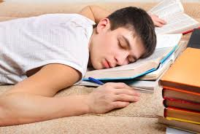
Organize your space
have a spot like a desk or table where you can spread out your work
get together everything you need before you start (pencils, paper, markers)
don’t use your bed – you might snooze or play instead of work!
Notes:
Read slide with students. Talk about the importance of having a designated space to do homework. Ask the students where they do their homework.

Slide 7
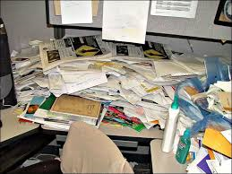
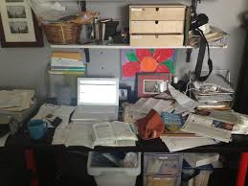
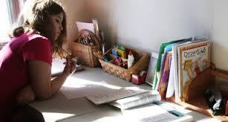
Organized or not?
Notes:
Read slide with students. Click to bring up each picture and discuss what the students see. What makes an organized homework space?

Slide 8
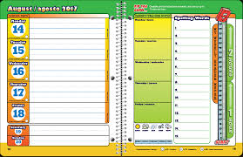
Organize your time
use a planner!
mark test dates and when you’ll study for them
mark dates for sports practice, music or karate lessons –you get the idea
write down your homework every day
check your planner every day!
Notes:
Read slide with students. Ask if/how they use a planner to stay organized. What else do they do to keep on track with homework?

Slide 9
2. Stay Focused
Being focused means keeping your attention on your work
Get rid of distractions
- keep the TV and music off
- remind yourself that it’s time to focus on homework
- give yourself free time when your homework is done
Notes:
Read slide with students. Ask if they ever feel distracted when trying to do their homework. What distracts them?

Slide 10
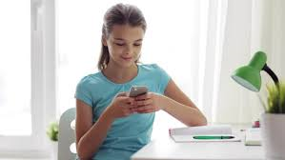
Focused or not?
Notes:
Read slide with students. Click to bring up each picture and discuss. What could happen if you’re distracted while doing your homework?

Slide 11
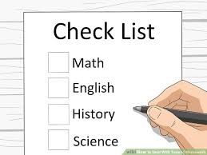
Get started
make a quick list of what you’ll work on
talk yourself through each item on the list
focus on each task as you work through your list
Notes:
Read slide with students. Ask if they every make a “to do” list. Share your experiences of the benefits of a “to do” list.

Slide 12
Take short breaks
get up and move around if your attention starts to wander
stand up or have a good stretch
moving around keeps your brain alert and helps you focus
Notes:
Read slide with students. Explain that it’s okay to take a short break when they feel like they’re losing focus. What kind of things to they like to do on a short break? How does that help them?

Slide 13
Refocus
after a break, get back to work
go to the next task on your list and work through it
check off the things you’ve already done
stay focused so that you can finish your list
Notes:
Read slide with students. Talk about the importance of getting right back to work after they’ve taken a break.

Slide 14
3. Get It Done!
You’re almost there! It’s time to check your work and finish up:
make sure it’s neat
check for mistakes and fix them
make sure your name is on it
Notes:
Read slide with students. Tell them this is the last step – they’re almost done!

Slide 15
Be proud of yourself
it’s okay to tell yourself that you did a good job
it feels good to know that you did your best!
Notes:
Read slide with students. Explain that it’s good to be proud of a job well done.

Slide 16
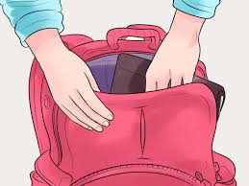
Now put it where it belongs
put your homework in the right folder
put your folder in your backpack
put your backpack in your “go spot”!
Notes:
Read slide with students. Emphasize the importance of this last step: make sure your homework is where it needs to be to make it to school with you the next day!

Slide 17
Now you’re done!

Slide 18
I Can Handle Homework
Get Organized
Stay Focused
Get It Done!
Notes:
Read slide with students and review each tip.

Slide 19
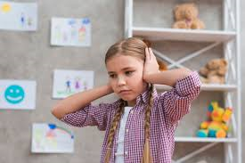
So…what do YOU think?
It’s pretty noisy at home when you’re trying to do your homework. Your brother wants to watch TV and your sister is practicing her flute.
What can you do?
Notes:
Read slide with students. Brainstorm strategies to handle the situation: find a quieter place to work; ask your brother to turn down the volume on the TV; ask your sister to practice her flute in her room; etc.

