Slide 1

I Can Accept Consequences
adapted from www.boystowntraining.org
Notes:
Read slide with students. Ask for their definitions of “consequence”. Explain that today’s lesson is about learning how to accept consequences for our actions.

Slide 2
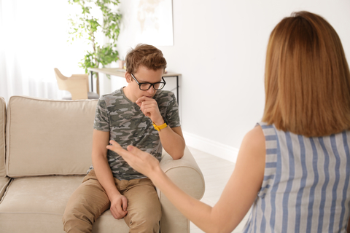
What is a consequence?
a consequence is the result of an action or situation
it could be something that happens after you make a mistake
maybe you say or do something that you shouldn’t
Notes:
Read slide with students. Review the bullet points and talk about what might be happening in the picture.

Slide 3
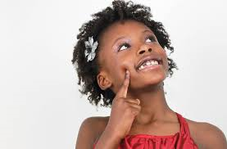
Everyone makes mistakes…
we can learn from the mistakes we make
what mistakes have YOU made?
Hmmmmm…
Notes:
Read slide with students. Emphasize that we all make mistakes but that we can learn from them so that they don’t happen again. Ask students for examples of mistakes they have made. Share a mistake or two of your own.

Slide 4
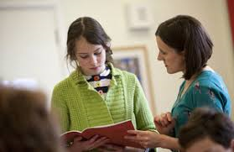
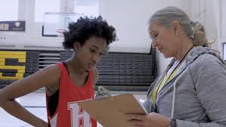
Sometimes when we make mistakes, there are consequences
What are some possible consequences when you make a mistake at school?
Tonya, you missed practice twice this week.
Sarah, you didn’t finish this assignment.
Notes:
Read slide with students. Talk about how sometimes mistakes may lead to consequences. Click to animate captions. Ask students if these situations have ever happened to them. What were the consequences?

Slide 5
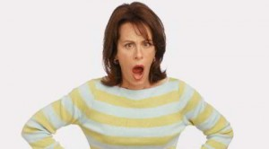
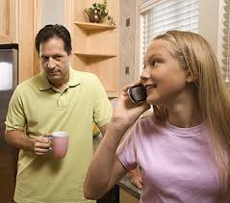
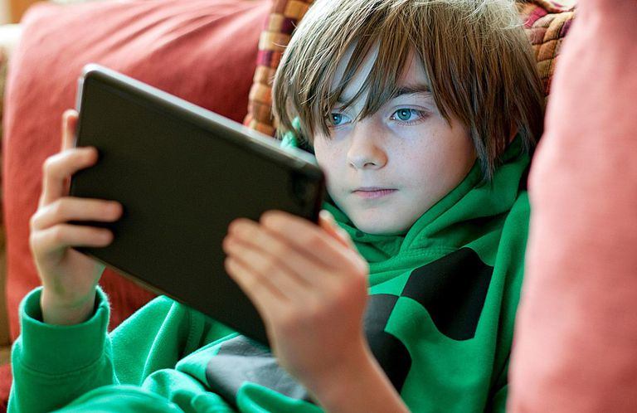
What are some possible consequences when you make a mistake at home?
Michael, did you forget to put the dishes away?
Is your homework done yet?
Notes:
Read slide with students. Click to animate captions. Ask students if these situations have ever happened to them. What were the consequences?

Slide 6
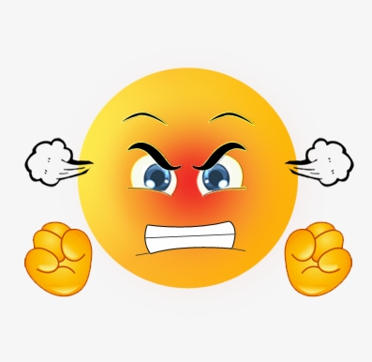
What might happen if you argue?
it could make the person angrier
it could make the consequence worse
Notes:
Read slide with students. Click to animate picture. Ask students if they’ve ever argued and made the situation worse. What happened as a result?

Slide 7
Let’s learn how to
accept consequences
and take responsibility for our actions!
Notes:
Read slide with students. Talk about how we can learn to accept consequences so that we take responsibility for our actions.

Slide 8
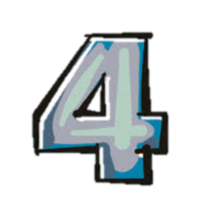
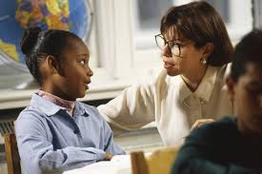
Steps to Accepting a Consequence
Look at the person
Say “okay”
Stay calm
Don’t argue
Okay
Notes:
Read slide with students. Discuss the importance of each step – what might happen if we don’t do these things?

Slide 9
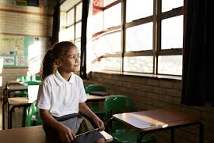
So…what do YOU think?
Your friend was cracking jokes in class and got in trouble for it. The teacher is making her stay in for recess and she’s really upset.
What can you do?
Notes:
Read slide with students. Remind them of the 4 steps they’ve learned and encourage them to think about how they might help their friend using these steps.

