Slide 1

I Can Turn a
Bad Day Into a
Better One!
adapted from www.wikihow.com
Notes:
Read slide with students. Ask students if they’ve ever had a bad day. What happened? Were they able to turn it around into a better day? Explain that today’s lesson will give them some strategies to help turn bad days into better ones.

Slide 2

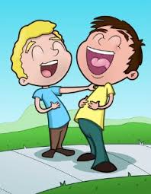
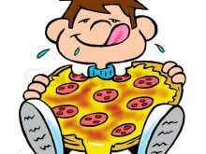
Every day is different…
Some days are GREAT!
You aced a tough test
You tell a joke and everyone laughs
It’s pizza day in the cafeteria!
Notes:
Read slide with students. Click to bring up each picture. Ask students how they felt if/when these things happened to them. Ask for additional things that can make it a great day

Slide 3



Some days are just okay…
you passed a tough test
you almost made a basket in gym
you got a cookie in your lunch bag…
one cookie
Notes:
Read slide with students. Click to bring up each picture. Talk about how it felt if/when these things happened. Ask students if there are other things that make it an okay day.

Slide 4

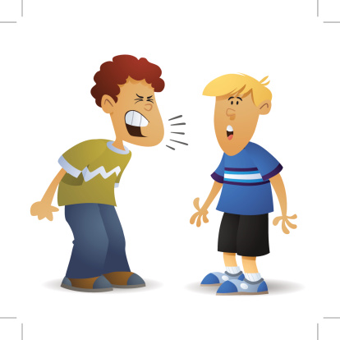
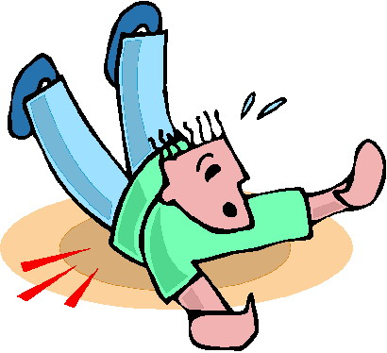
And some days are pretty bad…
that test was REALLY tough
you had a fight with your best friend
you wiped out in front of everyone in the cafeteria
Notes:
Read slide with students. Click to bring up each picture. Ask students how they felt if/when this happened to them. What did they do?

Slide 5

Everyone has bad days
The Good News:
We can turn a bad day
into a
better one!
Notes:
Read slide with students. Emphasize the good news: we can turn a bad day into a better one! Ask students for their ideas on how to turn the day around.

Slide 6
4 ways to turn a bad day into a better one
talk to someone
spend time doing something you like
focus on the positive!
remember that today will pass
Notes:
Read slide with students. Explain that they will learn 4 strategies that can help them turn a bad day into a better one.

Slide 7
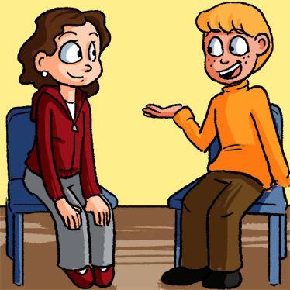
1. Talk to someone
I got a bad grade on a test, fought with my friend, and then I wiped out in the cafeteria – awful day!
Sometimes just talking it out with someone can make you feel better about things. It can help you realize you’re not alone.
Yuck- That IS awful! I made my best friend mad last week. So here’s what I did to fix it…
Notes:
Read slide with students. Explain that sometimes talking with someone helps you get it out so you don’t dwell on it. And talking with someone can help you realize that others have bad days too. You might even be able to get ideas from others about how to handle bad days when they happen.

Slide 8

2. Spend time doing something you like
Doing what you like can take your mind off of the bad parts of your day
Notes:
Read slide with students. Talk about how doing something you like can give you a different perspective on things because you’re in a better state off mind. Ask students for ideas of things they might do to get them into a better frame of mind so that they can put their day into perspective.

Slide 9

3. Focus on the positives!
Well…today wasn’t really ALL bad. I did get a B on my book report. And I had a good soccer practice after school.
Notes:
Read slide with students. Talk about how easy it is to get dragged down by a few bad things that happen in a day. That makes it hard to remember all of the good things! We have to try to focus on those good things and not let the bad stuff outweigh them.

Slide 10
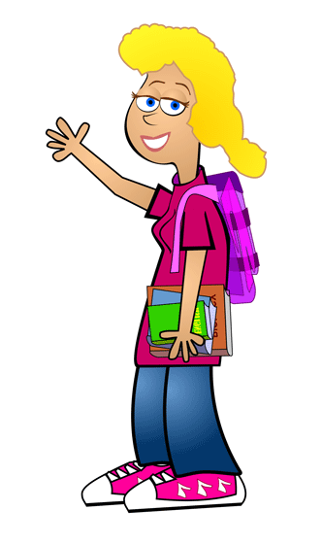
4. Remember that today will pass
Bye-bye today!!
A bad day is just a bad day. It doesn’t mean the end of the world. Tomorrow is a new day – it could be a better one!
Today’s problems will be in the past.
Notes:
Read slide with students. Talk about how a bad day is just that. It will be over, and then we can start a brand new day tomorrow and today’s problems will be in the past!

Slide 11

Turn a bad day into a better one
Talk to someone
Spend time doing something you like
Focus on the positives!
Remember that today will pass

Slide 12
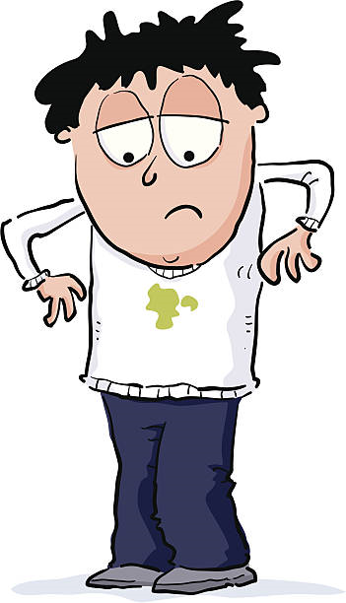
So…what do YOU think?
Your friend complains that he had the “WORST DAY EVER”!
He forgot his homework, spilled juice on his white shirt, and then didn’t make the football team.
What can you do to help him?

